Slide 1
Artificial intelligence and healthcare- what the doctor needs to know
By
Dimie Ogoina
Professor/Consultant Physician
Niger Delta University/Niger Delta University Teaching Hospital

Slide 2
Outline of presentation
Definitions
Historical background
Components of AI
Applications of AI in healthcare
Challenges and potential threats of AI
Recommendations
Conclusion

Slide 3
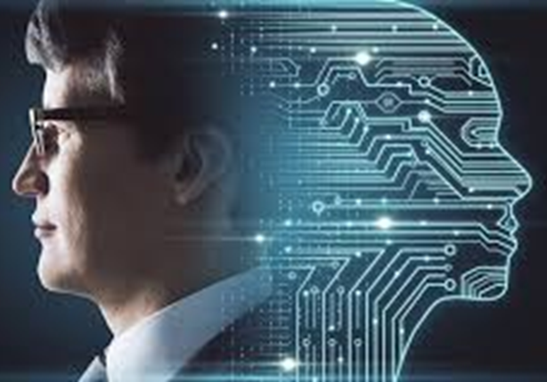
What is artificial intelligence (AI)?
“Artificial intelligence” generally refers to the performance by computer programs of tasks that are commonly associated with intelligent beings
AI is defined as the automation of activities associated with human thinking such as decision-making, problem-solving, and learning
AI is the ability of computer algorithms to approximate conclusions based solely on input data
An AI system is a machine-based system that can, for a given set of human-defined objectives, make predictions, recommendations, or decisions influencing real or virtual environments. (OECD)
Source:https://corporatefinanceinstitute.com/resources/data-science/artificial-intelligence-ai/
https://oecd.ai/en/ai-principles
OECD-Organisation for Economic Co-operation and Development

Slide 4
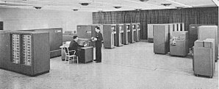
Historical background (1)
Began in antiquity, with myths, stories and rumors of artificial beings
Birth of artificial intelligence (1952–1956)
  The field of artificial intelligence research was founded as an academic discipline in 1956
The historical timelines
  The optimism (1956-1970)
  First AI winter (1974–1980)-Limited computer power and lack of data
The IBM 702 a computer used in mid-50s
1958, H. A. Simon and Allen Newell: "within ten years a digital computer will be the world's chess champion" and "within ten years a digital computer will discover and prove an important new mathematical theorem.
https://en.wikipedia.org/wiki/History_of_artificial_intelligence#:~:text=In%20the%201940s%20and%2050s,an%20academic%20discipline%20in%201956.

Slide 5
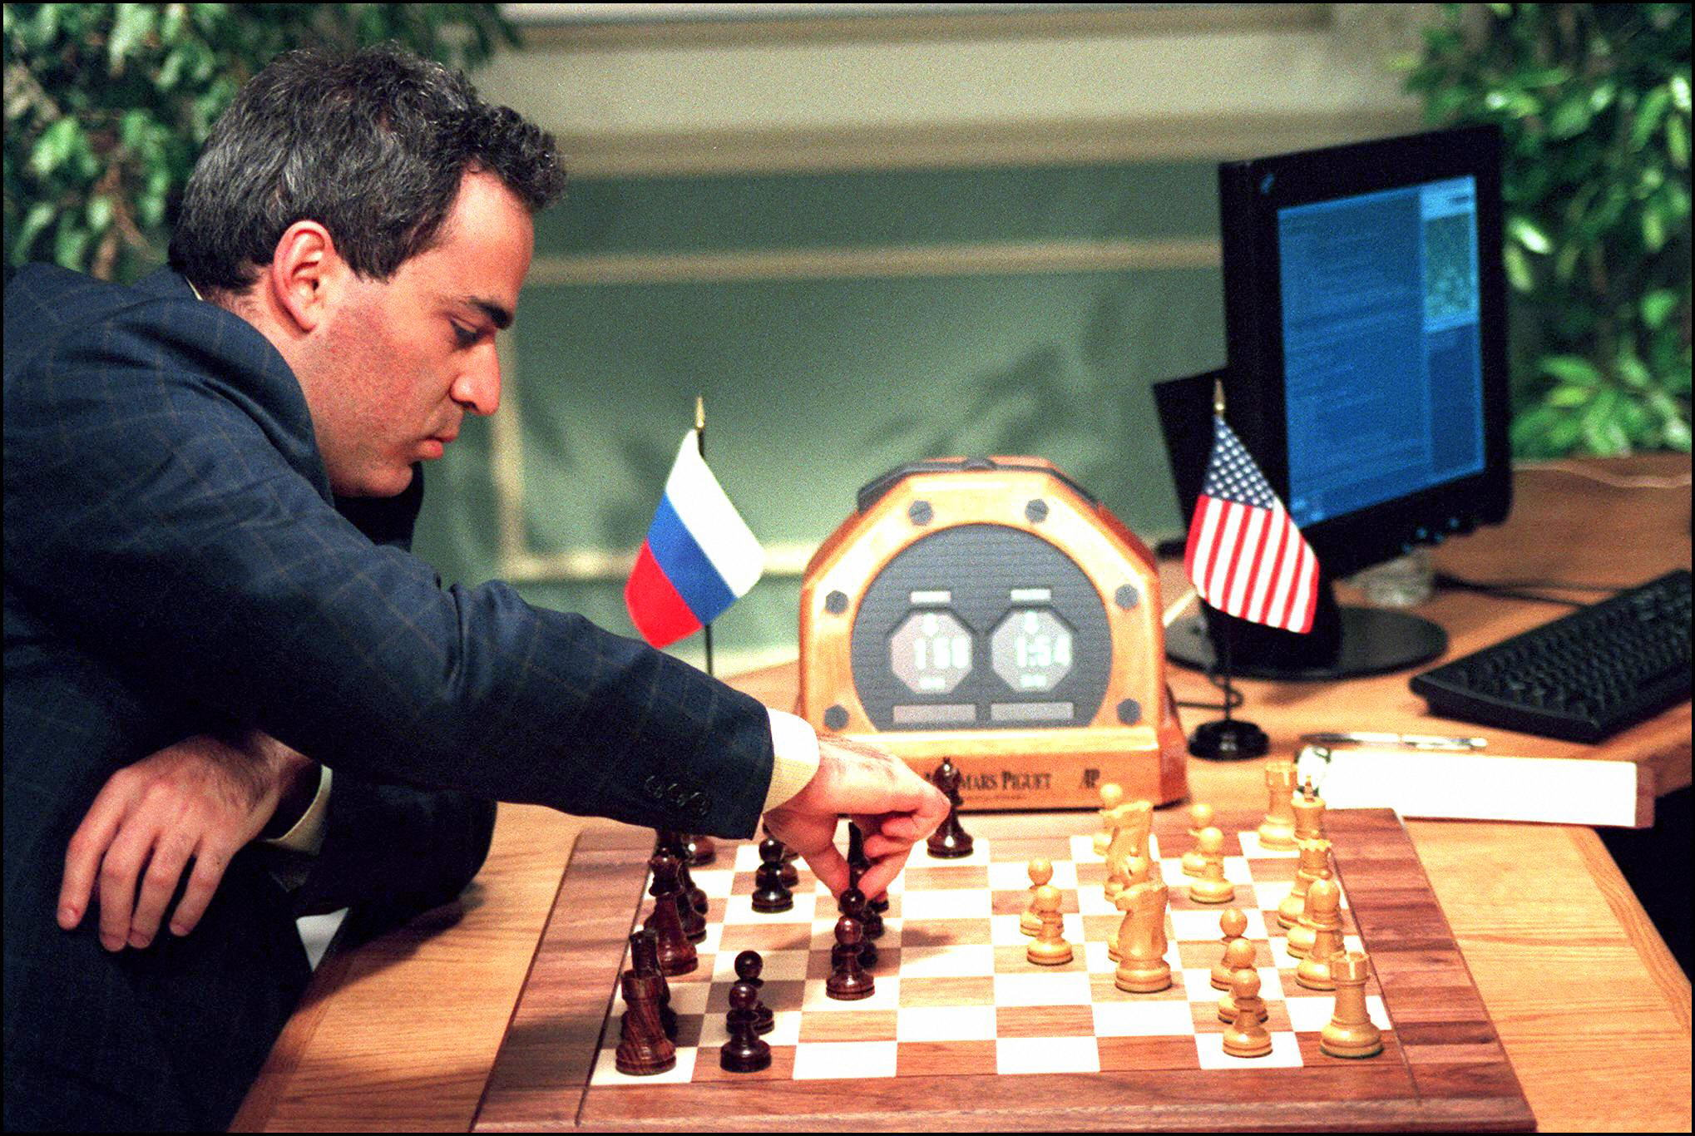
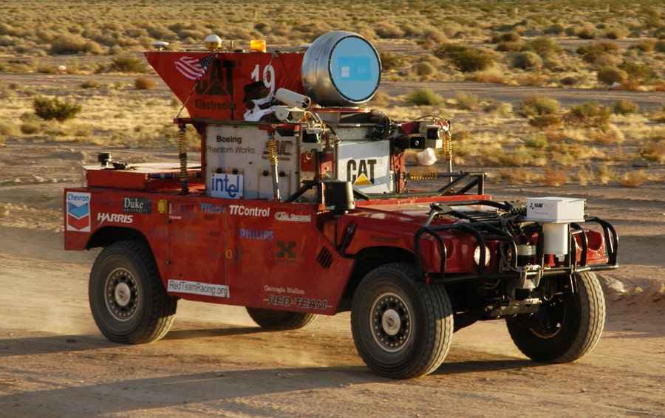
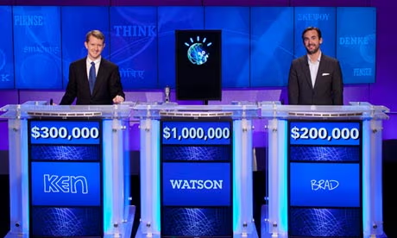
Historical background (2)
The historical timelines
  Boom (1980–1987)-
    Rise of expert systems
  Bust: second AI winter (1987–1993)-
    Failure of workable solutions
  AI (1993–2011)- the reawakening-
    Increasing computer power and task-focused systems
  2011-present-deep learning & ML era, large language models
    Models such as GPT-3 released by OpenAI in 2020, and Gato released by DeepMind in 2022
Deep Blue defeat chess world champion 1997
Self driving cars (2005)
IBM Watson wins quiz game (2011)

Slide 6
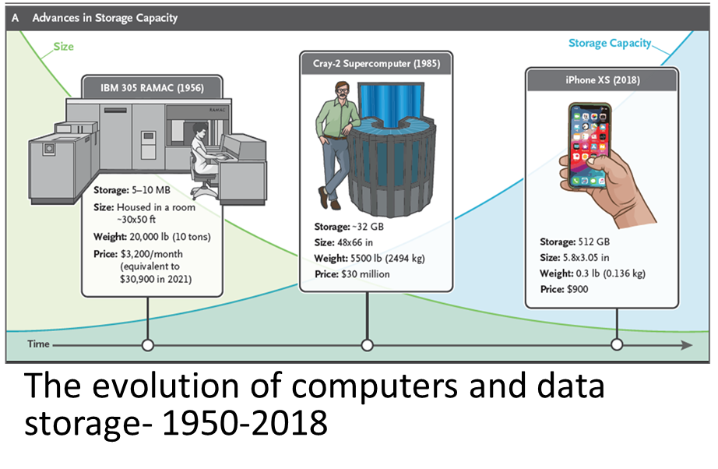
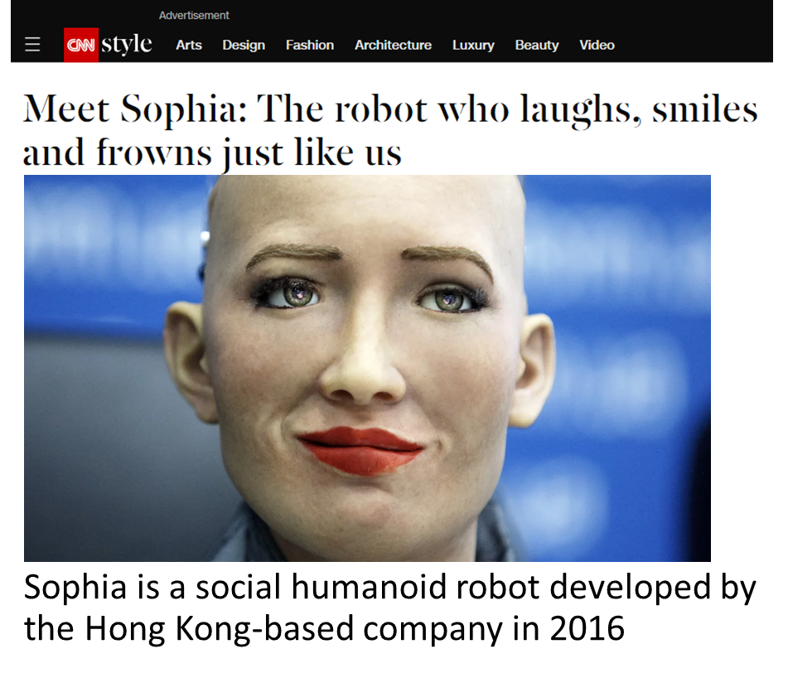
Historical background (3)
Source: N Engl J Med 2023;388:1201-8.

Slide 7




Components of AI
Input data
Algorithms
Model creation
External output
Big data
Machine learning
Deep learning
Neural networks
Natural language processing
Learning methods
Supervised
Unsupervised
Reinforcement
Outputs
Classification
Prediction
Prescribe

Slide 8
Artificial intelligence process
Algorithms: Machine learning, deep neural networks, or hybrid
Text, numbers, images, video, or audio.
Noise removal
Trained to identify patterns, classify and predict
Data collection
Data preprocessing
Model selection
Training the model
Testing and evaluation
Model optimization
Deployment
Continuous learning
Validate for accuracy
Fine tunning, regularization model parameters and algorithms
Integrating model into new or existing systems
Reinforcement learning
https://www.upwork.com/resources/how-does-ai-work

Slide 9
Sources/Types of data for AI
Historical/Archived data
  Internet-based data
  Research and public generated data
  Expert data
  Textbooks and other literary repositories
  Videos, audios, images
Real time data
  Data from senses- touch, see, ear, smell and taste
  Speech, text, video, image
  Biological data from human body-e.g., human genome data
  Data from the physical environment- e.g., temperature, location, air quality etc.

Slide 10
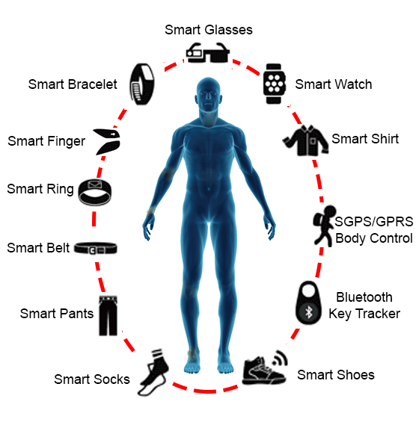
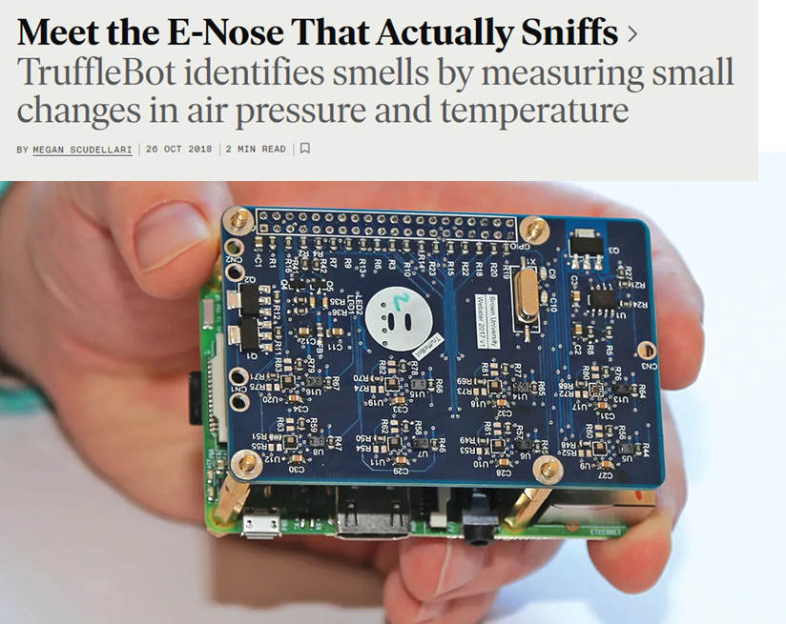
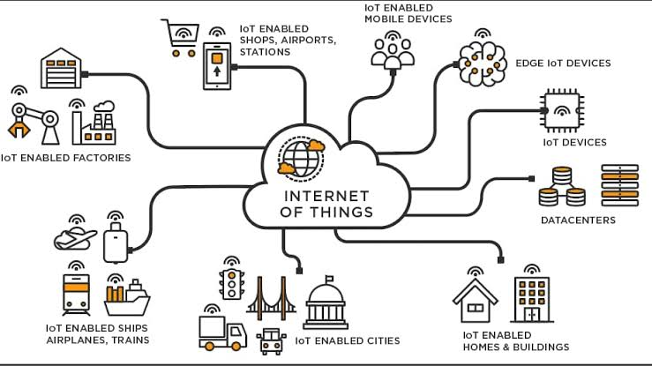
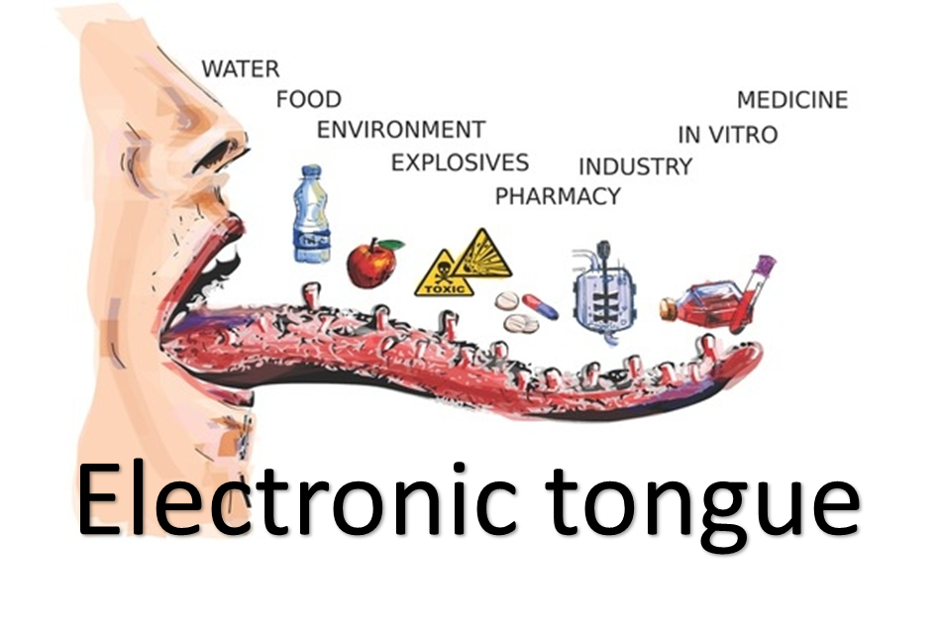
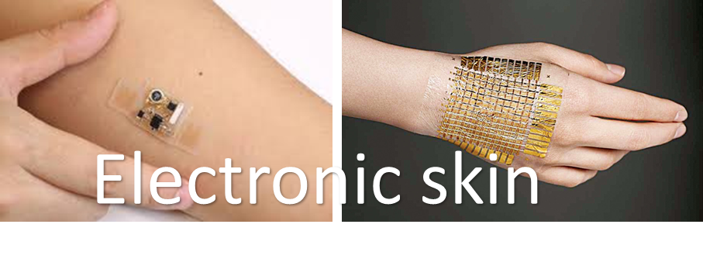
Data sources
Internet of things
The interconnection via the internet of computing devices embedded in everyday objects, enabling them to send and receive data.

Slide 11
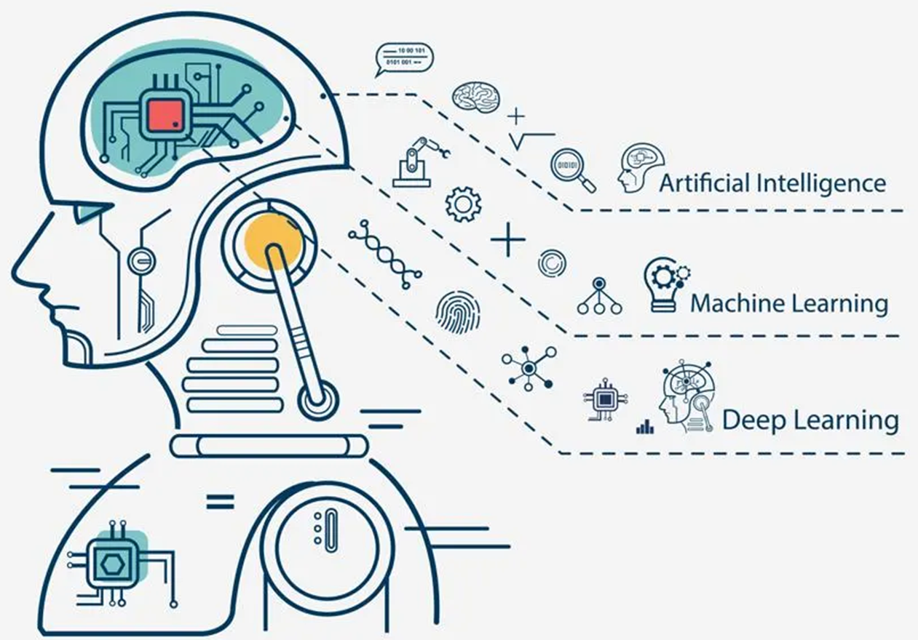
Robots and AI
A robot is a machine—especially one programmable by a computer—capable of carrying out a complex series of actions automatically
AI gives robots the ‘sixth sense’-
  Autonomous thinking
  Ability to learn and make decisions
  Perceive the environment
  Mobility
  Determine the emotions of people
  Engage in human-like conversations
Intelligent robots

Slide 12
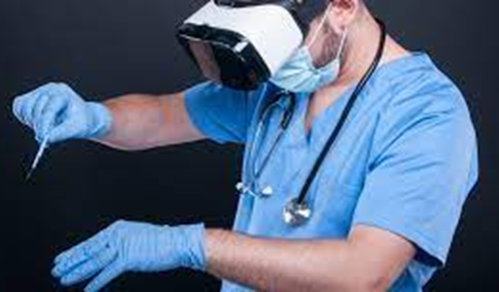
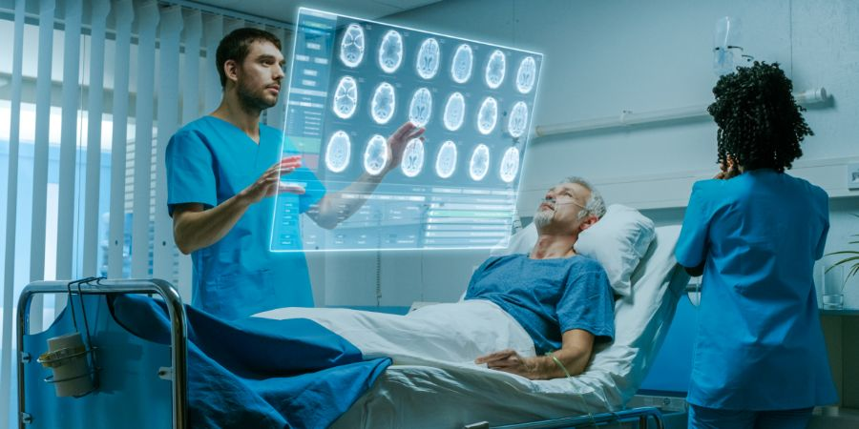
AI, augmented reality and virtual reality
Virtual reality is the use of computer technology to create simulated environments
Augmented reality is an interactive experience in which a real-world environment is enhanced with computer-generated visual elements, sounds, and other stimuli
AI, has the ability to create realistic and interactive virtual environments that can transport users to entirely new worlds
Virtual reality
Augmented reality

Slide 13
Applications of AI in healthcare
1
2
3
4
Disease prevention
Disease diagnosis
Disease treatment and monitoring
Care delivery support
5
6
7
8
Healthcare administration
Patient engagement
Research and development
Medical education

Slide 14

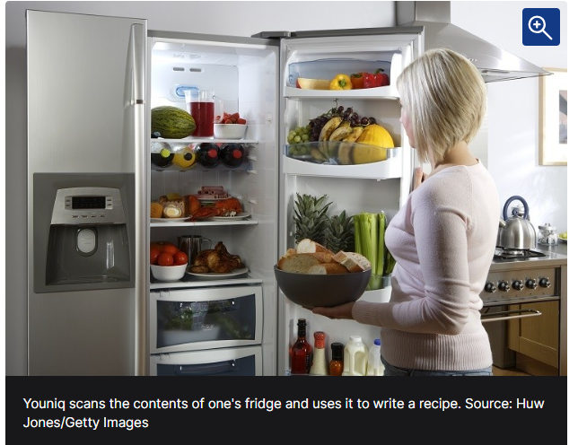
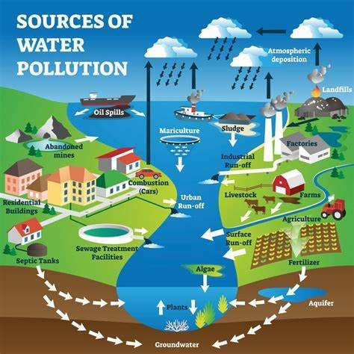

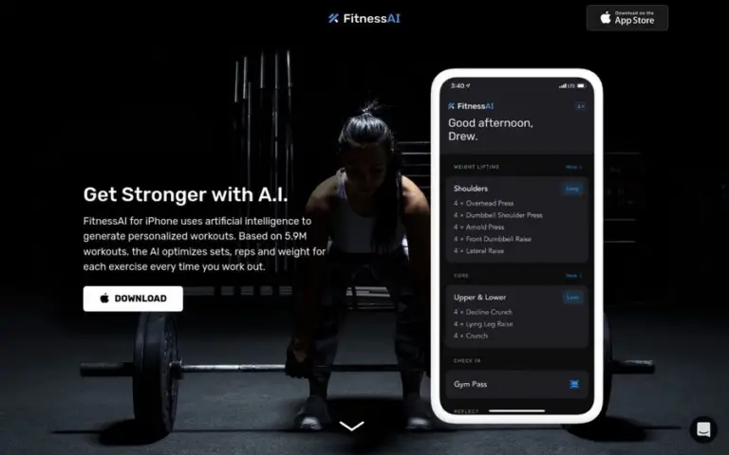
Disease prevention
Health and environmental risk identification
Fitness and wellness
Nutrition
Sister Agnes- ANC AI app
Youniq nutrition app app
Ada – check your health
Using AI to assess risk of water pollution
FitnessAI

Slide 15
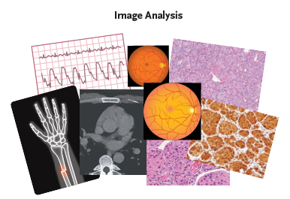
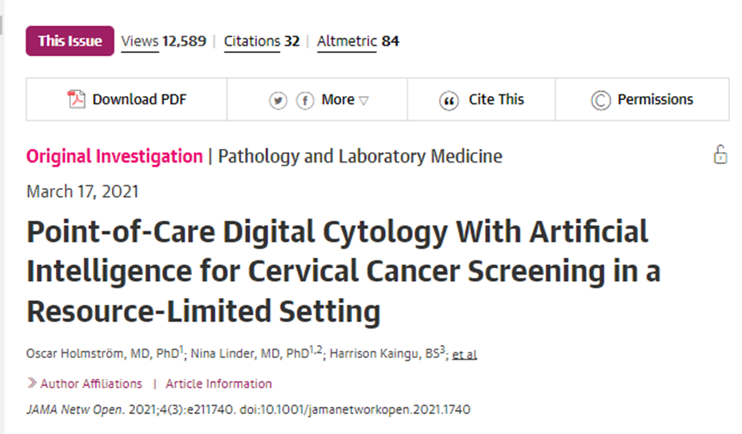
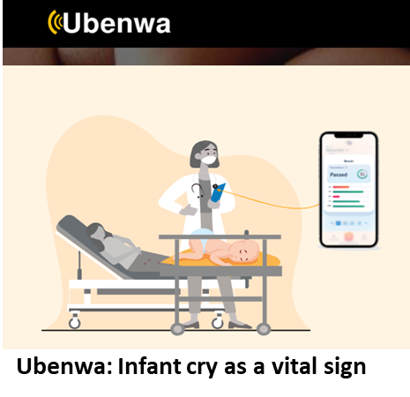
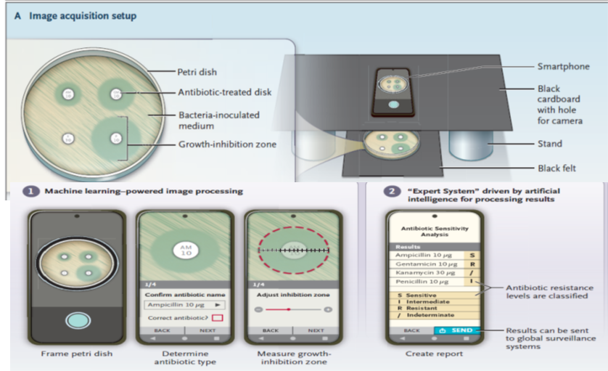
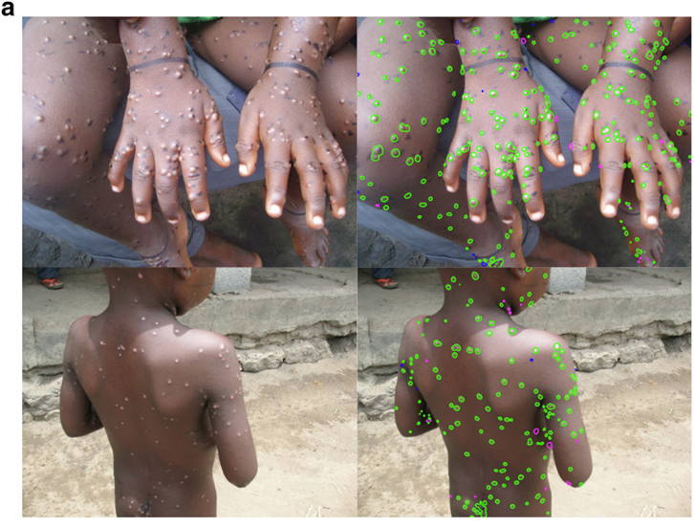
Disease diagnosis
Early detection and diagnosis
Automated image analysis
Diseases
  Tuberculosis, COVID-19, cancers, diabetic retinopathy, AMR, skin disease cardiac diseases
Antibiotic Susceptibility with AI.
Mpox AI lesion predictions on photos
The Journal of Investigative Dermatology. 2023 Feb;143(2):347-350
J Ambient Intell Humaniz Comput. 2023;14(7):8459-8486.

Slide 16
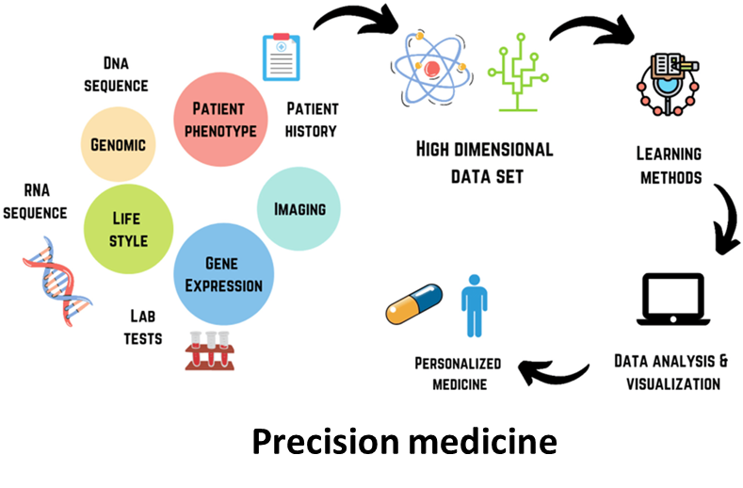

Disease treatment and monitoring
Precision medicine
Treatment design
Prognosis
Health monitoring
Patient adherence
Robot-assisted surgery
Robot assisted therapy

Slide 17
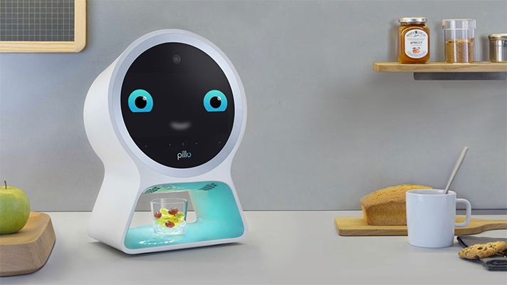
Patient adherence using AI robots
Pillo is an automated medication dispenser that can deliver personalized support
The device uses voice commands and an AI to engage patients and remind them of their treatment plans
Pillo can deliver audio- or video-based health content and connect patients and their caregivers
Pillo-automated medication dispenser

Slide 18
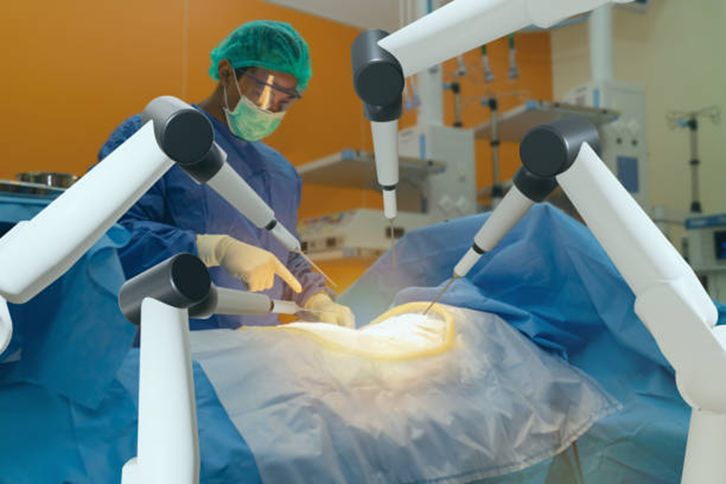
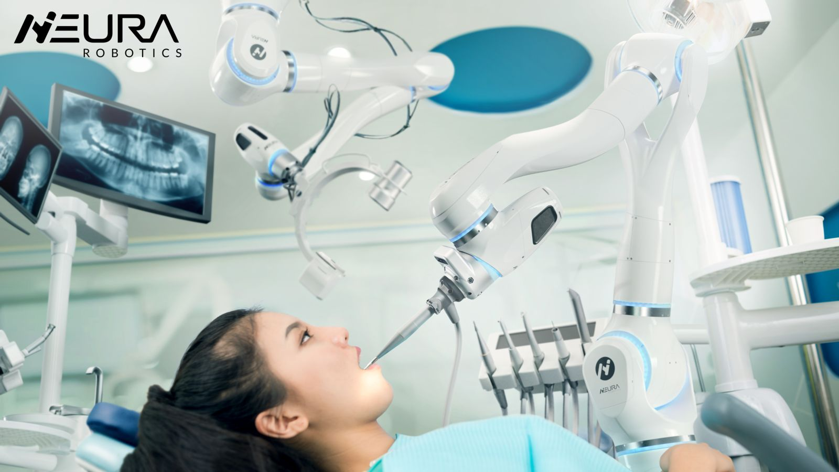
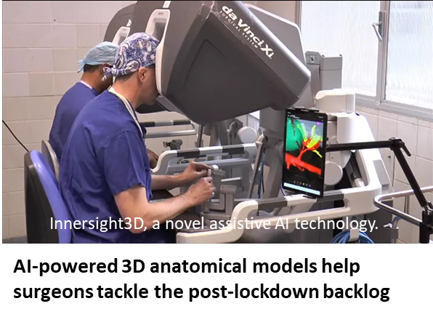

AI, robotics and the surgeon
Surgical assistance
  a robotic “hand” can access hard-to-reach areas while minimizing risk
  make surgery more accurate and less risky
Remote surgery
Operative analysis
Surgical planning
Robots in dentistry
Robots as surgical assistance

Slide 19
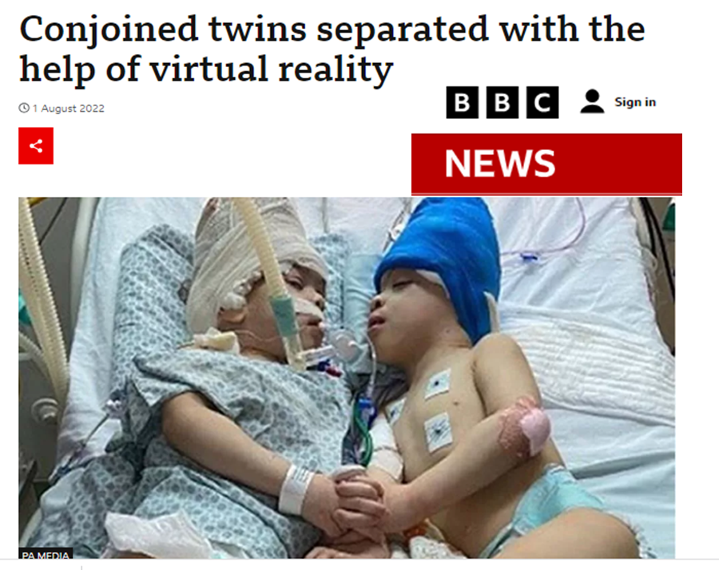
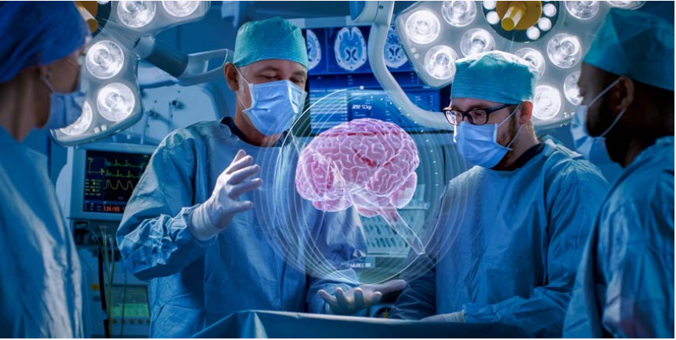
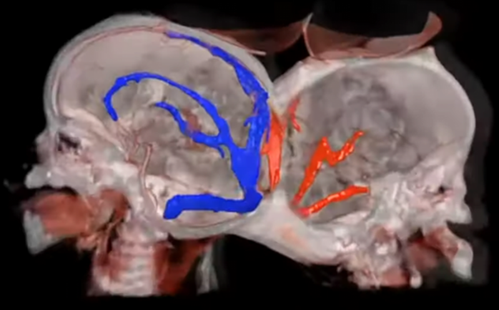
Surgical planning using virtual reality+AI
Brazilian twins who were joined at the head have been successfully separated with the help of virtual reality.(2022)

Slide 20
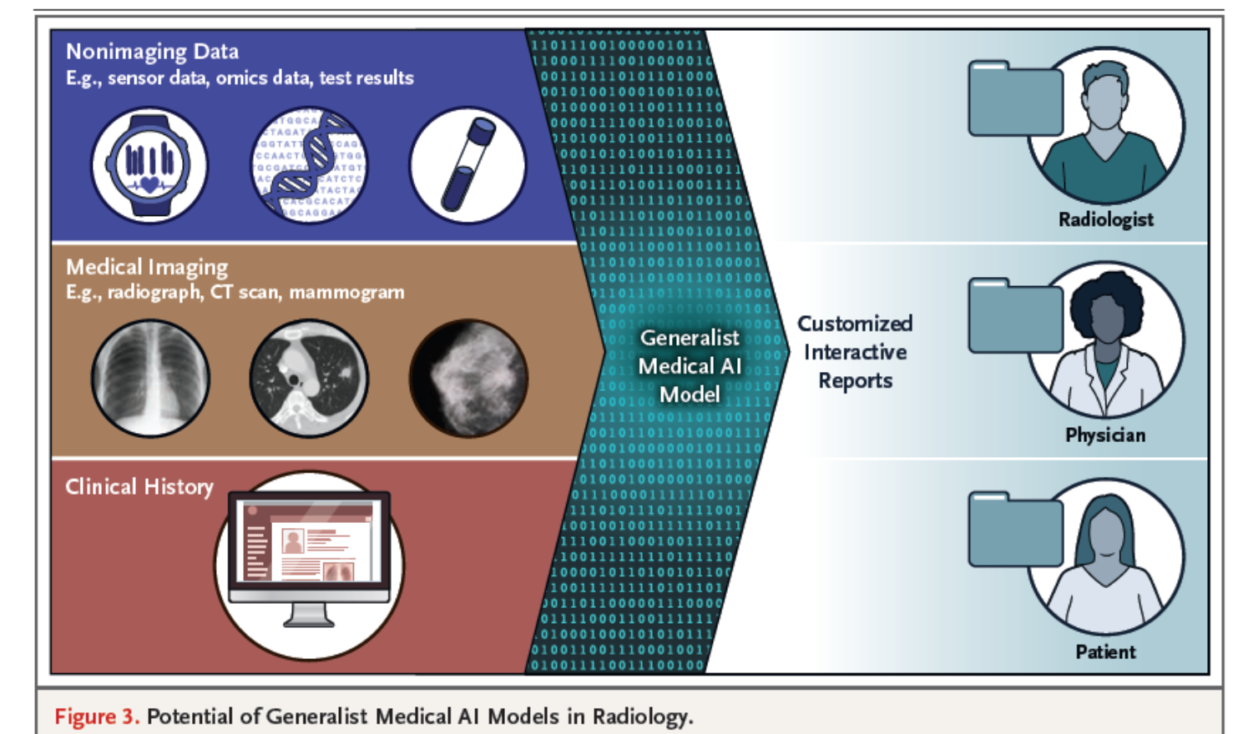

Care delivery support
Clinical workflows
  Writing of patient notes
Virtual nurses
Care coordination
Dosage error reduction
  Writing of patient notes

Slide 21
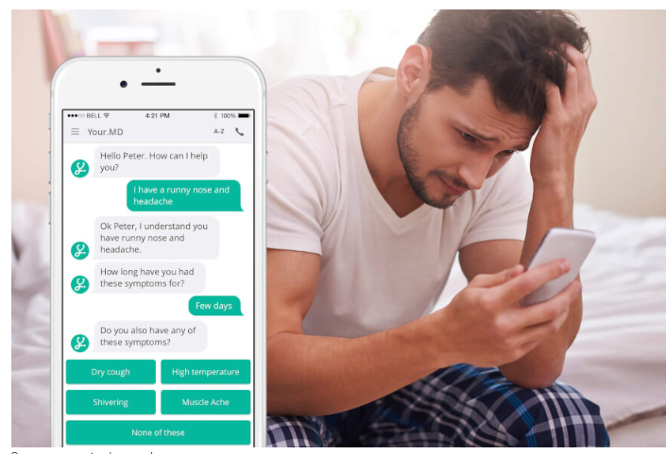

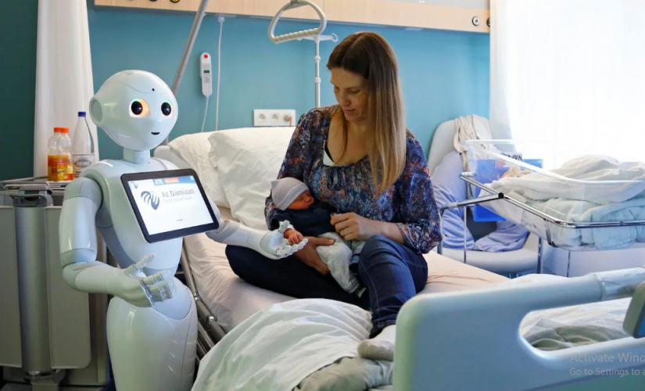
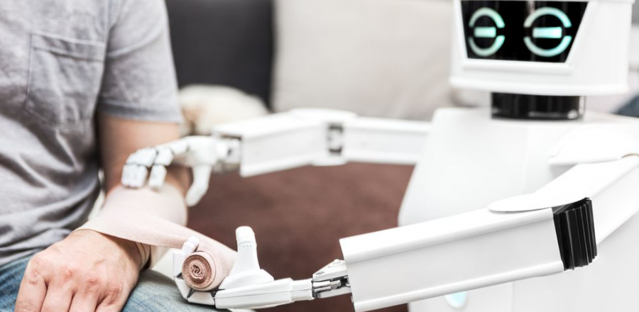
Virtual health assistants
https://pharmaphorum.com/news/sensely-mayo-clinic-develop-virtual-doctor

Slide 22


AI and electronic health records- Smart EHR
Telemedicine
Voice commands
Ability to create reports
Patient access
Connected to Internet of Things
Automatic disease ICD coding
Differential diagnosis

Slide 23
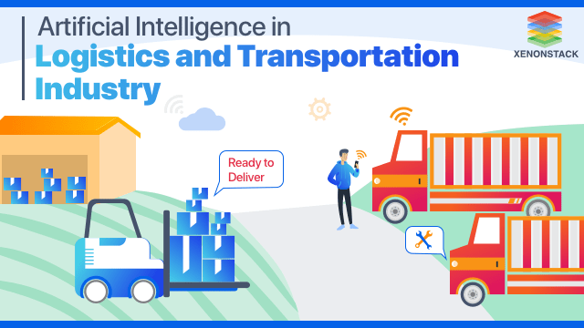
Healthcare administration
Customer acquisition and relationship management
Clinical insights and risk analysis
Healthcare system analysis
Health benefits administration
Data infrastructure and interoperability
Patient data management
Cybersecurity and fraud detection
Quality management and reporting
Billing and payment

Slide 24
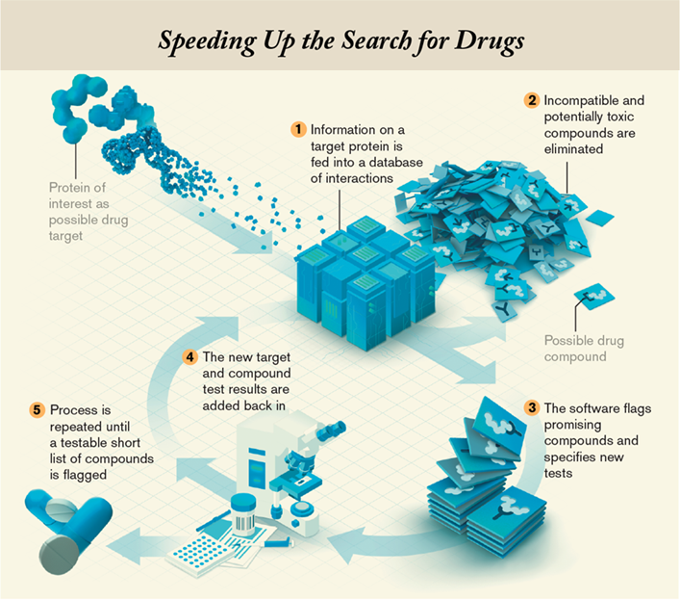
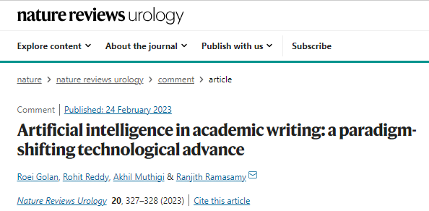
Research and development
Research reading, writing and referencing
Clinical trials
Drug development
Genetic research
Device development

Slide 25
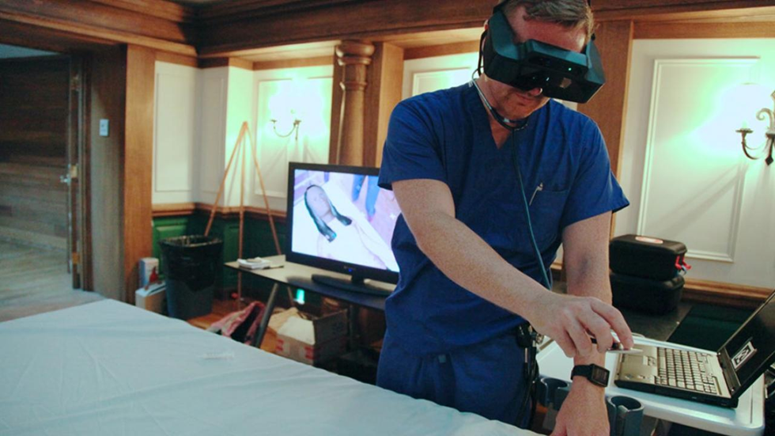

Medical education
Used in curriculum development and analysis, learning, and assessment
Areas
  AI tutor
  AI examiner
  AI-based simulations
  Virtual patients
  Robotic patients

Slide 26



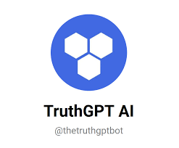
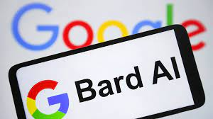
Chatbot and healthcare
A chatbot is a computer program used to simulate conversations with human users.
Applications
  Health education
  Medical education
  Research
  Patient care
  Clinical diagnosis

Slide 27
Key challenges and risks of Artificial Intelligence
Quality representative data
Lack of Transparency
Bias and Discrimination
Privacy Concerns
Ethical Dilemmas
Security Risks
Concentration of Power
Dependence on AI
Job Displacement
Economic Inequality
Legal and Regulatory Challenges
AI Arms Race
Loss of Human Connection
Misinformation and Manipulation
Unintended Consequences
Existential Risks

Slide 28




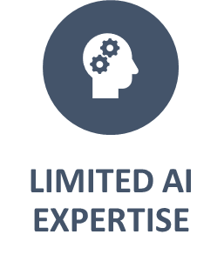



AI implementation challenges in resource-constrained settings

Slide 29
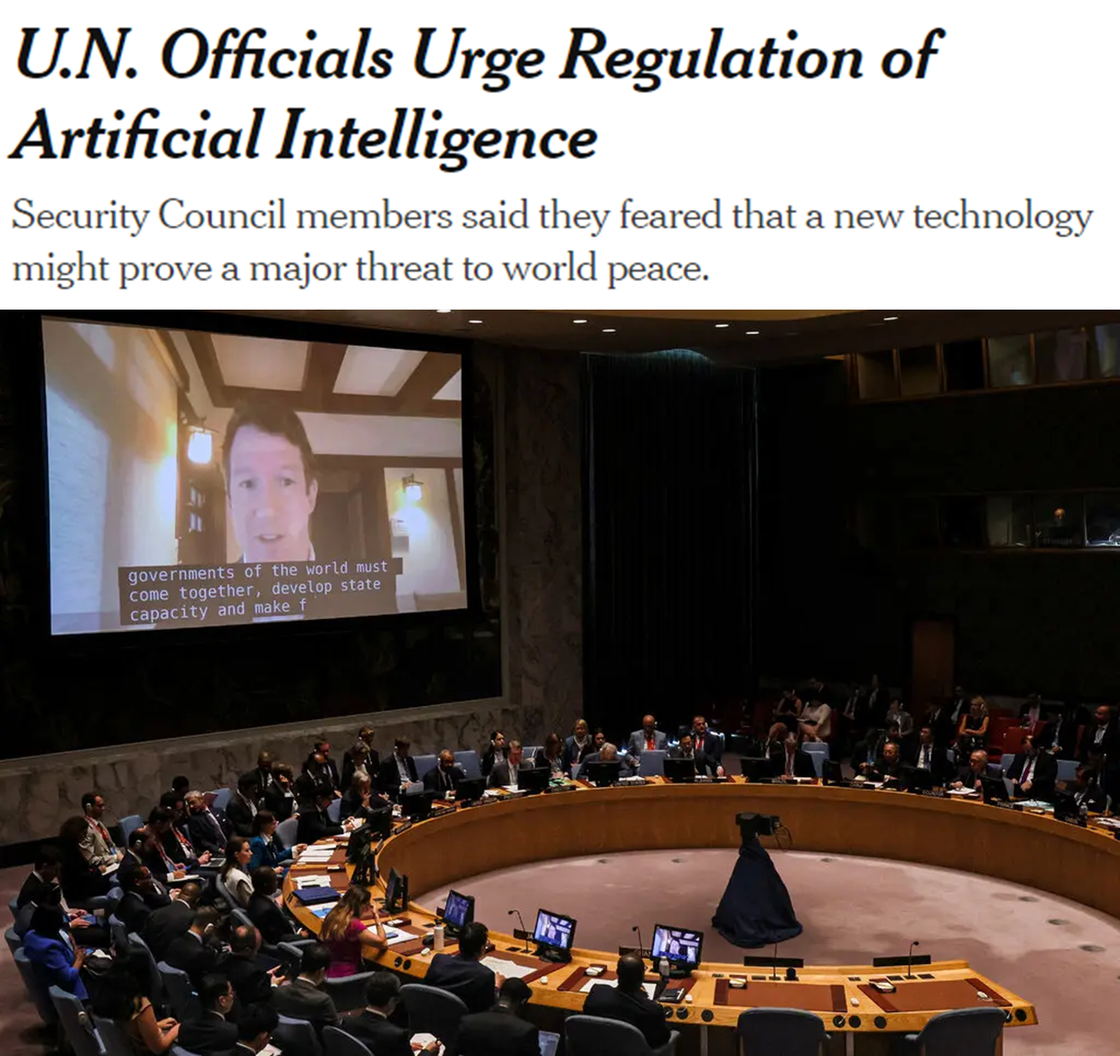
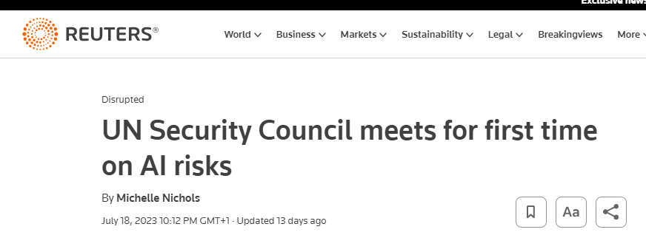
AI and global peace and security
Artificial Intelligence: Opportunities and Risks for International Peace and Security - Security Council, 9381st Meeting-18 Jul 2023

Slide 30
Ensuring AI works for the public interest in all countries (WHO’s recommendation)
The six guiding principles for use of AI
  Protect human autonomy
  Promote human well-being and safety and the public interest
  Ensure transparency, explainability and intelligibility
  Foster responsibility and accountability
  Ensure inclusiveness and equity
  Promote AI that is responsive and sustainable
https://www.who.int/publications/i/item/9789240029200

Slide 31
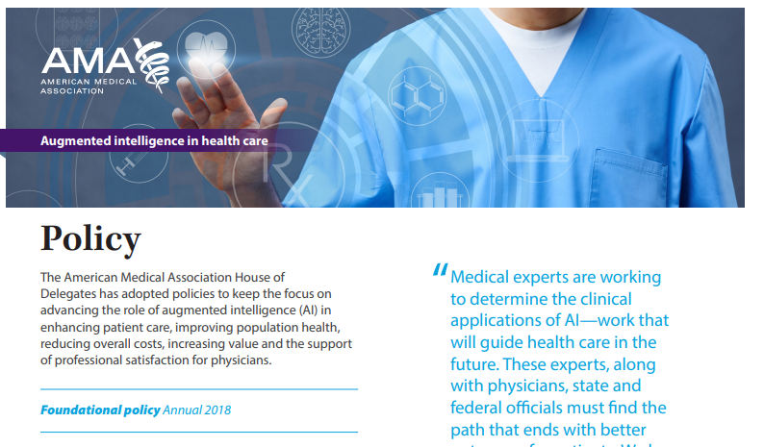
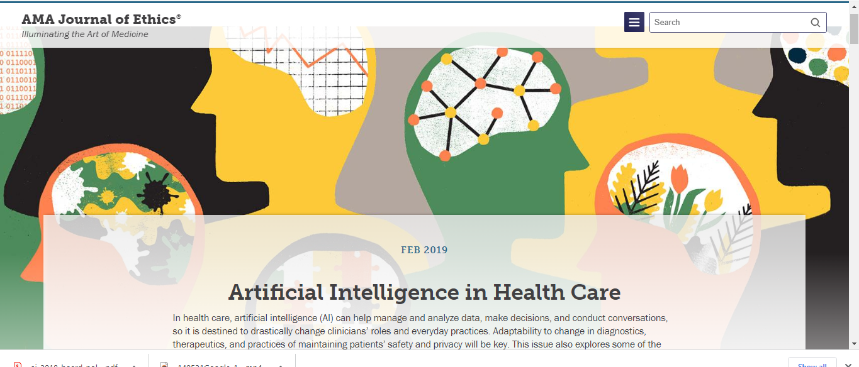

Adoption of AI by medical professionals

Slide 32



Implementing AI in the health sector in Nigeria- Way forward
Policy and legislation
Improve knowledge and awareness among practitioners
Improve knowledge and awareness among patients and populations
Digital education among practitioners
Investments and funding

Slide 33
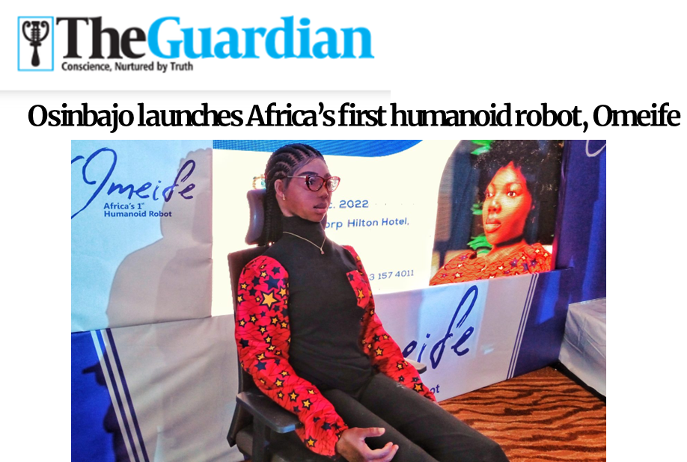
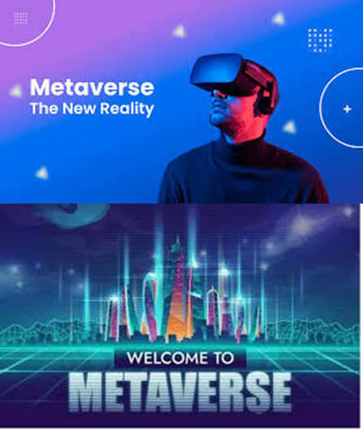
The future
Nigeria’s first human-like robot Dec 2022

Slide 34
Thank you for listening

