Slide 2
INTODUCTION
HISTORIC PASPECTIVE AND REGULATORY LAWS:
The first attempt at establishing an Agency for demand side financing was in 2002
The Bayelsa Health Insurance Scheme was first established as Bayelsa State Health Services Scheme, based on the Bayelsa State Health Services Scheme Law, 2013, Laws of Bayelsa State
This was repealed and re-enacted as Bayelsa Health Insurance Scheme Law, 2019, Laws of Bayelsa State, which makes Health Insurance mandatory to every resident of Bayelsa State, where every other Private health Insurance policy outside the National Health Insurance Scheme and the Bayelsa Health Insurance Scheme is supplementary Health Insurance Policy.

Slide 3
INTRODUCTION CONT.
BAYELSA HEALTH INSURANCE SCHEME IS;
A social security program designed to achieve UHC as an enabler for an inclusive social protection system
Creating access to quality and essential healthcare services, access to safe, effective, quality and affordable essential medicines and vaccines and financial risk protection for all Bayelsans
Against this background, the State Govt. established BHIS through the BHIS LAW, 2019, laws of Bayelsa State, that makes participation mandatory for every resident of the State.
BHIS is authorized to fashion out sustainable and equitable domestic health financing mechanisms and policies that will promote equitable access to and utilization of healthcare services across all income and social strata and health-risk and demographic distribution of the state.

Slide 4
INTRODUCTION CONT.
BHIS is created to be a single publicly owned and administered strategic purchaser of healthcare services in the state.
MANDATE
To ensure that all residents of Bayelsa State have access to needed healthcare services that are available, accessible, affordable, effective, efficient and of good quality.
THE AIM
Have a unified purchasing system of health services in Bayelsa State that will guarantee and offer all Bayelsans of all socio-economic classes easy access to needed medical care that is available, affordable and most importantly of good quality without driving them into financial hardship.

Slide 5
OBJECTIVES
To provide quality health care without payment at the point of access;
Provide and maintain accessible healthcare delivery system;
Provide, Promote and Maintain affordable healthcare services;
Provide and maintain functional and professionally satisfactory healthcare delivery system;
Eliminate the existence of the consequences of fake and adulterated drugs as well as out of stock syndrome in the healthcare delivery environment through a well-coordinated drug supply and distribution system;
Improve and harness private sector participation in healthcare services.

Slide 6
INTRODUCTION CONT.
VISION
To create a virile, dynamic and highly responsive healthcare financing system that is directed at making needed health services available, accessible, and affordable to all residents of Bayelsa State based on appropriateness, social solidarity, progressive universalism and equity
MISSION
BHIS mission is to make health services available to all Bayelsans of all socio-economic classes through.
Fair and equitable financing of health care cost.
Improving technical and allocative efficiency.
Strengthening governance and accountability mechanisms
Provision of regulatory oversight to all stakeholders in the value chain

Slide 7
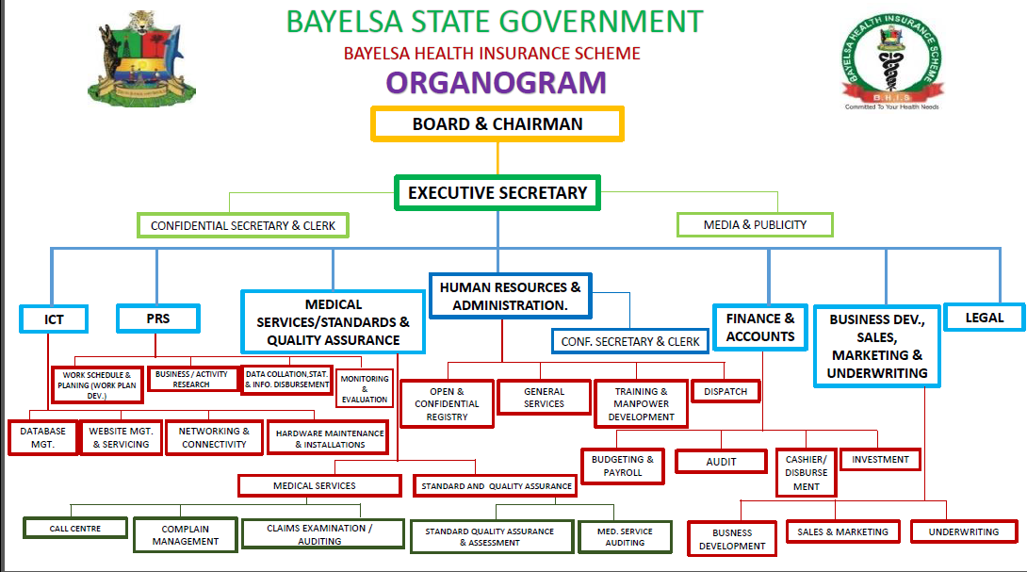

Slide 8
POLICY AND PROGRAMS
CORE VALUES
Fairness and equity
Effective, efficient and quality service delivery
Good governance and accountability
Promotion of social solidarity
Progressive universalism
POLICY AND PROGRAMME
The Scheme is planned to run in phases.
1. Formal sector Social Health Insurance Program
2. Informal/Private Sector Social Health Insurance Program
3. The Vulnerable population Social Health Insurance Program
The scheme is in its third phase through the BHCPF program

Slide 9
POLICIES AND PROGRAMS CONT
THE BASIC HEALTHCARE PROVISION FUND AND THE BASIC MINIMUM HEALTHCARE PACKAGE: BHCPF/BMPHS
This is a program initiated by the Federal Government for the vulnerable population in the country
State social health insurance Agencies and State primary healthcare development Agencies are the operators of the program through the NHIA and NPHCDA gateways respectively

Slide 10
FUNDING AND FINANCE
FUNDING
2% 0F CONSOLIDATED SALARY OF ALL PUBLIC SERVANTS (INCLUDING CIVIL SERVANTS, POLITICAL OFFICE HOLDERS, AND RETIREES OF THE STATE AND LGAs)
A FIXED AMOUNT PAID AS PREMIUM PER PARTICIPANT BY THE INFORMAL SECTOR
5% OF IGR BY THE STATE
FINANCE
AS SUMMARIZED IN THE FOLLOWING SLIDES

Slide 11
DATA AND STATISTICS
COMMENCEMENT:
ACCREDITATION OF HOSPITALS – JULY/AUGUST, 2017
NO OF HOSPITALS – 66 to now 87 (Private 49, Public 38)
PRESENT NUMBER 109, PRIMARY 79
ENROLLMENT – 15/08/2017
NO. OF ENROLLEES – 121,273, VPP – 23,346
ACCESS TO CARE – 14/09/2017
NO. OF HOSPITAL ATTENDANCE – 885,700 (secondary cases 174,709)
NO. OF SURGERIES – 6,239
TOTAL AMOUNT PAID TO HOSPITALS AS AT Dec, 2022 – 4,318,369,951.67

Slide 12
BAYELSA HEALTH INSURANCE SCHEME
SUMMARY OF 2022 OPERATIONS
S/N | MONTHS | NO. OF REG. | HOSPITAL ATTENDANCE | SECONDARY CASES | CAPITATION | FEES FOR SERVICE
1 | Jan-22 | 120,698 | 16,898 | 5,323 | 48,279,200.00 | 34,136,927.50
2 | Feb-22 | 120,917 | 16,651 | 3,373 | 48,366,800.00 | 38,294,546.50
3 | Mar-22 | 120,957 | 18,253 | 3,590 | 60,478,500.00 | 36,028,014.19
4 | Apr-22 | 121,152 | 17,901 | 3,452 | 60,566,000.00 | 45,037,907.20
5 | May-22 | 120,926 | 18,587 | 3,638 | 60,463,000.00 | 19,850,230.16
6 | Jun-22 | 120,860 | 18,357 | 3,981 | 60,430,000.00 | 33,855,698.82
7 | Jul-22 | 120,795 | 18,635 | 3,771 | 60,397,500.00 | 43,684,138.20
8 | Aug-22 | 121,158 | 18,327 | 4,003 | 60,569,000.00 | 38,523,306.10
9 | Sep-22 | 121,255 | 18,056 | 3,956 | 60,627,500.00 | 40,246,912.14
10 | Oct-22 | 121,355 | 14,044 | 2,915 | 60,677,500.00 | 44,738,203.17
11 | Nov-22 | 121,226 | 17,186 | 3,662 | 60,613,000.00 | 46,494,756.88
12 | Dec-22 | 121,273 | 15,673 | 3,090 | 60,636,500.00 | 41,613,509.61
 | TOTAL |  | 208,568 | 44,754 | 702,104,500.00 | 462,504,150.47

Slide 13
BAYELSA HEALTH INSURANCE SCHEME
YEAR 2022
S/N | YEAR 2022 | JAN | FEB | MAR | APR | MAY | JUN | JUL | AUG | SEP | OCT | NOV | DEC | TOTAL
1 | MYOMECTOMY | 10 | 13 | 15 | 14 | 13 | 17 | 13 | 17 | 13 | 16 | 14 | 13 | 168
2 | HERNIORAPH/HYDROCELECTOMY | 11 | 10 | 11 | 15 | 12 | 16 | 13 | 16 | 13 | 15 | 17 | 12 | 161
3 | ICT SCAN | 4c | 6c | 2c | 4c | 6c | 13c | 6c | 12c | 12c | 13c | 15c | 15c | 98c
4 | APPENDECTOMY | 11 | 11 | 19 | 16 | 21 | 19 | 12 | 15 | 16 | 18 | 20 | 18 | 196
5 | CEASERIAN SECTION | 28 | 24 | 33 | 37 | 36 | 33 | 37 | 33 | 31 | 36 | 34 | 31 | 393
6 | MRI | 0 | 0 | 0 | 0 | 0 | 6m | 0 | 0 | 0 | 0 | 0 | 8m | 14m
7 | LAPAROTOMY | 5 | 5 | 6 | 4 | 11 | 6 | 8 | 6 | 8 | 8 | 11 | 6 | 84
8 | ORIF | 5 | 6 | 6 | 6 | 3 | 6 | 7 | 5 | 4 | 7 | 5 | 4 | 64
9 | CATARACT EXTRACTION | 6 | 8 | 5 | 3 | 7 | 8 | 7 | 9 | 6 | 8 | 4 | 6 | 77
10 | MASTECTOMY | 3 | 2 | 1 | 4 | 25 | 7 | 3 | 4 | 3 | 3 | 2 | 3 | 60
11 | PROSTATECTOMY | 3 | 5 | 3 | 6 | 5 | 4 | 3 | 4 | 5 | 2 | 6 | 4 | 50
12 | TONSILECTOMY | 2 | 3 | 2 | 3 | 2 | 4 | 2 | 4 | 3 | 2 | 6 | 1 | 34
13 | HAEMORROIDECTHOMY | 2 | 3 | 4 | 3 |  | 5 | 3 | 6 | 4 | 4 | 2 | 4 | 40
14 | FISTULECTOMY | 0 | 2 | 0 | 1 | 2 | 0 | 3 | 6 | 2 | 0 | 1 | 2 | 19
15 | URETHROPLASTY /URETHROTOMY | 1 | 1 | 0 | 2 | 0 | 2 | 0 | 2 | 1 | 0 | 1 | 2 | 12
16 | OCHIDECTOMY | 1 | 4 | 0 | 2 | 2 | 3 | 1 | 3 | 2 | 2 | 4 | 2 | 26
17 | HYSTERECTOMY | 2 | 3 | 3 | 4 | 4 | 3 | 1 | 4 | 2 | 3 | 4 | 2 | 35
18 | THYROIDECTOMY | 1 | 1 | 2 | 2 | 3 | 4 | 2 | 1 | 3 | 3 | 2 | 3 | 27
19 | AMPUTATION | 1 | 2 | 0 | 1 | 1 | 2 | 3 | 1 | 3 | 2 | 1 | 1 | 18
20 | NEPHROUTOTHOMY | 0 | 2 | 0 | 0 | 0 | 0 | 0 | 0 | 0 | 0 | 0 | 0 | 2
21 | SEQUESTRECTOMY | 0 | 1 | 1 | 0 | 0 | 1 | 2 | 2 | 1 | 1 | 1 | 2 | 12
22 | PTERIGIUM | 5 | 7 | 7 | 8 | 5 | 5 | 6 | 9 | 8 | 4 | 6 | 8 | 78
23 | LUMPECTOMY | 4 | 8 | 6 | 9 | 11 | 12 | 6 | 11 | 7 | 8 | 11 | 6 | 99
24 | MAMOGRAPHY | 0 | 0 | 0 | 0 | 0 | 0 | 0 | 0 | 0 | 0 | 0 | 0 | 0
 | TOTAL | 101 | 121 | 124 | 140 | 163 | 157 | 132 | 158 | 135 | 142 | 152 | 130 | 1,655

Slide 14
S/N | MONTHS/ YEARS | NO. OF REG. ENROLLEES | HOSPITAL ATTENDANCE | PRE-AUTH CODE | MYOMECTOMY | HERNIORAPH/HYDROCELECTOMY | ICT SCAN | APPENDECTOMY | CEASERIAN SECTION | MRI | LAPAROTOMY | ORIF | CATARACT EXTRACTION | MASTECTOMY | PROSTATECTOMY | TONSILECTOMY | HAEMORROIDECTHOMY | FISTULECTOMY | URETHROPLASTY /URETHROTOMY | OCHIDECTOMY | HYSTERECTOMY | THYROIDECTOMY | AMPUTATION | NEPHROUTOTHOMY | SEQUESTRECTOMY | PTERIGIUM | LUMPECTOMY | MAMOGRAPHY | TOTAL SURGERIES | TOTAL CAPITATION | TOTAL FEE FOR SERVICE
1 | Sep-17 | 8,463 | 133 | 15 | 0 | 0 | 0 | 0 | 0 | 0 | 0 | 0 | 0 | 0 | 0 | 0 | 0 | 0 | 0 | 0 | 0 | 0 | 0 | 0 | 0 | 0 | 0 | 0 | 0 | 3,385,200.00 | 37,025.00
2 | Oct-17 | 17,638 | 903 | 141 | 3 | 1 | 4 | 1 | 0 | 0 | 0 | 0 | 0 | 0 | 0 | 0 | 0 | 0 | 0 | 0 | 1 | 0 | 0 | 0 | 0 | 0 | 0 | 5 | 6 | 7,055,200.00 | 905,832.00
3 | Nov-17 | 24,723 | 1,918 | 409 | 4 | 3 | 5 | 3 | 0 | 0 | 0 | 0 | 0 | 0 | 0 | 0 | 0 | 0 | 0 | 0 | 0 | 0 | 0 | 0 | 0 | 0 | 0 | 7 | 10 | 9,889,200.00 | 2,270,009.00
4 | Dec-17 | 27,554 | 2,500 | 522 | 3 | 2 | 3 | 3 | 3 | 0 | 0 | 0 | 0 | 0 | 0 | 0 | 0 | 0 | 0 | 0 | 0 | 0 | 0 | 0 | 0 | 0 | 0 | 5 | 11 | 11,021,600.00 | 3,346,547.00
5 | Jan-18 | 31,037 | 3,520 | 769 | 4 | 8 | 14 | 8 | 7 | 6 | 3 | 0 | 0 | 0 | 0 | 0 | 0 | 0 | 0 | 0 | 0 | 0 | 0 | 0 | 0 | 0 | 0 | 9 | 30 | 12,414,800.00 | 6,125,657.00
6 | Feb-18 | 40,775 | 3,903 | 796 | 8 | 12 | 16 | 9 | 13 | 5 | 7 | 0 | 0 | 0 | 0 | 0 | 0 | 0 | 0 | 0 | 0 | 0 | 0 | 0 | 0 | 0 | 0 | 8 | 49 | 16,310,000.00 | 5,670,772.50
7 | Mar-18 | 51,464 | 5,468 | 1,116 | 12 | 16 | 17 | 11 | 13 | 6 | 8 | 0 | 0 | 0 | 0 | 0 | 0 | 0 | 0 | 0 | 0 | 0 | 0 | 0 | 0 | 0 | 0 | 7 | 60 | 20,585,600.00 | 7,271,864.00
8 | Apr-18 | 68,206 | 5,677 | 1,327 | 13 | 15 | 20 | 17 | 15 | 9 | 14 | 0 | 0 | 0 | 0 | 0 | 0 | 0 | 0 | 0 | 0 | 0 | 0 | 0 | 0 | 0 | 0 | 10 | 74 | 27,282,400.00 | 10,442,789.00
9 | May-18 | 80,852 | 6,764 | 1,371 | 16 | 21 | 22 | 15 | 17 | 12 | 0 | 0 | 0 | 0 | 0 | 0 | 0 | 0 | 0 | 0 | 0 | 0 | 0 | 0 | 0 | 0 | 0 | 14 | 69 | 32,340,800.00 | 12,932,385.00
10 | Jun-18 | 94,729 | 9,239 | 1,893 | 17 | 22 | 18 | 24 | 21 | 7 | 0 | 0 | 0 | 0 | 0 | 0 | 0 | 0 | 0 | 0 | 0 | 0 | 0 | 0 | 0 | 0 | 0 | 0 | 84 | 37,891,600.00 | 15,745,851.50
11 | Jul-18 | 101,490 | 12,762 | 2,591 | 19 | 20 | 17 | 21 | 24 | 9 | 0 | 0 | 0 | 0 | 0 | 0 | 0 | 0 | 0 | 0 | 0 | 0 | 0 | 0 | 0 | 0 | 0 | 0 | 84 | 40,596,000.00 | 18,901,398.00
12 | Aug-18 | 102,874 | 13,430 | 2,653 | 23 | 24 | 19 | 24 | 21 | 8 | 0 | 0 | 0 | 0 | 0 | 0 | 0 | 0 | 0 | 0 | 0 | 0 | 0 | 0 | 0 | 0 | 0 | 0 | 92 | 41,149,600.00 | 18,657,152.00
13 | Sep-18 | 104,678 | 13,473 | 2,913 | 22 | 18 | 15 | 21 | 25 | 7 | 0 | 0 | 0 | 0 | 0 | 0 | 0 | 0 | 0 | 0 | 0 | 0 | 0 | 0 | 0 | 0 | 0 | 0 | 86 | 41,871,200.00 | 18,735,248.50
14 | Oct-18 | 105,842 | 15,114 | 2,186 | 19 | 18 | 13 | 20 | 20 | 6 | 0 | 0 | 0 | 0 | 0 | 0 | 0 | 0 | 0 | 0 | 0 | 0 | 0 | 0 | 0 | 0 | 0 | 0 | 77 | 42,336,800.00 | 23,376,478.00
15 | Nov-18 | 106,596 | 15,450 | 2,665 | 16 | 20 | 14 | 18 | 18 | 6 | 0 | 0 | 0 | 0 | 0 | 0 | 0 | 0 | 0 | 0 | 0 | 0 | 0 | 0 | 0 | 0 | 0 | 0 | 72 | 42,638,400.00 | 19,191,443.50
16 | Dec-18 | 107,520 | 13,594 | 1,905 | 18 | 15 | 14 | 14 | 22 | 4 | 4 | 0 | 0 | 0 | 0 | 0 | 0 | 0 | 0 | 0 | 0 | 0 | 0 | 0 | 0 | 0 | 0 | 0 | 73 | 43,008,000.00 | 14,101,265.00
17 | Jan-19 | 107,940 | 12,280 | 2,266 | 16 | 13 | 17 | 13 | 19 | 5 | 4 | 2 | 5 | 1 | 0 | 0 | 0 | 0 | 0 | 0 | 0 | 0 | 0 | 0 | 0 | 0 | 0 | 0 | 73 | 43,176,000.00 | 19,444,380.00
18 | Feb-19 | 108,207 | 12,017 | 2,461 | 10 | 17 | 15 | 10 | 20 | 3 | 3 | 2 | 6 | 0 | 2 | 0 | 0 | 0 | 0 | 0 | 0 | 0 | 0 | 0 | 0 | 1 | 0 | 0 | 71 | 43,282,800.00 | 15,052,792.00
19 | Mar-19 | 108,517 | 12,544 | 2,580 | 15 | 19 | 16 | 14 | 21 | 4 | 4 | 4 | 13 | 1 | 2 | 5 | 1 | 0 | 1 | 0 | 0 | 3 | 0 | 0 | 0 | 5 | 0 | 0 | 108 | 43,406,800.00 | 19,025,224.50
20 | Apr-19 | 109,252 | 14,298 | 2,809 | 12 | 19 | 14 | 15 | 22 | 6 | 6 | 4 | 7 | 4 | 5 | 6 | 2 | 3 | 2 | 0 | 0 | 1 | 0 | 0 | 0 | 1 | 0 | 0 | 109 | 43,700,800.00 | 23,544,827.00
21 | May-19 | 109,725 | 17,030 | 3,009 | 13 | 13 | 15 | 12 | 24 | 7 | 5 | 5 | 12 | 2 | 5 | 4 | 0 | 2 | 0 | 0 | 2 | 0 | 0 | 0 | 0 | 0 | 0 | 0 | 99 | 43,890,000.00 | 21,581,753.00
22 | Jun-19 | 110,390 | 15,194 | 2,907 | 11 | 14 | 12 | 11 | 29 | 6 | 4 | 5 | 11 | 5 | 7 | 5 | 3 | 2 | 1 | 0 | 4 | 2 | 0 | 0 | 0 | 0 | 0 | 0 | 114 | 44,156,000.00 | 21,583,814.50
23 | Jul-19 | 110,984 | 18,436 | 3,090 | 14 | 12 | 14 | 10 | 21 | 4 | 2 | 5 | 11 | 4 | 4 | 8 | 2 | 1 | 1 | 0 | 8 | 1 | 0 | 0 | 0 | 6 | 0 | 0 | 110 | 44,393,600.00 | 24,995,727.50
24 | Aug-19 | 111,542 | 16,756 | 3,202 | 15 | 16 | 15 | 10 | 18 | 3 | 3 | 5 | 9 | 3 | 4 | 10 | 1 | 3 | 0 | 2 | 3 | 0 | 0 | 2 | 0 | 5 | 0 | 0 | 109 | 44,616,800.00 | 22,203,854.00
25 | Sep-19 | 112,238 | 16,592 | 2,989 | 12 | 18 | 18 | 13 | 21 | 4 | 5 | 5 | 6 | 3 | 5 | 7 | 1 | 1 | 2 | 0 | 2 | 0 | 0 | 0 | 0 | 0 | 0 | 0 | 101 | 44,895,200.00 | 24,145,259.55
26 | Oct-19 | 112,749 | 19,541 | 3,603 | 15 | 13 | 14 | 13 | 23 | 2 | 6 | 5 | 5 | 2 | 4 | 5 | 2 | 1 | 0 | 2 | 6 | 0 | 2 | 0 | 0 | 0 | 0 | 0 | 104 | 45,099,600.00 | 23,899,741.00
27 | Nov-19 | 113,424 | 15,511 | 2,543 | 14 | 14 | 9 | 17 | 24 | 1 | 7 | 5 | 9 | 4 | 2 | 9 | 2 | 0 | 1 | 0 | 5 | 1 | 0 | 0 | 0 | 0 | 0 | 0 | 114 | 45,369,600.00 | 26,208,734.00
28 | Dec-19 | 113,843 | 14,586 | 2,334 | 9 | 16 | 7 | 8 | 29 | 2 | 4 | 5 | 10 | 3 | 2 | 3 | 1 | 0 | 1 | 1 | 1 | 0 | 1 | 1 | 0 | 0 | 0 | 0 | 95 | 45,537,200.00 | 23,816,284.50
29 | Jan-20 | 114,010 | 14,801 | 2,806 | 8 | 19 | 11 | 8 | 29 | 2 | 4 | 5 | 10 | 3 | 4 | 3 | 3 | 0 | 1 | 2 | 3 | 0 | 2 | 0 | 0 | 0 | 0 | 0 | 104 | 45,604,000.00 | 21,648,424.00
30 | Feb-20 | 114,314 | 13,189 | 2,624 | 12 | 20 | 10 | 9 | 20 | 1 | 5 | 5 | 11 | 5 | 3 | 6 | 1 | 0 | 2 | 1 | 3 | 1 | 1 | 0 | 0 | 0 | 0 | 0 | 105 | 45,725,600.00 | 20,455,936.50
31 | Mar-20 | 114,866 | 14,470 | 2,725 | 7 | 12 | 11 | 8 | 22 | 1 | 5 | 5 | 9 | 0 | 3 | 6 | 1 | 2 | 0 | 2 | 2 | 0 | 1 | 1 | 1 | 0 | 0 | 0 | 87 | 45,946,400.00 | 20,782,121.50
32 | Apr-20 | 114,459 | 13,412 | 2,288 | 11 | 11 | 12 | 14 | 19 | 1 | 6 | 5 | 6 | 1 | 2 | 4 | 2 | 0 | 0 | 1 | 1 | 1 | 1 | 0 | 0 | 0 | 0 | 0 | 85 | 45,783,600.00 | 16,817,208.50
33 | May-20 | 114,464 | 13,663 | 2,140 | 11 | 13 | 0 | 8 | 14 | 0 | 5 | 5 | 4 | 2 | 3 | 3 | 3 | 0 | 0 | 0 | 2 | 2 | 2 | 0 | 0 | 0 | 0 | 0 | 77 | 45,785,600.00 | 20,496,198.05
34 | Jun-20 | 114,401 | 14,800 | 2,520 | 14 | 18 | 0 | 11 | 20 | 0 | 7 | 5 | 9 | 4 | 3 | 5 | 3 | 0 | 2 | 3 | 3 | 2 | 2 | 1 | 0 | 0 | 0 | 0 | 112 | 45,760,400.00 | 18,379,580.05
35 | Jul-20 | 114,684 | 12,948 | 2,429 | 14 | 17 | 0 | 18 | 24 | 0 | 9 | 5 | 7 | 3 | 2 | 6 | 4 | 1 | 0 | 2 | 2 | 1 | 1 | 0 | 0 | 0 | 0 | 0 | 116 | 45,873,600.00 | 17,900,730.00
36 | Aug-20 | 114,861 | 12,510 | 2,394 | 10 | 13 | 0 | 12 | 26 | 0 | 7 | 5 | 9 | 2 | 2 | 7 | 3 | 0 | 0 | 3 | 3 | 1 | 1 | 1 | 0 | 0 | 0 | 0 | 105 | 45,944,400.00 | 18,654,023.50
37 | Sep-20 | 115,129 | 15,368 | 2,895 | 14 | 14 | 6 | 16 | 27 | 0 | 9 | 5 | 7 | 3 | 4 | 5 | 3 | 1 | 0 | 2 | 2 | 2 | 1 | 2 | 1 | 0 | 0 | 0 | 118 | 46,051,600.00 | 23,167,297.00
38 | Oct-20 | 115,517 | 17,409 | 3,403 | 18 | 17 | 3 | 13 | 31 | 6 | 10 | 5 | 8 | 6 | 3 | 5 | 5 | 3 | 1 | 3 | 2 | 1 | 1 | 0 | 0 | 0 | 0 | 0 | 132 | 46,206,800.00 | 24,168,411.00
39 | Nov-20 | 116,220 | 17,822 | 3,807 | 17 | 18 | 0 | 13 | 33 | 7 | 8 | 5 | 8 | 5 | 4 | 5 | 3 | 4 | 0 | 3 | 3 | 4 | 2 | 3 | 1 | 8 | 0 | 0 | 147 | 46,488,000.00 | 26,006,765.50
40 | Dec-20 | 116,766 | 16,955 | 3,052 | 14 | 15 | 5 | 17 | 24 | 6 | 6 | 5 | 9 | 3 | 3 | 8 | 4 | 1 | 1 | 2 | 2 | 2 | 3 | 1 | 1 | 6 | 0 | 0 | 127 | 46,706,400.00 | 22,265,885.00
41 | Jan-21 | 116,936 | 16,057 | 3,202 | 13 | 27 | 0 | 9 | 24 | 4 | 5 | 5 | 10 | 2 | 2 | 2 | 5 | 1 | 1 | 2 | 2 | 1 | 1 | 0 | 0 | 1 | 4 | 0 | 117 | 46,774,400.00 | 25,522,328.00
42 | Feb-21 | 117,471 | 14,868 | 3,055 | 11 | 18 | 0 | 12 | 16 | 1 | 3 | 5 | 4 | 2 | 1 | 3 | 1 | 0 | 0 | 2 | 1 | 1 | 1 | 0 | 0 | 3 | 5 | 0 | 89 | 46,988,400.00 | 25,915,338.00
43 | Mar-21 | 118,018 | 13,421 | 3,574 | 10 | 17 | 0 | 8 | 27 | 1 | 4 | 5 | 9 | 3 | 4 | 2 | 2 | 1 | 1 | 2 | 2 | 1 | 1 | 0 | 0 | 4 | 7 | 0 | 110 | 47,207,200.00 | 21,493,236.50
44 | Apr-21 | 118,271 | 14,000 | 3,304 | 8 | 9 | 2 | 18 | 26 | 0 | 6 | 5 | 7 | 2 | 5 | 3 | 0 | 1 | 1 | 3 | 2 | 1 | 1 | 0 | 0 | 4 | 3 | 0 | 105 | 47,308,400.00 | 29,375,453.55
45 | May-21 | 119,067 | 14,725 | 3,477 | 13 | 13 | 6 | 10 | 30 | 0 | 3 | 5 | 7 | 3 | 2 | 2 | 0 | 0 | 0 | 0 | 6 | 1 | 1 | 0 | 0 | 5 | 3 | 0 | 104 | 47,626,800.00 | 26,891,366.00
46 | Jun-21 | 119,342 | 15,330 | 3,350 | 10 | 12 | 2 | 12 | 32 | 0 | 3 | 5 | 5 | 1 | 3 | 3 | 1 | 1 | 1 | 2 | 3 | 1 | 0 | 0 | 1 | 4 | 5 | 0 | 105 | 47,736,800.00 | 31,609,281.00
47 | Jul-21 | 119,571 | 20,022 | 3,633 | 10 | 14 | 4 | 10 | 26 | 0 | 4 | 5 | 7 | 3 | 1 | 1 | 4 | 2 | 2 | 0 | 3 | 0 | 1 | 0 | 0 | 2 | 3 | 0 | 98 | 47,828,400.00 | 35,199,810.00
48 | Aug-21 | 120,118 | 16,430 | 3,534 | 13 | 15 | 2 | 16 | 27 | 0 | 7 | 5 | 4 | 4 | 2 | 1 | 1 | 0 | 0 | 1 | 3 | 1 | 1 | 0 | 1 | 2 | 5 | 0 | 109 | 48,075,200.00 | 28,786,458.00
49 | Sep-21 | 120,378 | 15,804 | 3,127 | 11 | 13 | 2 | 12 | 24 | 0 | 5 | 5 | 7 | 2 | 0 | 0 | 1 | 0 | 0 | 2 | 0 | 0 | 0 | 0 | 0 | 2 | 4 | 0 | 88 | 48,151,600.00 | 57,263,487.50
50 | Oct-21 | 120,442 | 15,486 | 3,409 | 12 | 16 | 0 | 9 | 28 | 0 | 3 | 5 | 4 | 1 | 1 | 1 | 3 | 1 | 1 | 1 | 1 | 0 | 0 | 0 | 0 | 3 | 5 | 0 | 95 | 48,176,800.00 | 27,833,001.00
51 | Nov-21 | 120,380 | 17,407 | 3,327 | 9 | 12 | 0 | 8 | 35 | 0 | 3 | 5 | 3 | 2 | 2 | 1 | 0 | 0 | 0 | 0 | 1 | 0 | 1 | 0 | 0 | 3 | 3 | 0 | 88 | 48,152,000.00 | 36,707,410.50
52 | Dec-21 | 120,721 | 17,602 | 2,815 | 10 | 10 | 0 | 9 | 21 | 0 | 5 | 5 | 2 | 0 | 0 | 1 | 1 | 0 | 0 | 3 | 1 | 0 | 2 | 0 | 0 | 2 | 5 | 0 | 77 | 48,288,400.00 | 27,715,842.00
53 | Jan-22 | 120,698 | 16,898 | 5,323 | 10 | 11 | 4 | 11 | 28 | 0 | 5 | 5 | 6 | 3 | 3 | 2 | 2 | 0 | 1 | 1 | 2 | 1 | 1 | 0 | 0 | 5 | 4 | 0 | 101 | 48,279,200.00 | 34,136,927.50
54 | Feb-22 | 120,917 | 16,651 | 3,373 | 13 | 10 | 6 | 11 | 24 | 0 | 5 | 6 | 8 | 2 | 5 | 3 | 3 | 2 | 1 | 4 | 3 | 1 | 2 | 2 | 1 | 7 | 8 | 0 | 121 | 48,366,800.00 | 38,294,546.50
55 | Mar-22 | 120,957 | 18,253 | 3,590 | 15 | 11 | 2 | 19 | 33 | 0 | 6 | 6 | 5 | 1 | 3 | 2 | 4 | 0 | 0 | 0 | 3 | 2 | 0 | 0 | 1 | 7 | 6 | 0 | 124 | 60,478,500.00 | 36,028,014.19
56 | Apr-22 | 121,152 | 17,901 | 3,452 | 14 | 15 | 4 | 16 | 37 | 0 | 4 | 6 | 3 | 4 | 6 | 3 | 3 | 1 | 2 | 2 | 4 | 2 | 1 | 0 | 0 | 8 | 9 | 0 | 140 | 60,566,000.00 | 45,037,907.20
57 | May-22 | 120,926 | 18,587 | 3,638 | 13 | 12 | 6 | 21 | 36 | 0 | 11 | 3 | 7 | 25 | 5 | 2 |  | 2 | 0 | 2 | 4 | 3 | 1 | 0 | 0 | 5 | 11 | 0 | 163 | 60,463,000.00 | 19,850,230.16
58 | Jun-22 | 120,860 | 18,357 | 3,981 | 17 | 16 | 13 | 19 | 33 | 6 | 6 | 6 | 8 | 7 | 4 | 4 | 5 | 0 | 2 | 3 | 3 | 4 | 2 | 0 | 1 | 5 | 12 | 0 | 157 | 60,430,000.00 | 33,855,698.82
59 | Jul-22 | 120,795 | 18,635 | 3,771 | 13 | 13 | 6 | 12 | 37 | 0 | 8 | 7 | 7 | 3 | 3 | 2 | 3 | 3 | 0 | 1 | 1 | 2 | 3 | 0 | 2 | 6 | 6 | 0 | 132 | 60,397,500.00 | 43,684,138.20
60 | Aug-22 | 121,158 | 18,327 | 4,003 | 17 | 16 | 12 | 15 | 33 | 0 | 6 | 5 | 9 | 4 | 4 | 4 | 6 | 6 | 2 | 3 | 4 | 1 | 1 | 0 | 2 | 9 | 11 | 0 | 158 | 60,569,000.00 | 38,523,306.10
61 | Sep-22 | 121,255 | 18,056 | 3,956 | 13 | 13 | 12 | 16 | 31 | 0 | 8 | 4 | 6 | 3 | 5 | 3 | 4 | 2 | 1 | 2 | 2 | 3 | 3 | 0 | 1 | 8 | 7 | 0 | 135 | 60,627,500.00 | 40,246,912.14
62 | Oct-22 | 121,355 | 14,044 | 2,915 | 16 | 15 | 13 | 18 | 36 | 0 | 8 | 7 | 8 | 3 | 2 | 2 | 4 | 0 | 0 | 2 | 3 | 3 | 2 | 0 | 1 | 4 | 8 | 0 | 142 | 60,677,500.00 | 44,738,203.17
63 | Nov-22 | 121,226 | 17,186 | 3,662 | 14 | 17 | 15 | 20 | 34 | 0 | 11 | 5 | 4 | 2 | 6 | 6 | 2 | 1 | 1 | 4 | 4 | 2 | 1 | 0 | 1 | 6 | 11 | 0 | 152 | 60,613,000.00 | 46,494,756.88
64 | Dec-22 | 121,273 | 15,673 | 3,090 | 13 | 12 | 15 | 18 | 31 | 8 | 6 | 4 | 6 | 3 | 4 | 1 | 4 | 2 | 2 | 2 | 2 | 3 | 1 | 0 | 2 | 8 | 6 | 0 | 130 | 60,636,500.00 | 41,613,509.61
 | TOTAL |  | 885,700 | 174,709 | 801 | 923 | 561 | 831 | 1,488 | 176 | 305 | 236 | 347 | 154 | 151 | 179 | 109 | 51 | 35 | 73 | 120 | 59 | 49 | 14 | 18 | 145 | 151 | 65 | 6,239 | 2,787,596,100.00 | 1,530,773,851.67

Slide 15
CONCLUSION
WITHIN THE PERIOD IN REVIEW
BHIS WAS ABLE TO HAVE A OFFICE COMPLEX THAT CAN ACCOMMODATE ALL DEPARTMENTS AND UNITS
INFORMAL SECTOR PROGRAM HAS COMMENCED
VPP IN FULL OPERATION
THE MARKETING AND SALES IS DONE BY MARKETING AGENTS EXTENDING THE REACH TO THE INFORMAL SECTOR.

Slide 16
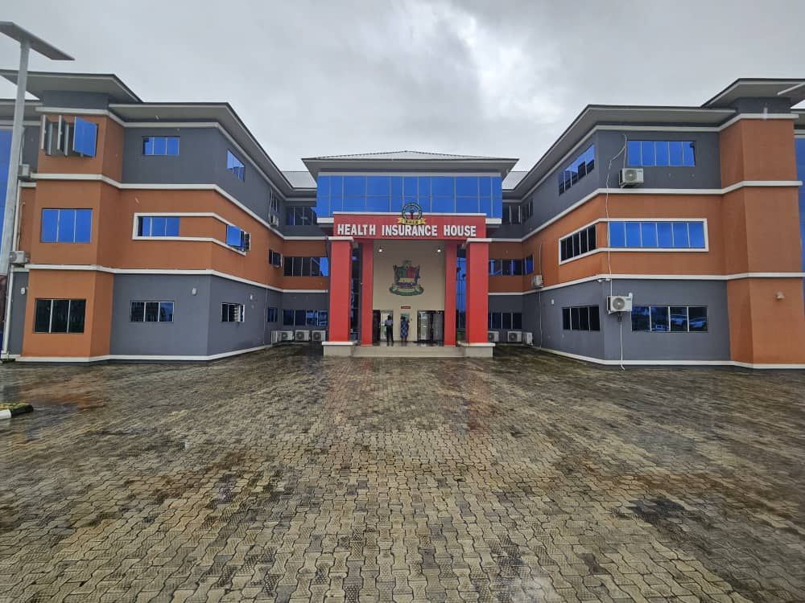
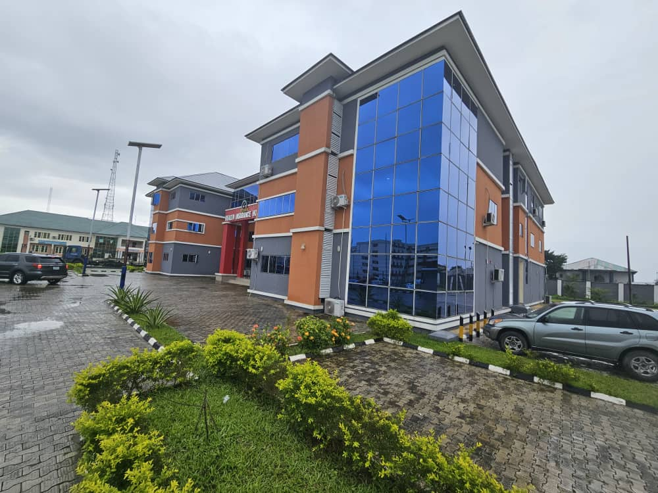

Slide 17
CONCLUSION CONT.
CHALLENGES
MORAL HARZADS
GOVT, COMMITMENT TO THE EQUITY FUND
ADVERS SELECTION IN THE INFORMAL SECTOR
ABUSE, INDUCEMENT AND MISREPRESENTATION (GAMING)
SOCIETAL ACCEPTABILITY/CULTURAL NORMS
DEMARKETING BY BENEFITING STAKEHOLDERS
UNDUE POLITICAL ENTANGLEMENT
INFLATION AND HIGH COST OF HEALTH TECHNOLOGY AND SKILL
DEFICIENCY IN HEALTH MANPOWER AND HUMAN RESOURCE

Slide 18
THANK YOU FOR YOUR ATTENTION

