Slide 1
COMMON DANGER SIGNS IN THE NEONATAL PERIOD
Dr. Idholo, Urire
(Paediatrician)

Slide 2
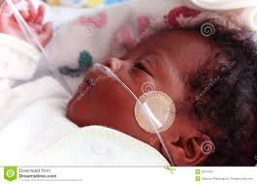

Slide 3
Objectives
To identify the common danger signs in the neonate
To manage the babies with a view to preventing complications and mortalities

Slide 4
Outline
Introduction
How far we have done
Common morbidities leading to mortalities
Risk factors leading to danger signs
Danger signs
How to mitigate

Slide 5
Introduction
Neonatal mortality is of public health importance as it is one of the challenging issues in Nigeria and globally. It is at the top of the agenda of the SDGs.(3rd-Good health and well being)
SDGs calls for ending preventable deaths of newborn babies and children younger than 5 years by 2030.
Aim is to reduce neonatal mortality rate(NMR) to 12 deaths per 1000 live births or fewer

Slide 6
Introduction contd.
Under-5 mortality to 25 deaths per 1000 live births or fewer in 2030.
According to WHO fact sheet, Globally 2.5 million children die in the first month of life out of which Sub-Sahara Africa accounts >40% per annum.
3/4 of neonatal mortality occur in first seven days of life, and 1/3rd die on the first day

Slide 7
According to UNICEF, approximately 660 babies will die each day before reaching their first month, 838 stillbirths occur everyday
Half of all under-five mortality globally occur in Ethopia, Nigeria, India, Pakistan and DR Congo

Slide 8
In a systematic review, globally between 1990-2017 the trend decreased by 51%, with 36.6 deaths/1,000 live births(35.5-37.8) in 1990- 18 deaths per 1,000 live births(17-19.9) in 2017

Slide 9
In 2021 the Neonatal mortality rate in Nigeria according to UNICEF was 34.9 deaths per 1,000 live births, 63.7 deaths per 1000 in 1972
NMR in rural areas was 44 deaths per 1,000 live births and 34 deaths per 1,000 live births in urban areas (urban –to-rural ratio 0.8)
NMR among the poorest households 45/1000 live birth, compared to 30/1000 live births among the richest households

Slide 10
Causes of Neonatal Mortality
In Nigeria according to UNICEF, the main causes of Neonatal deaths in 2015 were Prematurity(31%) , Birth Asphyxia and birth Trauma(30.9%), Sepsis(16.2%), Acute respiratory infections(7.2%), Congenital Anomalies(6%), Tetanus(2.5%), Injuries(1.3%)

Slide 11
Morbidiy (394) | Frequency (%)
Neonatal sepsis | 26.3
Preterm | 23
Neonatal Jaundice | 19
Perinatal Asphyxia | 16.7
Macrosomia Congenital anomalies Hemorrhagic disease of the Newborn Transient tachypnea of the new born | 0.04 0.04 0.01 0.02

Slide 12
Mortality(69/17%) | Freq(%)
Preterm | 47.8
Neonatal sepsis | 16.4
Perinatal Asphyxia | 11.9
Congenital anomaly | 4.4
Neonatal Jaundice | 4.4
Meconium Aspiration Syndrome | 0.01

Slide 13
There are some views that current effort at reducing neonatal mortality is hindered by poor understanding of the social determinants of health as well as danger signs of the neonate
Information on how to identify dangers signs, prompt diagnosis and prompt referral are important to mitigate the mortality and morbidity among the new born.

Slide 14
Risk factors for danger signs
Parental factors | Health Personnel | Government
Maternal infections | Poor supervision | Lack of facilities
Poor decision making | Lack of empathy | Lack of funds
Ignorance | Ignorance | Lack of training
Poverty | Late referrals | Lack of personnel
Religious beliefs | Missed diagnosis
Low or no education
Teenage pregnancy

Slide 15
Danger signs
New born danger signs refer to the presence of clinical signs that would indicate a high risk of neonatal mortality and morbidity and the need for early therapeutic intervention

Slide 16
Signs
Cough
Difficult/fast breathing
Lethargy
Loss of consciousness
Convulsion/jitteriness
Fever
Hypothermia

Slide 17
Signs contd
Poor feeding
Unable to suckle
Persistent vomiting
Diarrhoea
Jaundice
Eye discharge/redness
Discharge or pus from umbilicus
Excessive sweating
Abdominal distension

Slide 18
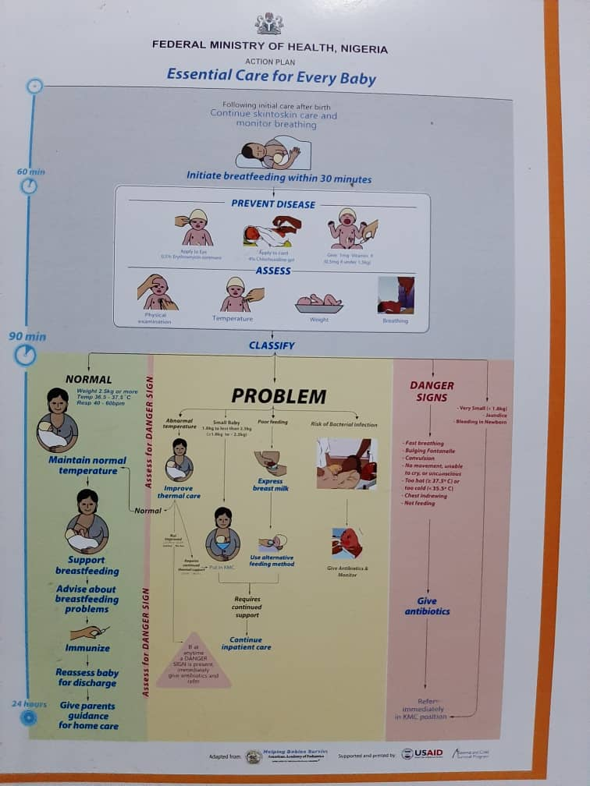

Slide 19
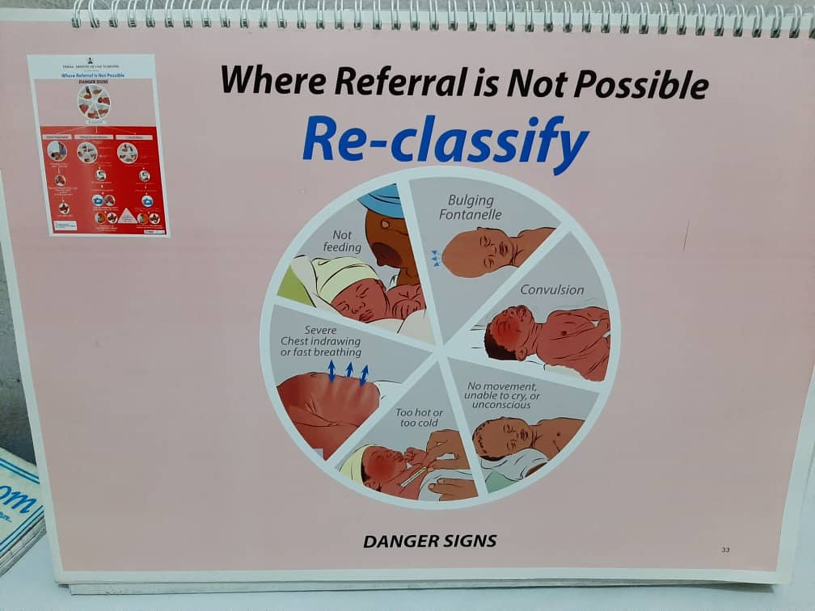

Slide 20
Interventions
High index of suspicion
RBS
Appropriate antibiotics
Phototherapy
Blood transfusion
Intravenous fluids
Prompt referral

Slide 21
Ways to mitigate
Health education
Alleviate poverty
Immunization
Family planning
Prophylaxis- Vit K, malaria
Training and retraining of health personnel
Government support of health- budget, facilities, good access roads, security

Slide 22
Reference
Guta A, Sena A, Amsali B, Sintayehu Y. Knowledge of Neonatal Danger signs and Associated Factors among mothers of < 6months old child in Dire Dawa, Ethopia: Acommunity based Cross –sectional Study. Int J Womens Health 2020; 12: 539- 548
World Health Organization (WHO). Newborns: reducing mortality. September 19, 2019. Available from: https://www.who.int/news-room/fact-sheets/detail/newborns-reducing-mortality. Accessed 13, December, 2020.

Slide 23
WHO fact sheet
UNICEF sheet

Slide 24



