Slide 1


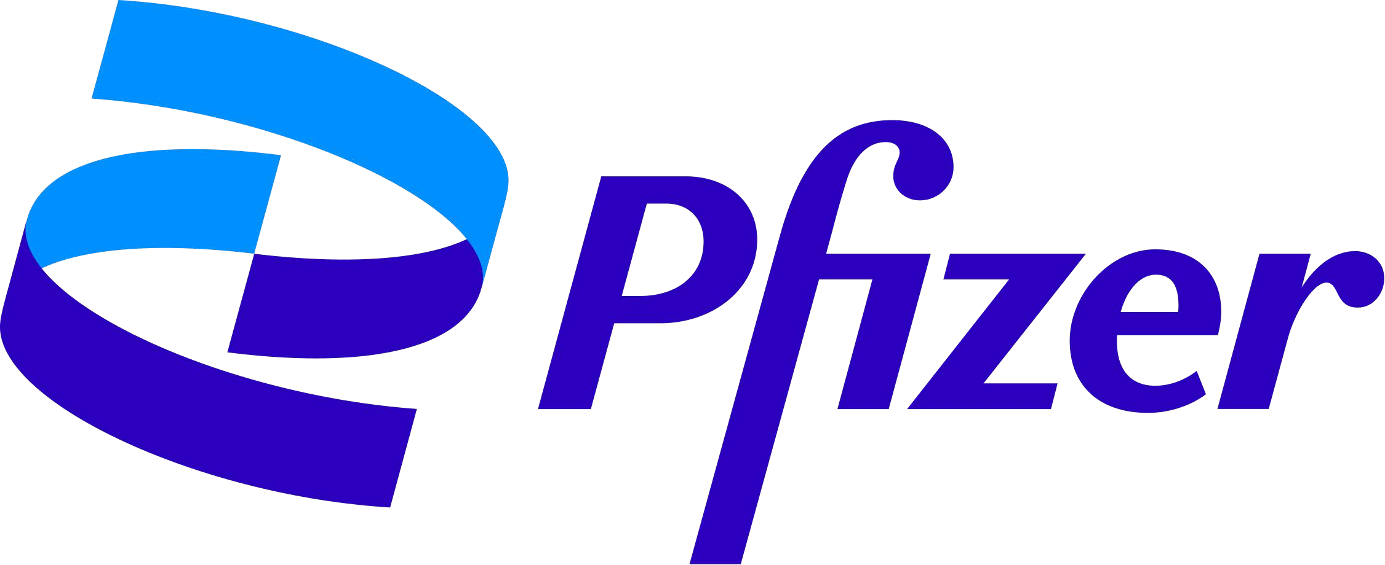
The Role Of ELIQUIS(APIXABAN) In Stroke Prevention in NVAF & DVT/PE
CHRISTOPHER JONAH
Pfizer Specialties Ltd.
Heritage Place 7th Floor, 21 Lugard Avenue, Ikoyi, Lagos, Nigeria.

Slide 2
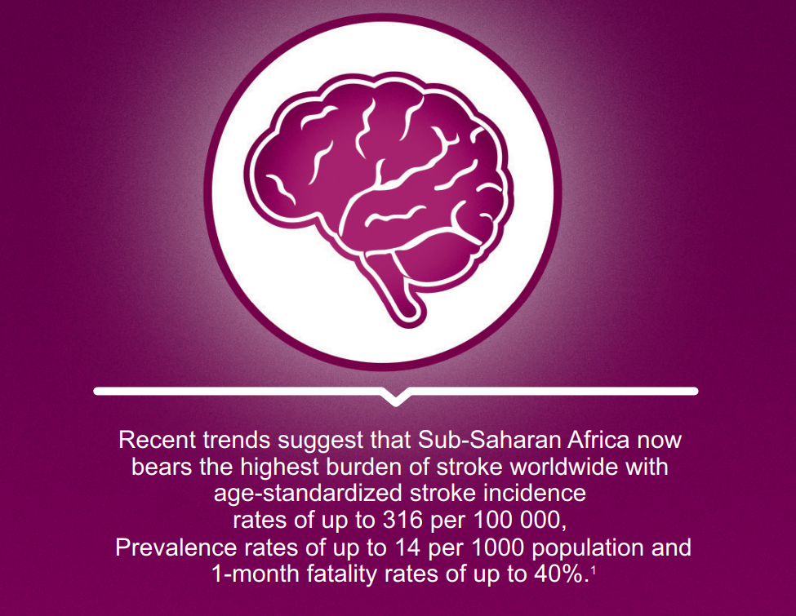
References: 1. Fred Stephen Sarfo et al. (2018). Stroke Among Young West Africans. Evidence From the SIREN (Stroke Investigative Research and Educational Network) Large Multisite Case–Control Study. Presented in part at the International Stroke Conference, Los Angeles, CA, January 24–26, 2018. DOI: 10.1161/STROKEAHA.118.020783
Notes:
174,000 new stroke cases annully

Slide 3
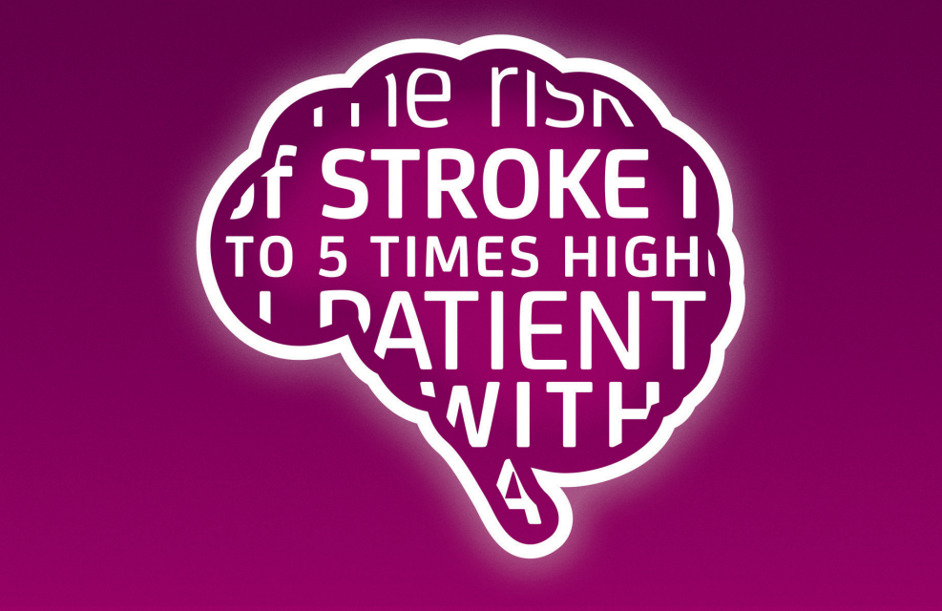
The risk of stroke is
UP TO 5 TIMES HIGHER in patients with AF ¹
Mi Kyoung Son et al. (2017). Risk of ischemic stroke after atrial fibrillation diagnosis: A national sample cohort. PLoS ONE 12(6): e0179687

Slide 4
High unmet need for stroke prevention in Atrial Fibrillation (AF)
AF is an arrhythmia responsible for one-third of all hospitalizations for cardiac rhythm disturbances ¹
Nearly one in four people at age 55 years will go on to develop AF (24% of men and 22% of women) ²
“Valvular AF” generally refers to AF in the setting of:
- Moderate-to-severe mitral stenosis
- Mechanical heart valve
Direct acting oral anticoagulants (DOACs) overcome some of the limitations of warfarin which include monitoring, slow onset of action, bridging, and multiple drug interactions
AF = Atrial Fibrillation
DOAC = Direct Acting Oral Anti-Coagulants
2019 AHA/ACC/HRS Focused Update of the 2014 AHA/ACC/HRS Guideline for the Management of Patients With Atrial Fibrillation: A Report of the American College of Cardiology/American Heart Association Task Force on Clinical Practice Guidelines and the Heart Rhythm Society in Collaboration With the Society of Thoracic Surgeons. Circulation. 2019;140:e125–e151. 2. Heeringa J et al. Eur Heart J 2006;27:949–53

Slide 5
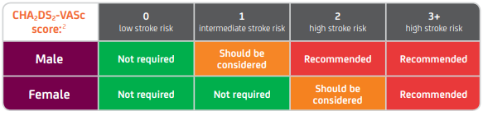
ASSESSMENT OF STROKE RISK – CHA2DS2-VASc SCORE
The European Society of Cardiology guidelines recommended use of the CHA2DS2-VASc score in newly diagnosed patients with non-valvular atrial fibrillation (NVAF).¹
STROKE RISK FACTORS ^{2,3}
1 Point
C Congestive heart failure (or LV systolic dysfunction)
H Hypertension (blood pressure consistently above 140/90 mmHg or treated hypertension on medication)
A2 Age ≥75 years
D Diabetes mellitus
S2 Prior stroke or TIA or thromboembolism
V Vascular disease (ie prior myocardial infarction, peripheral artery disease or aortic plaque)
A Age 65 – 74 years
Sc Sex category (female)
1 Point
2 Points
1 Point
2 Points
1 Point
1 Point
1 Point
Adapted from Lip 2010.2 LV, left ventricular; TIA, transient ischaemic attack.

Slide 6
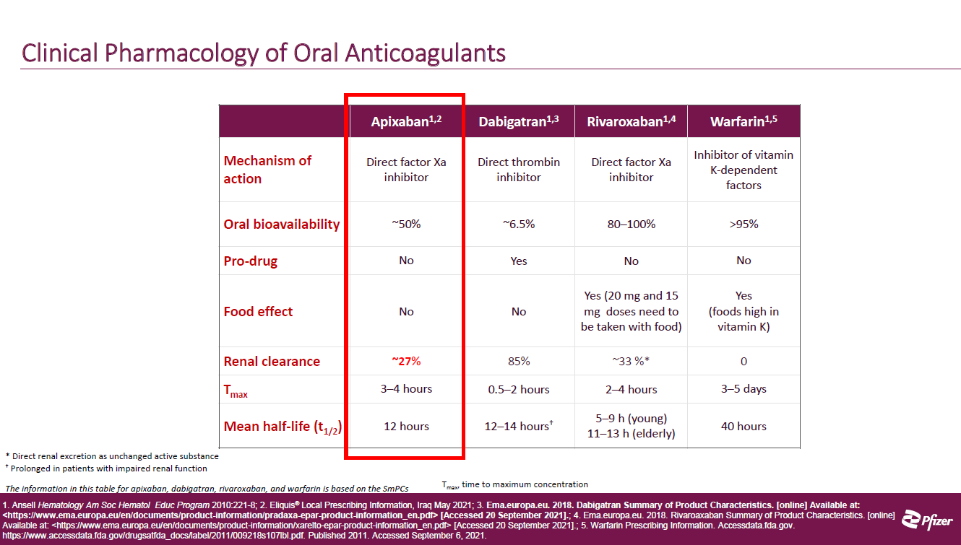

Slide 7
The choice of the apixaban BD dosage regimen
in all studied indications is based on a clear rationale:
to maximise efficacy without increasing bleeding risk
Efficacy
Safety
100
30
95
BD
25
90
20
OD
OD
Subjects without thrombotic events (%)
Subjects with
bleeding events (%)
85
15
BD
80
10
75
5
70
0
0
5000
10 000
15 000
0
5000
10 000
15 000
AUCss (ng*hr/mL)
AUCss (ng*hr/mL)
Exposure range (2.5th-97.5th percentile) for 2.5 mg BD dosing regimen
AUCss: Area under the plasma concentration-time curve at steady state
Adapted from Feng Y et al. Poster presented at: 21st Congress of ISTH; July 2007; Geneva, Switzerland. Poster P-M-663.
Notes:
7
Individual apixaban exposure from the six dose arms of the APROPOS study¹ was estimated from a population pharmacokinetic model.²
On the slide, the figures show the relationships between exposure and efficacy (i.e. venous thromboembolism) or safety (i.e. bleeding events).²
The figure on the left-hand side shows efficacy, i.e. the percentage of subjects without thrombotic events, and the figure on the right-hand side shows bleeding risk, i.e. the percentage of subjects with bleeding events.
The results of this modeling simulation study suggested that, using apixaban, twice-daily dosing would be more effective than once-daily dosing, with similar bleeding risk.²
Abbreviations
AUCss: Area under the plasma concentration-time curve at steady state
BD: Twice daily
OD: Once daily
References
1. Lassen MR, et al. The efficacy and safety of apixaban, an oral, direct factor Xa inhibitor, as thromboprophylaxis in patients following total knee replacement. J Thromb Haemost 2007;5:2368-75.
2. Feng Y, et al. Exposure-clinical outcome modeling and simulation to facilitate dose selection of apixaban in subjects undergoing elective knee replacement surgery. Poster presented at: 21st Congress of the International Society of Thrombosis and Haemostasis (ISTH), July 2007; Geneva, Switzerland. Poster P-M-663.

Slide 8
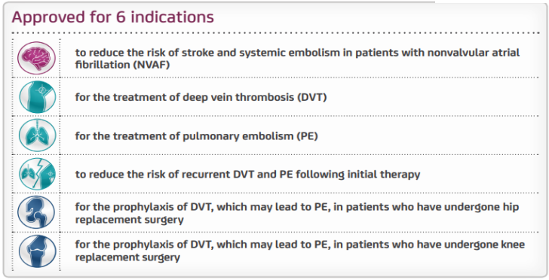
Indications
Reference: 1. ELIQUIS™ (apixaban) 2.5 mg and 5 mg LPD NEAR, January 2020, version 7.

Slide 9
Therapeutic indication of apixaban in AF patients
Prevention of stroke and systemic embolism in adult patients with non-valvular atrial fibrillation (NVAF), with one or more risk factors, such as
Prior stroke or transient ischaemic attack (TIA);
Age≥ 75 years;
Hypertension;
Diabetes mellitus;
Symptomatic heart failure (NYHA Class ≥ II)
Apixaban SmPC 2012.
Notes:
Abbreviations
NVAF: Non-valvular atrial fibrillation
NYHA: New York Heart Association
TIA: Transient ischaemic attack
References
Apixaban, SmPC 2012.

Slide 10
“I’m concerned patients will not comply as well with BD dosing compared to OD dosing, as with rivaroxaban.”
Patients with NVAF frequently have multiple
co-morbidities and take other BD medications; for those patients, the BD dosing regimen of Eliquis®
may not be an additional burden. Although rivaroxaban offers OD dosing, it must be taken once daily with food. Eliquis® does not have food restrictions and can be taken with or without food.
Eliquis® given BD demonstrated superior stroke/systemic embolism prevention vs. warfarin, a superior safety profile in reducing major bleeding vs. warfarin, and a superior reduction in all-cause mortality vs. Warfarin.

Slide 11
Apixaban is eliminated from the body via multiple routes
Only ~27% of apixaban is eliminated by the kidneys
Biliary elimination
Liver metabolism
Direct intestinal excretion
Renal elimination (27%)
Unchanged apixaban is the major drug-related component in human plasma
with no active circulating metabolites present
Apixaban SmPC 2012.
Notes:
References
Apixaban, SmPC 2012.

Slide 12




ELIQUIS ® efficacy and safety profile vs. warfarin: ARISTOTLE trial¹*
STROKE/SE
MAJOR BLEEDING
INTRACRANIAL BLEEDING
MAJOR GI BLEEDING
5.0
5.0
1.0
3.5
4.0
4.0
SUPERIOR
0.8
3.0
Event rate (%/year)
SUPERIOR
Event rate (%/year)
31% RRR
p<0.001
Event rate (%/year)
Event rate (%/year)
2.5
2.0
1.5
1.0
0.5
0.0
21% RRR
p=0.01 for superiority
58% RRR
p<0.001
3.0
3.0
0.6
p=0.37
2.0
2.0
0.4
1.0
1.60% n=265
1.27% n=212
1.0
3.09% n=462
2.13% n=327
0.2
0.80% n=122
0.33% n=52
0.86% n=119
0.76% n=105
0.0
0.0
0.0
Warfarin ELIQUIS ® N=9,081 N=9,120
Warfarin ELIQUIS ® N=9,052 N=9,088
Warfarin ELIQUIS ® N=9,052 N=9,088
Warfarin ELIQUIS ® N=9,052 N=9,088
Primary efficacy endpoint HR=0.79 (95% Cl: 0.66–0.95)
Primary safety endpoint HR=0.69 (95% Cl: 0.60–0.80)
HR=0.42 (95% Cl: 0.30–0.58)
HR=0.89 (95% Cl: 0.70–1.15)
ELIQUIS ® does not significantly increase major gastrointestinal bleeding, while maintaining superior efficacy with the same does, vs. warfarin.^{1–4}
Adapted from Granger et al. 2011¹
AF = Atrial Fibrillation, CL = Confidence Interval, HR = Hazard Ratio, NOAC = Non-vitamin K antagonist Oral Anticoagulant, OAC = Oral Anticoagulant, RRR = Relative Risk Reduction, SE = Systemic Embolism
* ELIQUIS™ was studied in a randomized, double-blind, double-dummy, non-inferiority trial in 18,201 patients.¹ Stroke / systemic embolism was the primary efficacy endpoint and major bleeding was the primary safety endpoint.¹ The endpoints presented on this page were selected due to their frequency and severity: intracranial bleeding, the most feared complication of anticoagulation therapy due to its high risk of death and disability;⁵ and gastrointestinal bleeding, the most frequent adverse event associated with OAC use.⁶⁻⁸
References: 1. Granger CB et al. N Engl J Med 2011; 365: 981–992. 2. Patel MR et al. N Engl J Med 2011; 365: 883–891. 3. Connolly SJ et al. N Engl J Med 2010; 363: 1875–1876. Supplementary appendix. 4. Giugliano RP et al. N Engl J Med 2013; 369: 2093–2104. 5.
Camm AJ et al. Eur Heart J 2012: 33: 2719–2747. 6. Majeed A et al. Circulation 2013; 128: 2325–2332. 7. Hylek EM et al. J Am Coll Cardiol 2014; 63: 2141–2147. 8. Goodman SG et al. J Am Coll Cardiol 2014; 63: 891–900.

Slide 13

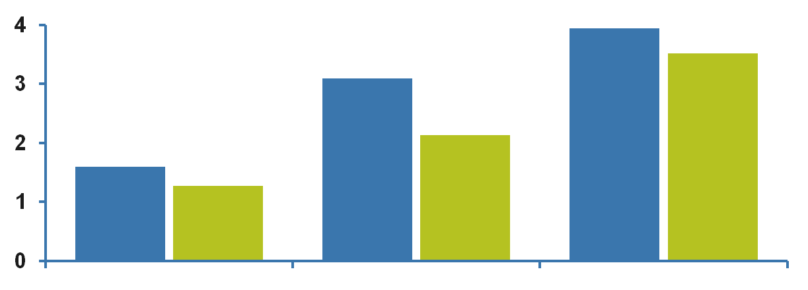
Apixaban is the only oral anticoagulant to demonstrate superiority vs. warfarin in all of the following 3 outcomes
Superior
profile in reducing
major bleeding
Superior
reduction in
all-cause mortality
Superior
stroke/systemic embolism
prevention
21% RRR
p=0.01
31% RRR
p<0.001
11% RRR
p=0.047
3.94%
669/9081
3.52%
603/9120
3.09%
462/9052
Event rate (% / year)
2.13%
327/9088
1.60%
265/9081
1.27%
212/9120
Primary efficacy endpoint
Primary safety endpoint
Key secondary endpoint
Median duration of follow-up 1.8 years
Apixaban
Warfarin (target INR 2.0-3.0)
Figure created from data in Granger et al. N Engl J Med 2011;365:981-92.
Notes:
Apixaban was superior to warfarin in reducing the rates of the three key outcomes of the ARISTOTLE study, i.e. stroke or systemic embolism, major bleeding and death from any cause.
Abbreviations
RRR: Relative risk reduction.
References
Granger CB et al; ARISTOTLE Committees and Investigators. Apixaban versus warfarin in patients with atrial fibrillation. N Engl J Med 2011;365:981-92.

Slide 14
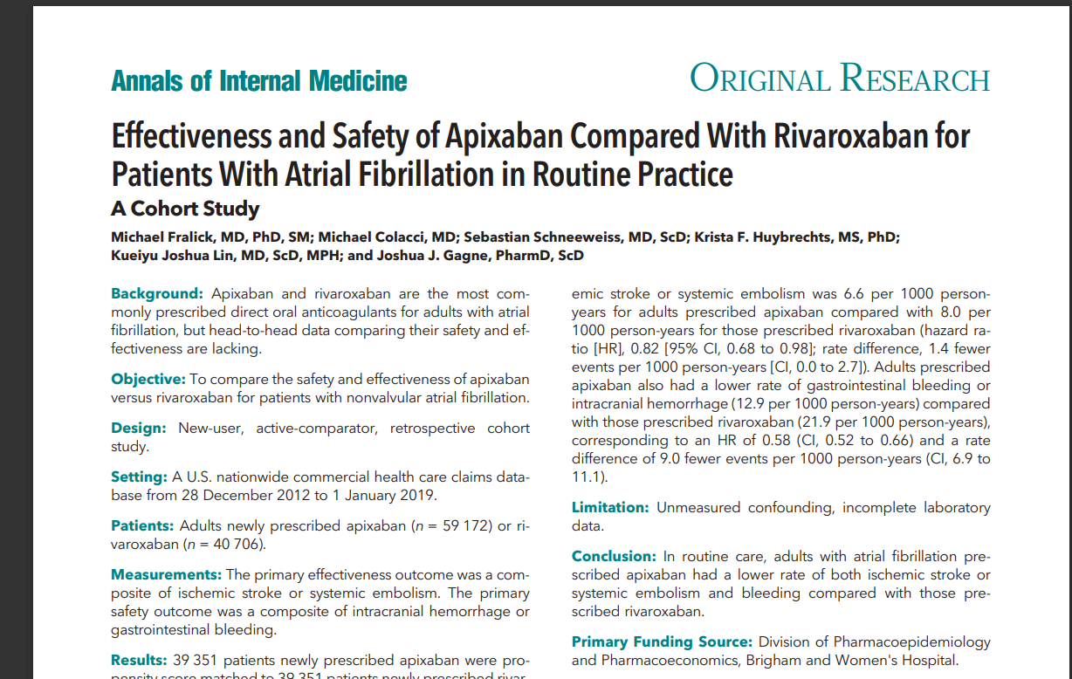

Slide 15
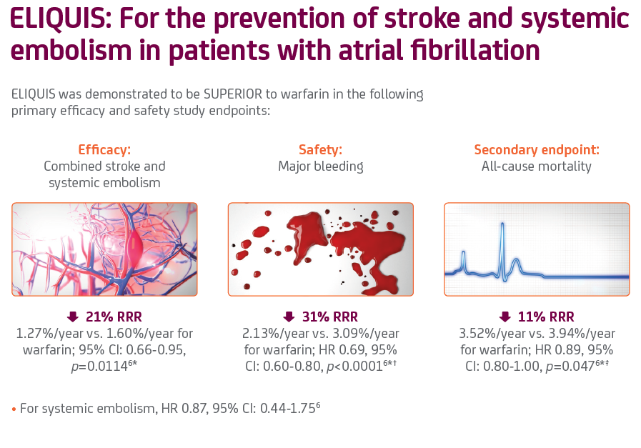

Slide 16
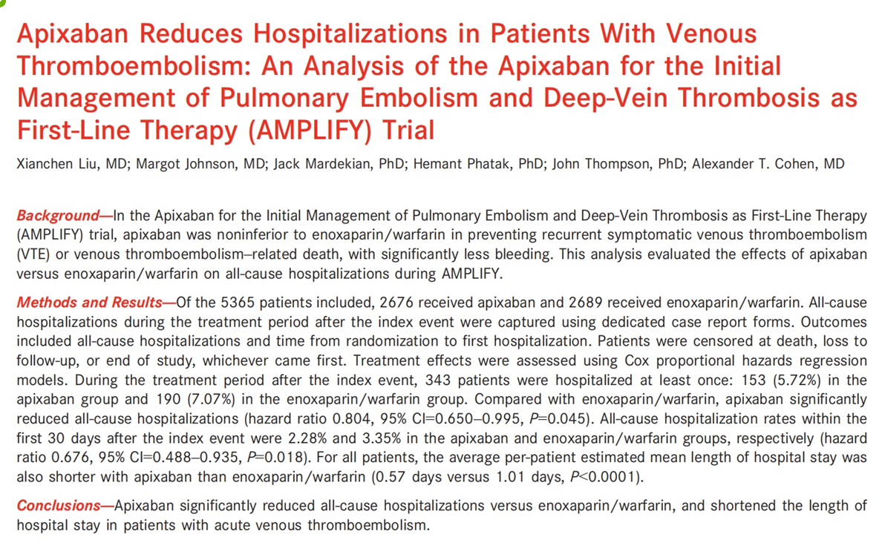

Slide 17









ELIQUIS® efficacy and safety profile vs. enoxaparin / warfarin: AMPLIFY trial^{1,2}
RECURRENT VTE /
MAJOR BLEEDING²
MAJOR/ CLINICALLY RELEVANT NON-MAJOR BLEEDING²
ALL BLEEDINGS²
VTE-RELATED DEATH²
4.0
2.0
30.0 -
SUPERIOR
10.0 -
25.0 -
Patients with event (%)
3.0
p<0.001 for non-inferiority
Patients with event (%)
69% RRR
Patients with event (%)
8.0 -
Patients with event (%)
p<0.001
for superiority
20.0 -
2.0
1.0
6.0 -
p<0.001
15.0 -
4.0 -
10.0 -
1.0
2.0 -
5.0 -
2.7%
2.3%
1.8%
0.6%
9.7%
4.3%
25.8%
15.5%
0.0
n=71
n=59
0.0
n=49
n=15
0 -
n=261
n=115
0 -
n=695
n=415
enoxaparin
/warfarin N = 2,704
ELIQUIS
enoxaparin
/warfarin N = 2,704
ELIQUIS
enoxaparin
/warfarin N = 2,704
ELIQUIS
enoxaparin
/warfarin N = 2,704
ELIQUIS
N=2,691
N=2,691
N=2,691
N=2,691
Primary efficacy endpoint RR 0.84 (95% Cl: 0.60-1.18)
Primary efficacy endpoint RR 0.31 (95% Cl: 0.17-0.55)
Secondary efficacy endpoint RR 0.44 (95% Cl: 0.36-0.55)
Secondary efficacy endpoint
Adapted from Agnelli G, et al. N Engl J Med. 2013.²
Reference: 1. . Eliquis (Apixaban) 2.5mg and 5mg LPD. NEAR, January 2020, version 7
2- Agnelli G, Buller HR, Cohen A, et al. Oral apixaban for the treatment of acute venous thromboembolism. N Engl J Med. 2013 Aug 29;369(9):799-808.

Slide 18
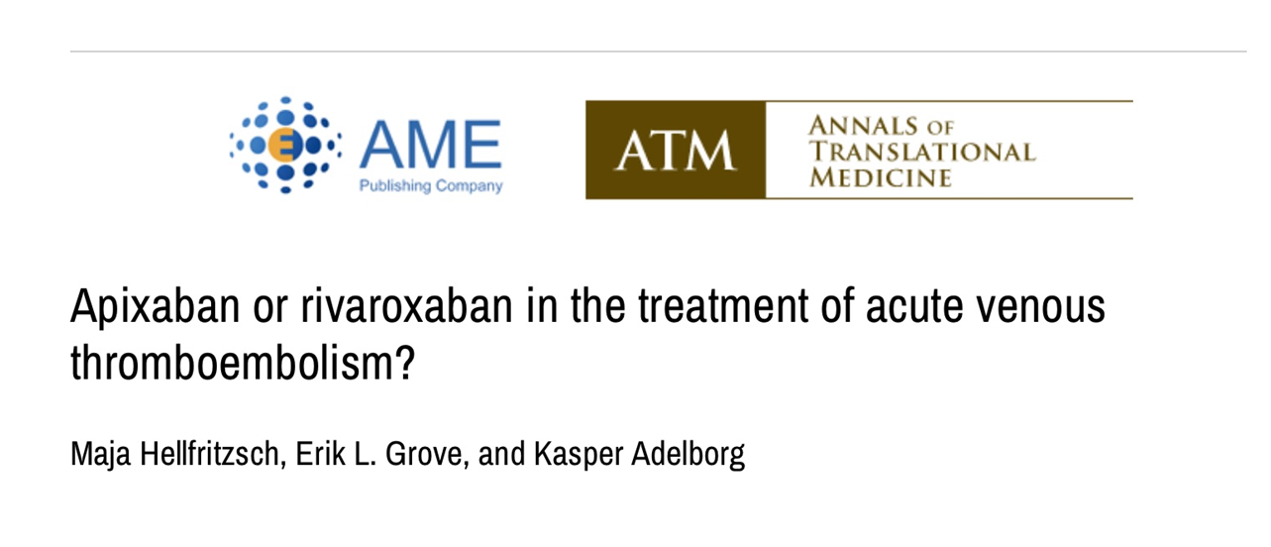

Slide 19
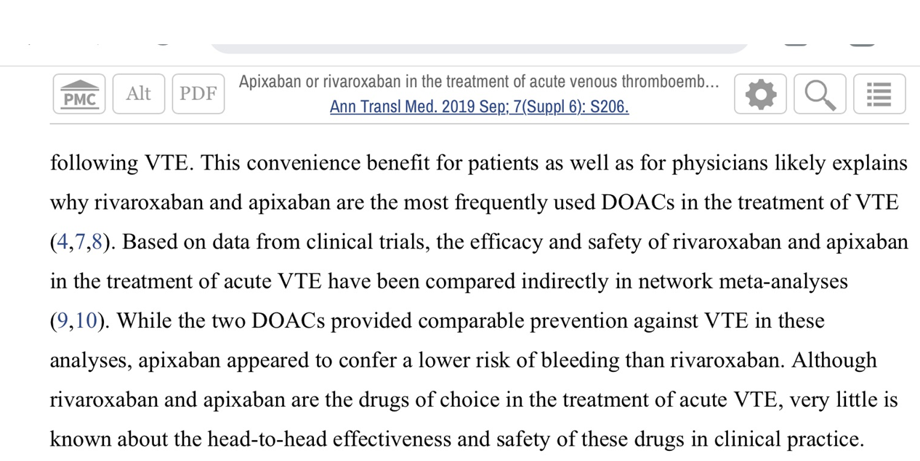

Slide 20
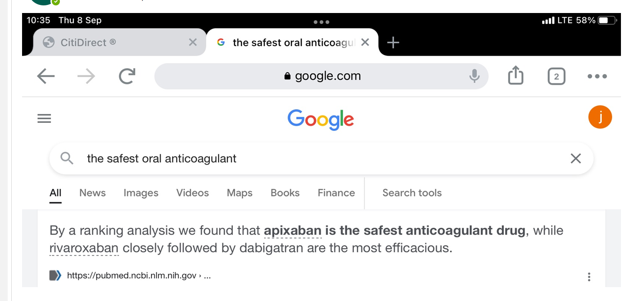

Slide 21
Dosing for prevention of stroke in NVAF
The recommended dose of apixaban is
5 mg taken orally twice daily (BD),
swallowed with water, with or without food.
Dose Adjustment to 2.5mg BD
Age ≥80 years
Body weight ≤60 kg
At least 2 characteristics
Apixaban
2.5mg BD
Serum creatinine ≥
1.5 mg/dL (133 µmol/L)
Severe renal
impairment alone
(CrCl: 15-29 mL/min)
Prior to initiating apixaban, liver function testing should be performed
If a dose is missed, the patient should take apixaban immediately and then continue with twice daily intake as before
Apixaban SmPC 2012.
Notes:
Abbreviations
BD: twice daily
NVAF: Non-valvular atrial fibrillation
References
Apixaban, SmPC 2012.

Slide 22




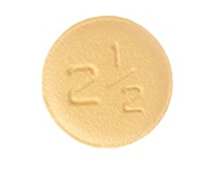



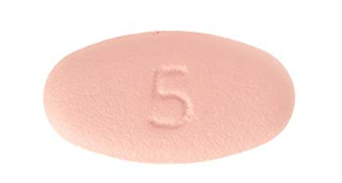
Simple to Initiate or Switch¹
For prevention of stroke / systemic embolism in patients with non-valvular AF, with one or more risk factors¹*
The recommended dose of
Apixaban for NVAF is 5mg BID
Apixaban dosage should be reduced to
2.5 mg BID in patients with the following:
taken orally with water
1
1
Age ≥80 years
Body weight ≤60 kg
At least
characteristics
Serum creatinine
≥1.5 mg/dL (133 μmol/L)
2.5 mg BID
MORNING
VEN ING
MORNING
EVENING
5 mg
5 mg
Severe renal impairment alone (creatinine clearance [CrCl] 15–29 mL/min)
†
2.5 mg BID
Tablets shown are not actual size.
Please refer to the Prescribing Information for full information.
1
AF = Atrial Fibrillation, BID = Twice Daily, CrCl = Creatinine Clearance, NOAC = Non-vitamin K antagonist Oral Anticoagulant, NYHA=New York Heart Association
* Such as prior stroke or translent lschaemic attack (TIA); age ≥75 years; hyerptension; diabetes mellitus; symptomatic heart failure (NYHA Class ≥II).
1
† ELIQUIS ® is not recommended for patients with CrCl <15 ml/min, or for patients undergoing dialysis.
Reference: 1. ELIQUIS® (apixaban) LPD NEAR, January 2020, version 7
1

Slide 23






















ELIQUIS™ offers clear dose-reduction criteria across non-valvular AF patients with normal renal function to moderate-severe renal impairment¹*
The ‘2018 EHRA Practical Guide on the Use of NOACs in patients with AF’ illustrates the use of NOACs according to renal function^{1†}
CrCl dabigatran rivaroxaban edoxaban apixaban (ELIQUIS™)
60 mg
95 ml/min
2 x 150 mg
20 mg
60 mg§
2 X 5 mg/ 2 X 2.5 mg#
50 ml/min
40 ml/min
2 x 150 mg or
2 x 110 mg‡
15 mg
30 mg
30 ml/min
15 mg
30 mg
2 X 2.5 mg
15 ml/min
Dialysis
Orange arrows indicate cautionary use (dabigatran in moderate renal insufficiency, Factor Xa inhibitiors in severe renal insufficiency, edoxaban in normal renal function). Adapted from Steffel et al. 2018.¹
AF = Atrial Fibrillation, BID = Twice Daily, CrCl = Creatinine Clearance, EHRA = European Heart Rhythm Association, NOAC = Non-vitamin K antagonist Oral Anticoagulant, P-Gp = Phosphorylated Glycoprotein, SmPC = Summary of Product Characteristics
* ELIQUIS ® is not recommended for patients with CrCl <15 ml/min or in patients undergoing dialysis.²
† The term ‘non-valvular’ has been eliminated in the 2018 EHRA guidelines on the management of patients with AF. However, the term is still found in the ELIQUIS ® LPD due to the original wording used in the exclusion criteria of the clinical trials on which their regulatory approval was based.¹ Full guidelines available at: www.noacforaf.eu.
‡ 2 x 110 mg in patients at high risk of bleeding (per Summary of Product Characteristics).¹
§ Other dose reduction criteria may apply (weight ≤60 kg, concomitant potent P-Gp inhibitor therapy).¹
# All patients should be given ELQIUIS ® 5 mg BID, unless they have 2 or more of the ABC dose reduction criteria: Age ≥80 years, Body weight ≤60 kg, or Creatinine ≥1.5 mg/dL (133 μmol/l).²
References: 1. Steffel J et al. Eur Heart J 2018; 39: 1330–1393. 2. ELIQUIS ® (apixaban) 2.5 mg and 5 mg NEAR, January 2020, version 7.

Slide 24






























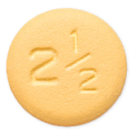



Dosing and administration
For treatment of DVT and PE in adults¹
The recommended dose of ELIQUIS™ for treatment of acute DVT and PE is 10 mg BID taken orally for the first 7 days followed by 5 mg BID taken orally¹*
For prevention of recurrent DVT and PE in adults¹
The recommended dose of ELIQUIS™ for the prevention of recurrent DVT and PE is 2.5 mg BID taken orally^{1†}
Initiation
10 mg BID
Long Term Treatment
5 mg BID
Extended therapy for prevention of recurrence†
2.5 mg BID
MORNING
EVENING
MORNING
EVENING
MORNING
EVENING
7 days
Treat for at least 3 months
6 months
Initiate after 6 months of treatment with ELIQUIS™ or another anticoagulant‡
ELIQUIS™ can be taken with or without food¹ No INR monitoring is required¹
Tablets shown are not actual size.
Adapted from ELIQUIS™ Prescribing Information 2019¹
BID = Twice Daily, CYP3A4 = Cytochrome P450 3A4, DVT = Deep Vein Thrombosis, LMWH = Low Molecular Weight Heparin, PE = Pulmonary Embolism, P-gp = P-glycoprotein
* As per available medical guidelines, short duration of treatment (at least 3 months) should be based on transient risk factors (eg, recent surgery, trauma, immobilization).1
The duration of overall therapy should be individualized after careful assessment of the treatment benefit against the risk for bleeding. ELIQUIS™ should not be used in patients
receiving concomitant systemic treatment with strong inducers of both CYP3A4 and P-gp since efficacy may be compromised.1
† When prevention of recurrent DVT and PE is indicated, the 2.5 mg BID dose should be initiated following completion of 6 months of treatment with ELIQUIS™ 5 mg BID or with another anticoagulant. ELIQUIS™ should be used with caution in patients receiving concomitant systemic treatment with strong inducers of both CYP3A4 and P-gp.1
‡ Switching from parenteral anticoagulants, eg, LMWH, to ELIQUIS™ can be done at the time of the next scheduled dose1
Reference: 1. Eliquis (Apixaban) 2.5mg and 5mg LPD. NEAR, January 2020, version 7.

Slide 25
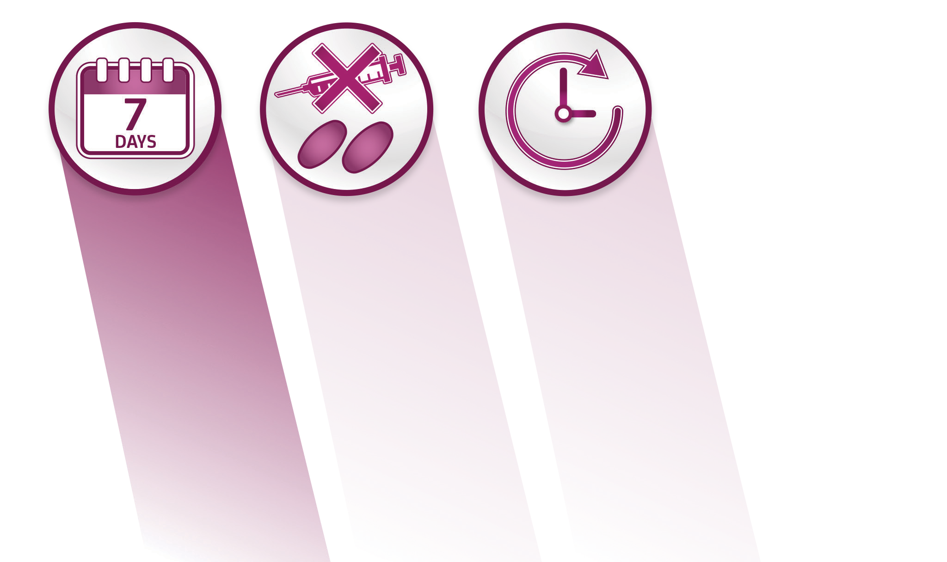
ELIQUIS™: a single oral treatment that can be prescribed from the start in patients with a DVT / PE¹
ELIQUIS™ has a simple dosing regimen with high-intensity (10 mg BID) treatment for only the first 7 days before continuing on 5 mg BID¹
Patients treated with ELIQUIS™ do not require any initial
injections or bridging with LMWH¹*
ELIQUIS™ has a fast onset of
action: maximum concentrations are reached 3–4 hours post-dose¹
ELIQUIS™ has low renal clearance (27%)^{1†}
No dose adjustments for DVT / PE patients, regardless of age, weight or renal function^{1†‡}
BID=Twice Daily, DVT=Deep Vein Thrombosis, HIV=Human Immunodeficiency Virus, LMWH=Low Molecular Weight Heparin, NOAC=Non-vitamin K antagonist Oral Anticoagulant, PE=Pulmonary Embolism, QD=Once Daily, VKA=Vitamin K Antagonist, VTE=Venous Thromboembolism
* In the AMPLIFY trial, 87% of patients had received LMWH, heparin or fondaparinux prior to randomisation. Patients were excluded if they had received more than two doses of a QD LMWH regimen, fondaparinux or a VKA; more than three doses of a BID LMWH regimen; or more than 36 hours of continuous intravenous heparin.²
† ELIQUIS™ should be used with caution in patients with severe renal impairment (creatinine clearance 15–29 ml/min) for the treatment of DVT, treatment of PE and prevention of recurrent DVT and PE. ELIQUIS is not recommended in patients with creatinine clearance <15 ml/min, or in patients undergoing dialysis.¹
‡ ELIQUIS™ is not recommended in patients receiving concomitant systemic treatment with strong inhibitors of both CYP3A4 and P-gp, such as azole-antimycotics (e.g., ketoconazole, itraconazole, voriconazole and posaconazole) and HIV protease inhibitors (e.g., ritonavir). In patients receiving concomitant systemic treatment with strong inducers of both CYP3A4 and P-gp, the following recommendations apply: ELIQUIS should be used with caution in patients being treated for prevention of VTE in elective hip or knee replacement surgery, and in patients being treated for prevention of recurrent DVT / PE; in patients undergoing treatment for DVT / PE, ELIQUIS should not be used as efficacy may be compromised.¹
References: 1. Eliquis (Apixaban) 2.5mg and 5mg LPD. NEAR, January 2020, version 7 . 2. Agnelli G et al. N Engl J Med 2013; 369: 799–808.

Slide 26
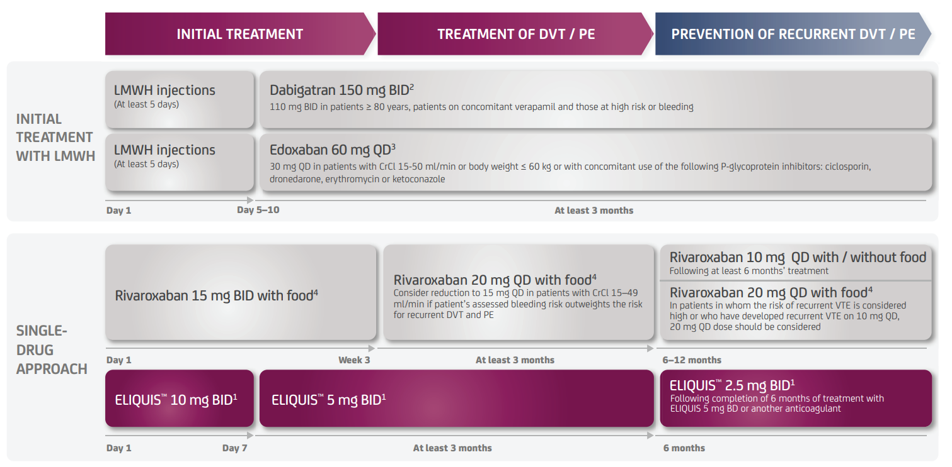
NOAC dosing regimens across each stage of DVT/PE treatment¹⁻⁴
BID = Twice Daily, CrCl = Creatinine Clearance, DVT = Deep Vein Thrombosis, INR = International Normalised Ratio, LMWH = Low Molecular Weight Heparin, NOAC = Non-vitamin K antagonist Oral Anticoagulant, PE = Pulmonary Embolism, QD = Once Daily, VTW = Venous Thromboembolism
References: 1. Eliquis (Apixaban) 2.5mg and 5mg LPD. NEAR, January 2020, version 7. 2. Dabigatran Summary of Product Characteristics. 26 June 2020. Available at: www.ema.europa.eu/en. Last accessed August 2020. 3. Edoxaban Summary of Product Characteristics. 23 July 2020. Available at: www.ema.europa.eu/en. Last accessed August 2020. 4. Rivaroxaban Summary of Product Characteristics. 17 January 2020. Available at: www.ema.europa.eu/en. Last accessed August 2020.

Slide 27
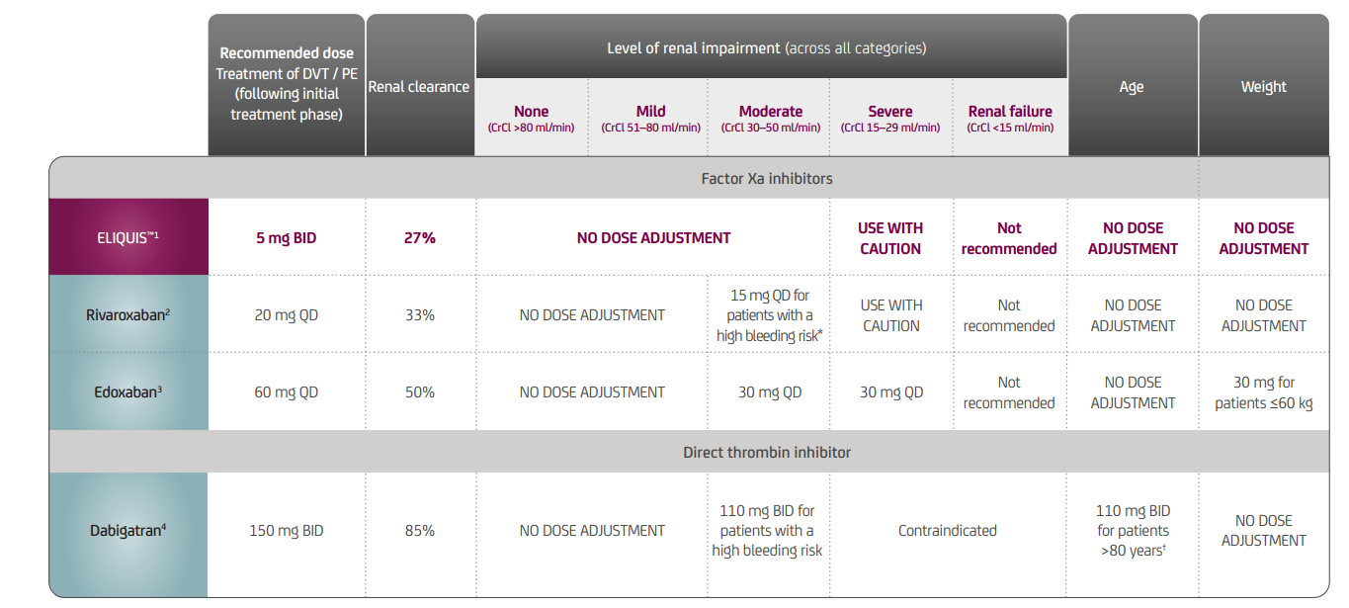
NOAC dosing considerations in patients with a DVT or PE by renal function, age, and weight¹⁻⁴
Dose reduction criteria for patients being treated for DVT/PE differ from criteria for patients with non-valvular AF¹⁻⁴
Adapted from the Eliquis™ Prescribing Information, rivaroxaban, edoxaban and dabigatran SmPCs.^{1–4}
AF = Atrial Fibrillation, BID = Twice Daily, CrCl = Creatinine Clearance, DVT = Deep Vein Thrombosis, NOAC = Non-vitamin K antagonist Oral Anticoagulant, PD = Pharmacodynamic, PE = Pulmonary Embolism, PK = Pharmacokinetic, QD = Once Daily, SmPC = Summary of Product Characteristics
* For rivaroxaban, 15 mg QD should be considered if the patient’s assessed risk for bleeding outweighs the risk for recurrent DVT / PE. The recommendation for the use of 15 mg rivaroxaban QD is based on PK modelling and has not been studied in the clinical setting. Patients should still be treated with 15 mg BID for the first 3 weeks.²
† This dosing recommendation for dabigatran is based on PK and PD analyses and has not been studied in this clinical setting^{.4}
Please refer to the ELQIUIS™ Prescribing Information for further information.¹
References: 1. Eliquis (Apixaban) 2.5mg and 5mg LPD. NEAR, January 2020, version 7. 2. Rivaroxaban Summary of Product Characteristics. 17 January 2020. Available at: www.ema.europa.eu/en. Last accessed August 2020. 3. Edoxaban Summary of Product Characteristics. 23 July 2020. Available at: www.ema.europa.eu/en. Last accessed August 2020. 4. Dabigatran Summary of Product Characteristics. 26 June 2020. Available at: www.ema.europa.eu/en. Last accessed August 2020.

Slide 28
Surgery and invasive procedures
Eliquis should be discontinued at least 48 hours prior to elective surgery or invasive procedures with a moderate or high risk of unacceptable or clinically significant bleeding.
Eliquis should be discontinued at least 24 hours prior to elective surgery or invasive procedures with a low risk of bleeding or where the bleeding would be non-critical in location and easily controlled.
References: 1. Eliquis (Apixaban) 2.5mg and 5mg LPD. NEAR, January 2020, version 7.

Slide 29





Start and stay with ELIQUIS™ for both the treatment and prevention of recurrent DVT / PE ^{1,2}
ELIQUIS™ is a single oral treatment with a fast onset* of action and no requirement for initial LMWH injections³
ELIQUIS™ offers continued efficacy, with a favourable bleeding profile
regardless of bleeding endpoint^{1,2}
Treatment of DVT / PE: ELIQUIS™ demonstrated superior reduction in the risk of
major bleeding and was as effective as enoxaparin / warfarin¹
Prevention of recurrent DVT / PE: ELIQUIS™ demonstrated comparable rate of
major bleeding with superior efficacy vs. placebo²
*Apixaban is rapidly absorbed with maximum concentrations appearing 3 to 4 hours after tablet intake.³ DVT = Deep Vein Thrombosis, LMWH = Low Molecular Weight Heparin, PE = Pulmonary Embolism
References: 1. Agnelli G et al. N Engl J Med 2013; 369:799–808. 2. Agnelli G et al. N Engl J Med 2013;368:699–708. 3. Eliquis (Apixaban) 2.5mg and 5mg LPD. NEAR, January 2020, version 7

Slide 30

Precautions for use¹
Contraindications¹
Not Recommended¹
Use with caution¹
Contraindications¹
Hypersensitivity to the active substance or any excipients of the ELIQUIS ® film-coated tablet
Active clinically significant bleeding
Hepatic disease associated with coagulopathy and clinically relevant bleeding risk
Lesion or condition at significant risk of major bleeding
Concomitant treatment with any other anticoagulant except when switching therapy to or from ELIQUIS®, when UFH is given at doses to maintain a open central venous or arterial catheter, or when UFH is given during catheter ablation for AF
Not recommended¹
Estimated CrCl <15 ml/min†
Undergoing dialysis
Severe hepatic impairment
Pregnancy
In patients with prosthetic heart valves (with or without AF)‡
As an alternative to unfractionated heparin in patients with PE who are haemodynamically unstable or may receive thrombolysis or pulmonary embolectomy
In combination with strong inducers of both
CYP3A4 and P-gp for the treatment of DVT and PE
In combination with strong inhibitors of both CYP3A4 and P-gp, or agents associated with serious bleeding
In patients with antiphospholipid syndrome
Use with caution¹
Mild or moderate hepatic impairment (Child-Pugh A or B)
Elevated liver enzymes (ALT/AST >2 x ULN) or total bilirubin ≥1.5 x ULN
In combination with strong inducers of both CYP3A4 and P-gp for the prevention of VTE in elective hip or knee replacement surgery, prevention of stroke/systemic embolism in non-valvular AF patients, or the prevention of recurrent DVT and PE
In combination with NSAIDs, SSRIs or SNRIs
In conditions with increased risk of haemorrhage
Please refer to the ELIQUIS ® NEAR LPD Prescribing Information for full information.¹
AF = Atrial Fibrillation, ALT = Alanine Aminotransferase, AST = Aspartate Aminotransferase, CrCl = Creatinine Clearance, CYP3A4 = Cytochrome P450 3A4, DVT = Deep Vein Thrombosis, ESC = European Society of Cardiology, NOAC = Non-vitamin K antagonist Oral Anticoagulant, NSAID = Non-Steroidal Anti-Inflammatory Drug, PE = Pulmonary Embolism, P-gp = P-glycoprotein, SSRI = Selective Serotonin Reuptake Inhibitor, SNRI = Serotonin Norepinephrine Reuptake Inhibitors, UFH = Unfractionated Heparin, ULN = Upper Limit of Normal, VTE = Venous Thromboembolism
* ELIQUIS ® is not indicated for valvular AF. Current ESC Guidelines recommend against the use of NOACs in AF patients with mechanical heart valves or moderate-to-severe mitral stenosis.²
† Current ESC Guidelines recommend against the use of NOACs in patients with CrCl <30 ml/min.²
‡ ESC Guidelines (2016) recommend against the use of NOACs in patients with mechanical heart valves or moderate-to-severe mitral stenosis.²
References: 1. ELIQUIS™ (apixaban) 2.5 mg and 5 mg LPD NEAR, January 2020, version 7. 2. Kirchhof P et al. Eur Heart J 2016; 27: 2893–2962.

Slide 31
Apixaban SmPC recommendations in AF patients with concomitant treatments
No dose adjustment* | Caution
Less potent inhibitors of CYP3A4 and/or P‑gp, such as: Diltiazem, naproxen, amiodarone, verapamil, quinidine Inducers of both CYP3A4 and P‑gp | Strong inducers of both CYP3A4 and P-gp, such as Rifampicin, phenytoin, carbamazepine, phenobarbital and St. John’s Wort NSAIDs including aspirin
Not recommended
Strong inhibitors of both CYP3A4 and P‑gp, such as: Azole-antimycotics (e.g., ketoconazole, itraconazole, voriconazole and posaconazole) HIV protease inhibitors (e.g., ritonavir) Agents associated with serious bleeding, such as: Thrombolytic agents, GPIIb/IIIa receptor antagonists, thienopyridines (e.g., clopidogrel), dipyridamole, dextran and sulfinpyrazone
*Unless other factors interfere
Apixaban SmPC 2012.
Notes:
Active substances which are not considered strong inhibitors of both CYP3A4 and P-gp, (e.g. diltiazem, naproxen, amiodarone, verapamil, quinidine)
are expected to increase apixaban plasma concentration to a lesser extent than strong inhibitors. Diltiazem (360 mg once a day), for instance, considered
a moderate CYP3A4 and a weak P‑gp inhibitor, led to a 1.4‑fold increase
in mean apixaban AUC and a 1.3‑fold increase in C_{max}. Naproxen (500 mg, single dose) an inhibitor of P‑gp but not an inhibitor of CYP3A4, led to a 1.5‑fold and 1.6‑fold increase in mean apixaban AUC and C_{max}, respectively. No dose adjustment for apixaban is required when co-administered with less potent inhibitors of CYP3A4 and/or P‑gp.
Co-administration of apixaban with rifampicin, a strong inducer of both CYP3A4 and P‑gp, led to an approximate 54% and 42% decrease in mean apixaban AUC and C_{max}, respectively. The concomitant use of apixaban with other strong CYP3A4 and P‑gp inducers (e.g., phenytoin, carbamazepine, phenobarbital or St. John’s Wort) may also lead to reduced apixaban plasma concentrations.
No dose adjustment for apixaban is required during concomitant therapy with such agents, however strong inducers of both CYP3A4 and P‑gp should be co-administered with caution.
Abbreviations
AF: Atrial fibrillation
AUC: Area under the curve
C_{max}: Maximum concentration
CYP3A4: Cytochrome P450 3A4
GPIIb/IIIa: Glycoprotein Iib/IIIa
HIV: Human immunodeficiency virus
NSAIDs: Nonsteroidal anti-inflammatory drugs
P-gp: P-glycoprotein
SmPC: Summary of product characteristics
References
Apixaban, SmPC 2012.

Slide 32













Switching to ELIQUIS ^{® 1,2}
Switching from warfarin to ELIQUIS^{®1}
Discontinue warfarin
Monitor INR daily until <2.0
Start ELIQUIS ® BID
Switching from another NOAC* to ELIQUIS ^{® 2}
Discontinue NOAC
Start ELIQUIS ® BID at the next scheduled dose
Switching from LMWH to ELIQUIS ^{® 1}
Discontinue LMWH
Start ELIQUIS ® BID at the next scheduled dose
Switching from ASA to ELIQUIS ^{® 2†}
Discontinue ASA
Start ELIQUIS ® BID
The NOAC can be started immediately and aspirin stopped, unless combination therapy is deemed necessary despite the increased bleeding risk of the association.²
Switching from ELIQUIS^{®1}
Switching from ELIQUIS ® to warfarin¹
Initiate warfarin and continue ELIQUIS ® for at least 2 days
Measure INR on day 2 prior to next scheduled dose of ELIQUIS ®
Discontinue ELIQUIS ® when INR is ≥2.0
Please refer to the ELIQUIS® NEAR LPD Prescribing Information for full information.¹
AF = Atrial Fibrillation, ASA = Acetylsalicylic Acid, BID = Twice Daily, DVT = Deep Vein Thrombosis, INR = International Normalised Ratio, LWMH = Low Molecular Weight Heparin, NOAC = Non-vitamin K antagonist Oral Anticoagulant, PE = Pulmonary Embolism, VTE = Venous Thromboembolism
* Other than ELIQUIS ®, other NOACs currently indicated for prevention of stroke and systemic embolism in adult patients with non-valvular AF, with one or more risk factors, are dabigatran, edoxaban, and rivaroxaban.⁴⁻⁶ These NOACs are also indicated for the treatment of DVT/PE and prevention of recurrent DVT/PE.⁴⁻⁶
Other than ELIQUIS ®, other NOACs currently indicated for prevention of venous thromboembolism (VTE) in adult patients who have undergone elective hip or knee replacement surgery are dabigatran and rivaroxaban.^{4,6}
† Some non-valvular AF patients may require combination therapy with an antiplatelet agent.¹ Switching from ASA to ELQIUIS ® (only for stroke prevention) is at the discretion of the patient’s clinician.¹ ESC guidelines no longer recommend ASA monotherapy for stroke prevention.³
References: 1. ELIQUIS™ (apixaban) 2.5 mg and 5 mg LPD NEAR, January 2020, version 7. 2. Steffel J, et al. Eur Heart J 2018;39:1330-1393. 3. Kirchhof P et al. Eur Heart J 2016; 37: 2893–2962. 4. Dabigatran Summary of Product Characteristics. 26 June 2020. Available at: www.ema.europa.eu/en. Last accessed August 2020. 5. Edoxaban Summary of Product Characteristics. 23 July 2020. Available at: www.ema.europa.eu/en. Last accessed August 2020. 6. Rivaroxaban Summary of Product Characteristics. 17 January 2020. Available at: www.ema.europa.eu/en. Last accessed August 2020.

Slide 33


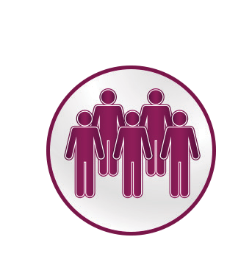
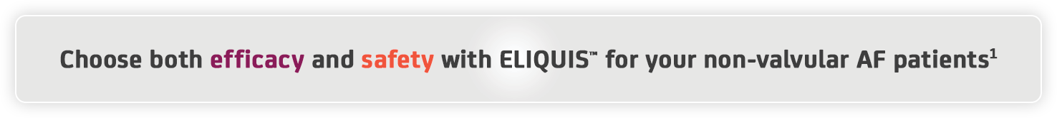
FOR YOURSELF,
WOULD YOU CONSIDER
BOTH EFFICACY AND SAFETY?
ELIQUIS® offers a superior stroke protection and a superior major bleeding profile, with the same dose, vs. warfarin^{1-4‡}
ELIQUIS® offers a significantly reduced all-cause mortality vs. warfarin¹⁻⁴*
ELIQUIS® provides stable coverage throughout the day with twice-daily dosing^{10–12}
ELIQUIS® does not significantly increase major gastrointestinal bleeding, while maintaining superior efficacy with the same dose, vs. warfarin¹⁻⁴
Benefits a broad range of
non-valvular AF patients, including those with normal renal function to severe renal impairment^{1,5–9†}
AF = Atrial Fibrillation, CrCl = Creatinine Clearance, NOAC = Non-vitamin K antagonist Oral Anticoagulant
* Pre-specified hierarchical sequential testing was performed first on stroke / systemic embolism (primary efficacy endpoint) for non-inferiority, then for superiority, then on major bleeding, and finally on death from any cause (secondary endpoint).¹
† A dose reduction to ELIQUIS™2 .5 mg is recommended for patients with CrCL 15–29 ml/min. ELIQUIS™ is not recommended for patients with CrCl <15 ml/min.¹³
‡ No head to head trials were conducted between the NOACs.
References: 1. Granger CB et al. N Engl J Med 2011; 365: 981–992. 2. Patel MR et al. N Engl J Med 2011; 365: 883–891. 3. Giugliano RP et al. N Engl Med 2013; 369: 2093–2104. 4. Connolly SJ et al. N Engl Med 2009; 361: 1139–1151. 5. Hohnloser SH et al. Eur Heart J
2012; 33: 2821–2830. 6. Halvorsen S et al. Eur Heart J 2014; 35: 1864–1872. 7. Garcia DA et al. Am Heart J 2013; 166; 549–558. 8. Lopes RD et al. Lancet 2012; 380: 1749–1758. 9. Easton JD et al. Lancet Neurol 2012; 11: 503–511. 10. Frost C et al. Br J Clin Pharmacol
2013; 76: 776–786. 11. Lassen MR et al. J Thromb Haemost 2007; 5: 2368–2375. 12. Leil TA et al. Clin Pharmacol Ther 2010; 88: 375–382. 13. ELIQUIS™ (apixaban) 2.5 mg and 5 mg LPD NEAR, January 2020, version 7.

Slide 34

ELIQUIS ® benefits different non-valvular AF patient groups, with clear dose-reduction criteria^{1–4}
Dosing recommendations for NOACs in non-valvular AF patients
 | Renal clearance | Level of renal impairment (across all categories) |  |  |  |  | Age | Weight
 |  | Normal (CrCl >90 ml/min) | Mild (CrCl 51–80 ml/min) | Moderate (CrCl 30–50 ml/min) | Severe (CrCl 15–29 ml/min) | Renal failure / dialysis (CrCl <15 ml/min)
Factor Xa inhibitors
ELIQUIS^{™1} (Recommended dose 5 mg BID) | 27% | NO DOSE ADJUSTMENT unless patients meet two or more of the ABC dose reduction criteria* |  |  | LOW DOSE (2.5 mg BID) | Not recommended | NO DOSE ADJUSTMENT unless patients meet two or more of the ABC dose reduction criteria*
rivaroxaban² (Recommended dose 20 mg QD) | 33% | NO DOSE ADJUSTMENT |  | LOW DOSE (15 mg QD)† |  | Not recommended | NO DOSE ADJUSTMENT
edoxaban³ (Recommended dose 60 mug QD) | 50% | CAREFUL EVALUATION REQUIRED‡ | NO DOSE ADJUSTMENT§ | LOW DOSE (30 mg QD)§ |  | Not recommended | NO DOSE ADJUSTMENT | LOW DOSE (30 mg QD for patients ≤60 kg)
Direct thrombin inhibitor
dabigatran⁴ (Recommended dose 150 mg BID) | 85% | NO DOSE ADJUSTMENT# |  | Consider using 110mg BID if high bleed risk# | Contraindicated |  | NO DOSE ADJUSTMENT#
Adapted from respective Summaries of Product Characteristics.^{1–4}
Renal function tends to decline over time;⁵ ELIQUIS® provides a solution for reducing the risk of stroke or systemic embolism in non-valvular AF patients with normal renal function to moderate-severe renal impairment, with few dose adjustments¹*
AF = Atrial Fibrillation, BID = Twice Daily, CrCl = Creatinine Clearance, mITT = modified Intent To Treat, NOAC = Non-vitamin K Antagonist Oral Anticoagulant, QD = Once Daily
* Dose reduction to ELIQUIS® 2.5 mg BD is recommended in non-valvular AF patients who meet two or more of the following criteria: ≥80 years, body weight ≤60 kg, or serum creatinine ≥1.5 mg/dl (133 μmol/l).¹ Patients with the exclusive criteria of severe renal impairment (CrCl 15–29ml/min) should also receive a lower dose of 2.5 mg BD.¹
† Rivaroxaban should be used with caution in patients with severe renal impairment (CrCl 15–29ml/min).²
‡ Edoxaban should only be used in non-valvular AF patients with high CrCl after a careful evaluation of the individual thromboembolic and bleeding risk, due to an increased trend observed towards decreasing efficacy with increased CrCl vs. well-managed warfarin. In ENGAGE AF-TIMI, there was a statistically significant interaction between the effect of edoxaban versus warfarin on the main study outcome (stroke / systemic embolism) and renal function (p-value 0.0042; mITT, overall study period).³
§ The lower dose of edoxaban 30 mg QD is recommended in non-valvular AF patients with one or more of the following clinical factors: moderate or severe renal impairment (CrCl 15–50 ml/min); low body weight ≤60 kg; concomitant use of the following P-glycoprotein (P-gp) inhibitors: ciclosporin, dronedarone, erythromycin, or ketoconazole.³
# For the following groups, the recommended daily dose of dabigatran is 220 mg taken as one 110 mg capsule twice daily: patients aged 80 years or above; patients who receive concomitant verapamil. For the following groups, the daily dose of dabigatran of 300 mg or 220 mg should be selected based on an individual assessment of the thromboembolic risk and the risk of bleeding: patients between 75–80 years; patients with moderate renal impairment; patients with gastritis, esophagitis or gastroesophageal reflux; other patients at increased risk of bleeding. Close clinical surveillance is recommended in patients with renal impairment and weight less than 50 kg.⁴
References: 1. ELIQUIS™ (apixaban) 2.5 mg and 5 mg NEAR, January 2020, version 7. 2. Rivaroxaban Summary of Product Characteristics. 17 January 2020. Available at: www.ema.europa.eu/en. Last accessed April 2022. 3. Edoxaban Summary of Product Characteristics. 23 April 2022. Available at: www.ema.europa.eu/en. Last accessed April 2022. 4. Dabigatran Summary of Product Characteristics. 26 June 2020. Available at: www.ema.europa.eu/en. Last accessed April 2022. 5. Fanikos J et al. Am J Med 2017; 130: 1015–1023.

Slide 35
Prescribing ELIQUIS ® in patients with common concomitant therapies
No dose adjustment is required when co-administered with the following agents that are not strong inhibitors of both CYP3A4 and P-gp:¹
Interactions with other medicinal products affecting haemostasis¹
Platelet aggregation The concomitant use of ELIQUIS®
inhibitors and NSAIDs: with antiplatelet agents increases
– ASA the risk of bleeding
^{– NSAIDs} Care is to be taken if patients are treated
^{– Clopidogrel} concomitantly with NSAIDs, including ASA
Anticoagulants: Concomitant treatment with ELIQUIS ®
– Heparins§ and any other anticoagulant agent
– Oral anticoagulants# is contraindicated, except under the
circumstances of:
– Switching therapy to or from ELIQUIS ®
– When unfractionated heparin is given at doses necessary to maintain a open central venous or arterial catheter, or when given during catheter ablation for AF
Amiodarone Clarithromycin
Diltiazem Naproxen
Quinidine Verapamil
Co-administration is not recommended with strong inhibitors* of both CYP3A4 and P-gp:¹
Azole antimycotics (e.g. ketoconazole) HIV protease inhibitors (e.g. ritonavir)
For the prevention of VTE in elective hip or knee replacement surgery, for the prevention of stroke/systemic embolism in non- valvular AF patients, and for the prevention of recurrent DVT/PE, ELIQUIS® should be used with caution when co-administered with strong inducers† of both CYP3A4 and P-gp:^{1‡}
Carbamazepine Phenobarbital
Phenytoin St. John’s wort Rifampicin
For the treatment of DVT/PE, ELIQUIS® should not be
co-administered with strong inducers of both CYP3A4 and P-gp as efficacy may be compromised¹
Please refer to the ELIQUIS ® NEAR LPD Prescribing Information for full information.¹
AF = Atrial Fibrillation, ASA = Acetylsalicylic Acid, CYP3A4 = Cytochrome P450 3A4, DVT = Deep Vein Thrombosis, HIV = Human Immunodeficiency Virus, NSAID = Non-Steroidal Anti-Inflammatory Drug, PE = Pulmonary Embolism, P-gp = P-glycoprotein, VTE = Venous Thromboembolism
* Strong inhibitors may increase ELIQUIS ® exposure.
† Strong inducers may reduce ELIQUIS™ exposure.
‡ In patients who have undergone elective hip or knee replacement surgery.
§ e.g. unfractionated heparin, low molecular weight heparins, heparin derivatives.
# e.g. warfarin, rivaroxaban, dabigatran, edoxaban.
Reference: 1. ELIQUIS™ (apixaban) 2.5 mg and 5 mg LPD NEAR, January 2020, version 7.

Slide 36
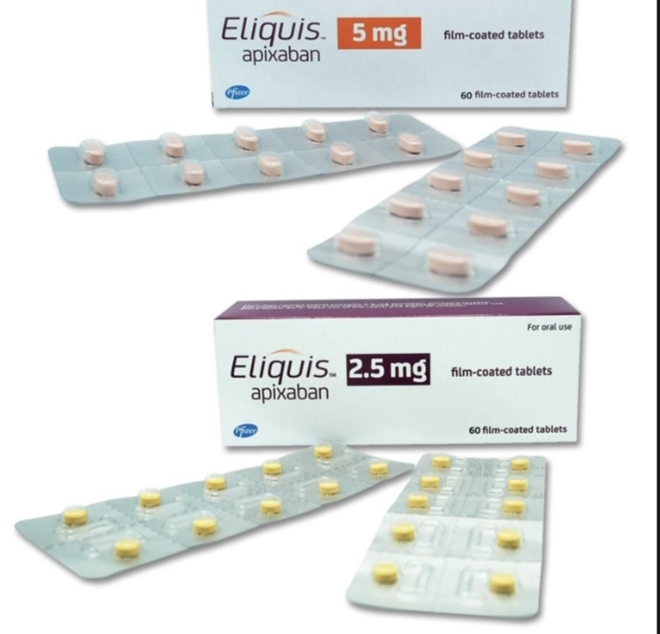

Slide 37
THANK YOU
08031146327

Slide 38
“I’m concerned patients will not comply as well with BD dosing compared to OD dosing, as with rivaroxaban.”
Patients with NVAF frequently have multiple
co-morbidities and take other BD medications; for those patients, the BD dosing regimen of Eliquis®
may not be an additional burden. Although rivaroxaban offers OD dosing, it must be taken once daily with food. Eliquis® does not have food restrictions and can be taken with or without food.
Eliquis® given BD demonstrated superior stroke/systemic embolism prevention vs. warfarin, a superior safety profile in reducing major bleeding vs. warfarin, and a superior reduction in all-cause mortality vs. Warfarin.

Slide 39
Apixaban is eliminated from the body via multiple routes
Only ~27% of apixaban is eliminated by the kidneys
Biliary elimination
Liver metabolism
Direct intestinal excretion
Renal elimination (27%)
Unchanged apixaban is the major drug-related component in human plasma
with no active circulating metabolites present
Apixaban SmPC 2012.
Notes:
References
Apixaban, SmPC 2012.

Slide 40
Drug–drug interactions for apixaban
Medication | Effect on CYP3A4 | Effect on P-gp | Impact on apixaban C_{max} | Impact on apixaban AUC
Rifampicin | Strong inducer | Strong inducer | 42% | 54%
Ketoconazole | Strong inhibitor | Strong inhibitor | 1.6-fold | 2-fold
Diltiazem | Moderate inhibitor | Weak inhibitor | 1.3-fold | 1.4-fold
Naproxen | No effect | Inhibitor | 1.6-fold | 1.5-fold
Atenolol | No effect | No effect | 18% | 15%
Famotidine | No effect | No effect | No effect | No effect
See SmPC for full list of drug interactions
Apixaban SmPC 2012.
Notes:
40
References
Apixaban, SmPC, 2012.

Slide 41
ARISTOTLE: Apixaban significantly reduced the rate of bleeding irrespective of the bleeding definition used
Outcome | Apixaban (N=9,088) Event Rate (%/yr) | Warfarin (N=9,052) Event Rate (%/yr) | HR (95% CI) | P value
Primary safety outcome: ISTH major bleeding | 2.13 | 3.09 | 0.69 (0.60, 0.80) | <0.001
Intracranial | 0.33 | 0.80 | 0.42 (0.30, 0.58) | <0.001
Other location | 1.79 | 2.27 | 0.79 (0.68, 0.93) | 0.004
Gastrointestinal | 0.76 | 0.86 | 0.89 (0.70, 1.15) | 0.37
Major or clinically relevant non-major bleeding | 4.07 | 6.01 | 0.68 (0.61, 0.75) | <0.001
GUSTO severe bleeding | 0.52 | 1.13 | 0.46 (0.35, 0.60) | <0.001
TIMI major bleeding | 0.96 | 1.69 | 0.57 (0.46, 0.70) | <0.001
Any bleeding | 18.1 | 25.8 | 0.71 (0.68, 0.75) | <0.001
Adapted from Granger et al. N Engl J Med 2011;365:981-92.
Notes:
The rate of bleeding was significantly reduced in the apixaban group irrespective of the bleeding definition used.
Clinically relevant non-major bleeding was defined as clinically overt bleeding that did not satisfy the criteria for major bleeding and that led to hospital admission, physician-guided medical or surgical treatment, or a change in antithrombotic therapy.¹
GUSTO severe bleeding: intracranial bleeding or bleeding that causes substantial haemodynamic compromise requiring treatment.²
TIMI major bleeding: (1) intracranial bleeding, or (2) clinically significant overt signs of haemorrhage associated with a drop in haemoglobin of >5 g/dL (or, when haemoglobin is not available, an absolute drop in haematocrit of >15%).³
Abbreviations
CI: Confidence interval
GUSTO: Global Use of Strategies to Open Occluded Coronary Arteries
HR: Hazard ratio
ISTH: International Society of Thrombosis and Haemostasis
TIMI: Thrombolysis In Myocardial Infarction
References
1. Granger CB et al; ARISTOTLE Committees and Investigators. Apixaban versus warfarin in patients with atrial fibrillation. N Engl J Med 2011;365:981-92.
2. An international randomized trial comparing four thrombolytic strategies for acute myocardial infarction. The GUSTO investigators. N Engl J Med 1993;329:673-82.
3. http://www.timi.org/wp-content/uploads/2010/10/TIMI-Definitions.pdf. Accessed on 02/10/2012.

Slide 42
Apixaban is the only oral anticoagulant to demonstrate superiority vs. warfarin in all of the following 3 outcomes
Superior
profile in reducing
major bleeding
Superior
reduction in
all-cause mortality
Superior
stroke/systemic embolism
prevention
21% RRR
p=0.01
31% RRR
p<0.001
11% RRR
p=0.047
3.94%
669/9081
3.52%
603/9120
3.09%
462/9052
Event rate (% / year)
2.13%
327/9088
1.60%
265/9081
1.27%
212/9120
Primary efficacy endpoint
Primary safety endpoint
Key secondary endpoint
Median duration of follow-up 1.8 years
Apixaban
Warfarin (target INR 2.0-3.0)
Figure created from data in Granger et al. N Engl J Med 2011;365:981-92.
Notes:
Apixaban was superior to warfarin in reducing the rates of the three key outcomes of the ARISTOTLE study, i.e. stroke or systemic embolism, major bleeding and death from any cause.
Abbreviations
RRR: Relative risk reduction.
References
Granger CB et al; ARISTOTLE Committees and Investigators. Apixaban versus warfarin in patients with atrial fibrillation. N Engl J Med 2011;365:981-92.

Slide 43
  For every 1000 AF patients treated for 1.8 years, apixaban, as compared with warfarin, prevented:
6
strokes
15
major bleeds
8
deaths
Granger et al. N Engl J Med 2011;365:981-92.
Notes:
Abbreviations
AF: Atrial fibrillation.
References
Granger CB et al; ARISTOTLE Committees and Investigators. Apixaban versus warfarin in patients with atrial fibrillation. N Engl J Med 2011;365:981-92.

Slide 44

Eliquis ® abbreviated prescribing information
PRESENTATION: Each film-coated tablet contains either 2,5 mg or 5 mg apixaban.
INDICATION(s): 1. Prevention of venous thromboembolic events (VTE): elective hip or knee replacement surgery: Prevention of VTE in adult patients who have undergone elective hip or knee replacement surgery. 2. Prevention of stroke and systemic embolism: nonvalvular atrial fibrillation (NVAF) Eliquis is indicated to reduce the risk of stroke, systemic embolism, and death in patients with nonvalvular atrial fibrillation with one or more risk factors, including patients unsuitable for warfarin. Compared to warfarin, Eliquis also results in less bleeding, including intracranial hemorrhage. 3. Treatment of VTE Eliquis is indicated for: i. treatment of deep vein thrombosis (DVT) and pulmonary embolism (PE) ii. prevention of recurrent DVT and PE.
DOSAGE AND ADMINISTRATION: Eliquis can be taken with or without food. If a dose is missed, the patient should take Eliquis immediately and then continue with twice daily administration as before.
Recommended dosage: Prevention of VTE: elective hip or knee replacement surgery: the recommended dose of Eliquis is 2.5 mg taken orally twice daily. The initial dose should be taken 12 to 24 hours after surgery. In patients undergoing hip replacement surgery, the recommended duration of treatment is 32 to 38 days. In patients undergoing knee replacement surgery, the recommended duration of treatment is 10 to 14 days. Prevention of stroke and systemic embolism: NVAF: The recommended dose of Eliquis is 5 mg taken orally twice daily. Age, body weight, serum creatinine: In patients with at least 2 of the following characteristics, age ≥80 years, body weight ≤60 kg, or serum creatinine ≥1.5 mg/dL (133 micromole/L), the recommended dose of Eliquis is 2.5 mg twice daily. Treatment of DVT and PE: The recommended dose of Eliquis is 10 mg taken orally twice daily for 7 days, followed by 5 mg taken orally twice daily. Prevention of recurrent DVT and PE: The recommended dose of Eliquis is 2.5 mg taken orally twice daily after at least 6 months of treatment for DVT or PE. Renal impairment: Prevention of VTE: elective hip or knee replacement surgery and Treatment of VTE: no dose adjustment in patients with renal clearance above 15ml/min., not recommended for patients with renal clearance below 15ml/min or undergoing dialysis. Prevention of stroke and systemic embolism: NVAF: No dose adjustment is recommended in patients with creatinine clearance 15 to 29 mL/min, except as described in dosage above. Dosing recommendation cannot be provided for patients with renal clearance below 15mL/min. Not recommended for patients undergoing dialysis. Hepatic impairment: ELIQUIS is not recommended in patients with severe hepatic impairment. ELIQUIS may be used with caution in patients with mild or moderate hepatic impairment (Child Pugh A or B). Body weight: No dose adjustment required, for Prevention of stroke and systemic embolism: NVAF, see under dosage.
Gender: no dose adjustment. Children: safety and efficacy not studied for children below 18 years. Elderly: No dose adjustment required; for Prevention of stroke and systemic embolism: NVAF, see under dosage. Surgery and invasive procedures: Eliquis should be discontinued at least 48 hours prior to elective surgery or invasive procedures with a moderate or high risk of unacceptable or clinically significant bleeding, at least 24 hours prior to elective surgery or invasive procedures with a low risk of bleeding or where the bleeding would be non-critical in location and easily controlled.
CONTRAINDICATIONS: Hypersensitivity to the active substance or to any of the excipients. Clinically significant active bleeding.
WARNING AND PRECAUTIONS: Haemorrhagic risk: patients using ELIQUIS are to be carefully observed for signs of bleeding. ELIQUIS is recommended to be used with caution in conditions with increased risk of haemorrhage, such as: congenital or acquired bleeding disorders; active ulcerative gastrointestinal disease; bacterial endocarditis; thrombocytopenia; platelet disorders; history of haemorrhagic stroke; severe uncontrolled hypertension; and recent brain, spinal, or ophthalmological surgery. ELIQUIS administration should be discontinued if severe haemorrhage occurs; investigate and treat the bleeding. Temporary discontinuation of Eliquis: Discontinuing anticoagulants, including Eliquis, for active bleeding, elective surgery, or invasive procedures places patients at an increased risk of thrombosis. If discontinuation is necessary, restart ELIQUIS as soon as possible.
INTERACTIONS: Use ELIQUIS with caution when co-administering with strong inducers of both CYP3A4 and P-gp, antiplatelet agents or during spinal/epidural anaesthesia or puncture.
PREGNANCY AND LACTATION: Safety and efficacy has not been established and ELIQUIS is not recommended. Patients with prosthetic heart valves: ELIQUIS is not recommended. LABORATORY PARAMETERS: Clotting tests are affected as expected by the mechanism of action of apixaban. Changes observed in these clotting tests at the expected therapeutic dose are small and subject to a high degree of variability.
OVERDOSING: There is no antidote to Eliquis. Overdose of Eliquis may result in a higher risk of bleeding. Activated charcoal may be helpful in managing an overdose. Dialysis is unlikely to be effective in managing overdose of ELIQUIS.
ADVERSE REACTION: Clinical experience: Prevention of VTE: elective hip or knee replacement surgery: Common adverse reactions were anaemia, haemorrhage, contusion, and nausea. The use of ELIQUIS may be associated with an increased risk of occult or overt bleeding from any tissue or organ. Most common treatment-emergent adverse reactions in post-surgery orthopaedic patients: Blood and lymphatic system disorders: Anaemia (including postoperative and haemorrhagic anaemia, and respective laboratory parameters). Vascular disorders: Haemorrhage (including haematoma, and vaginal and urethral haemorrhage). Gastrointestinal disorders: Nausea. Injury, poisoning and procedural complications: Contusion. Most Common treatment-emergent adverse reactions in NVAF patients: Eye disorders: Eye haemorrhage (including conjunctival haemorrhage). Vascular disorders: Other haemorrhage, haematoma. Respiratory, thoracic and mediastinal disorders: Epistaxis. Gastrointestinal disorders: Gastrointestinal haemorrhage (including haematemesis and melaena), rectal haemorrhage, gingival bleeding. Renal and urinary disorders: Haematuria. Injury, poisoning and procedural complications: Contusion.
PHARMACEUTICAL PRECAUTIONS: Store below 30°C.
REFERENCE: NEAR, January 2020, version 7.
FULL PRESCRIBING INFORMATION IS AVAILABLE UPON REQUEST
Pfizer Specialties Ltd.
Heritage Place 7th Floor, 21 Lugard Avenue, Ikoyi,
Lagos, Nigeria.
Telephone: 234-1-270 3921-3, 774 5304.
PP-ELI-NGA-0011

Slide 45
ARISTOTLE: Conclusion
  In patients with AF and at least one additional risk factor for stroke,
  the use of apixaban, as compared with warfarin, significantly
  reduced the risk of:
    Stroke or systemic embolism by 21% (p=0.01)
    Major bleeding by 31% (p<0.001)
    Death by 11% (p=0.047)
  The results were consistent in subgroups according to geographic region, status with respect to previous warfarin exposure, age, sex, and risk factors
  for stroke, as well as in other predefined subgroups
  Apixaban had an acceptable side-effect profile and a lower rate of study drug discontinuation than in the warfarin group
Granger et al. N Engl J Med 2011;365:981-92.
Notes:
Abbreviations
AF: Atrial fibrillation.
References
Granger CB et al; ARISTOTLE Committees and Investigators. Apixaban versus warfarin in patients with atrial fibrillation. N Engl J Med 2011;365:981-92.

Slide 46
Therapeutic indication of apixaban in AF patients
Prevention of stroke and systemic embolism in adult patients with non-valvular atrial fibrillation (NVAF), with one or more risk factors, such as
Prior stroke or transient ischaemic attack (TIA);
Age≥ 75 years;
Hypertension;
Diabetes mellitus;
Symptomatic heart failure (NYHA Class ≥ II)
Apixaban SmPC 2012.
Notes:
Abbreviations
NVAF: Non-valvular atrial fibrillation
NYHA: New York Heart Association
TIA: Transient ischaemic attack
References
Apixaban, SmPC 2012.

