Slide 1

General principles of the Ethics of Medical and Dental Practices in Nigeria
Dr Amatare Dinyain

Slide 2

CONTENTS
Introduction
Importance of Medical Ethics
Principles of Medical Ethics
Ethical Codes
Public Health Ethics
Research Ethics
Case Studies
References

Slide 3

Introduction
Ethics is concerned with moral principles, values and standards of conduct.(WHO)
Ethics is the study of morality – careful
and systematic reflection on and analysis of moral decisions and behaviour. #
Morality is the value dimension of human decision-making and behaviour.
# - World Medical Association Manual of Medical Ethics

Slide 4
Introduction
The Greek word ethike means habit, action, character.
The Latin word mos (morals) means habit or custom.
In simple words, Ethics is a set of philosophical beliefs and practices concerned with the distinction between right and wrong.

Slide 5
Introduction
Ethics is a very large and complex field of study with many branches or subdivisions.
Medical Ethics is the branch of ethics that deals with moral issues in medical practice.
Medical ethics is closely related, but not identical to, bioethics (biomedical ethics)

Slide 6
Introduction
Whereas medical ethics focuses primarily on issues arising out of the practice of medicine, bioethics is a very broad subject that is concerned with the moral issues raised by developments in the biological sciences more generally.

Slide 7

Introduction
Medical Etiquettes:
The conventional laws, customs of courtesy and the code of conduct governing the relationship of the physician with his professional colleagues.

Slide 8
Introduction
In recent times medical ethics has been greatly influenced by developments in human rights.
Physicians frequently have to deal with medical problems resulting from violations of human rights, such as forced migration and torture.

Slide 9
Introduction
Medical ethics is also closely related to law.
Quite often ethics prescribes higher standards of behaviour than does the law, and occasionally ethics requires that physicians disobey laws that demand unethical behaviour.

Slide 10

Importance of Medical Ethics
Ethical principles such as respect for persons, informed consent and confidentiality are basic to the physician-patient relationship.
Application of these principles in specific situations is often problematic , since physicians, patients, their family members and other healthcare personnel may disagree about what is the right way to act in a situation.

Slide 11
Importance of Medical Ethics
The study of ethics prepares medical professionals to recognize difficult situations and to deal with them in a rational and principled manner.
Ethics is also important in physicians’ interactions with society and their colleagues and for the conduct of medical research.

Slide 12
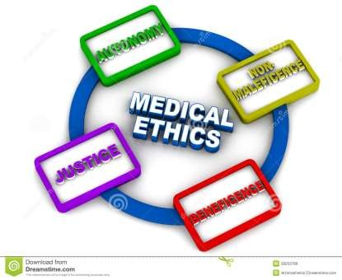
Principles of Medical Ethics
Autonomy
Beneficence
Confidentiality
Do no harm/ Non-maleficence
Equity or Justice

Slide 13

Principles of Medical Ethics
Autonomy
Patient has freedom of thought, intention and action when making decisions regarding health care procedures.
For a patient to make a fully informed decision, she/he must understand all risks and benefits of the procedure and the likelihood of success.

Slide 14
Principles of Medical Ethics
Autonomy
This includes the need to tell the truth (veracity) and to be faithful to one’s commitments (fidelity).

Slide 15
Principles of Medical Ethics
Beneficence
The practitioner should act in “the best interest” of the patient - the procedure be provided with the intent of doing good to the patient.
Patient’s welfare is the first consideration.

Slide 16
Principles of Medical Ethics
Confidentiality
Based on loyalty and trust.
Maintain the confidentiality of all personal, medical and treatment information.
Information to be revealed for the benefit of the patient and when ethically and legally required.

Slide 17

Principles of Medical Ethics
Do no harm/ Non-maleficence
“Above all, do no harm”
Make sure that the procedure does not harm the patient or others in society.

Slide 18
Principles of Medical Ethics
When interventions undertaken by physicians create a positive outcome while also potentially doing harm it is known as the "double effect."
Eg,. the use of morphine in the dying patient. eases pain and suffering while hastening the demise through suppression of the respiratory drive.

Slide 19
Principles of Medical Ethics
Equity or Justice
Fair and equal distribution of scarce health resources, and the decision of who gets what treatment.
The burdens and benefits of new or experimental treatments must be distributed equally among all groups in society.

Slide 20
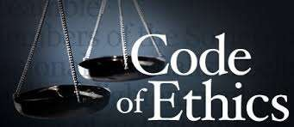
Ethical Codes
Hippocratic Oath – 5th century BC
Nuremberg Code -1948
Declaration of Geneva - 1948
Universal Declaration of Human Rights-1948
Helsinki Declaration -1964
International Code of Medical ethics
Indian Medical Council (Professional Conduct, Etiquettes and Ethics) Regulations, 2002

Slide 21
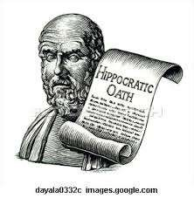
Hippocratic Oath
One of the earliest document in medical ethics – 5th century BC.
Traditionally all doctors recite this oath at swearing in. It is considered sacred for its religious foundation and sanctity.

Slide 22
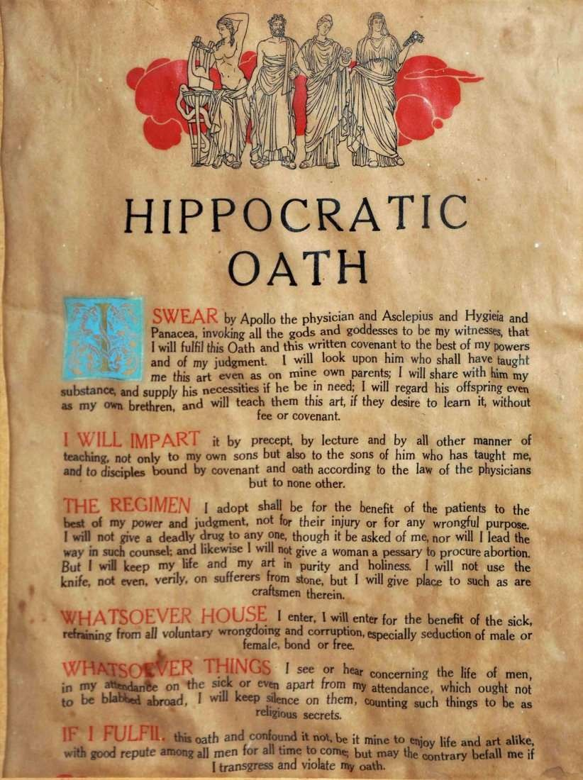

Slide 23
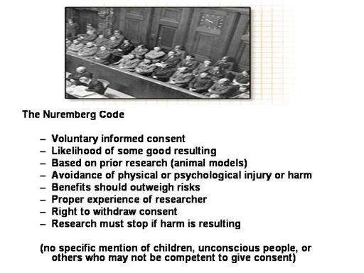
Nuremberg Code - 1948

Slide 24
Declaration of Geneva
Adopted at World Medical Association General Assembly in 1948.
Amended in 1968, 1984, 1994, 2005 and
2006.
Declaration of physicians’ dedication to the humanitarian goals of medicine.

Slide 25
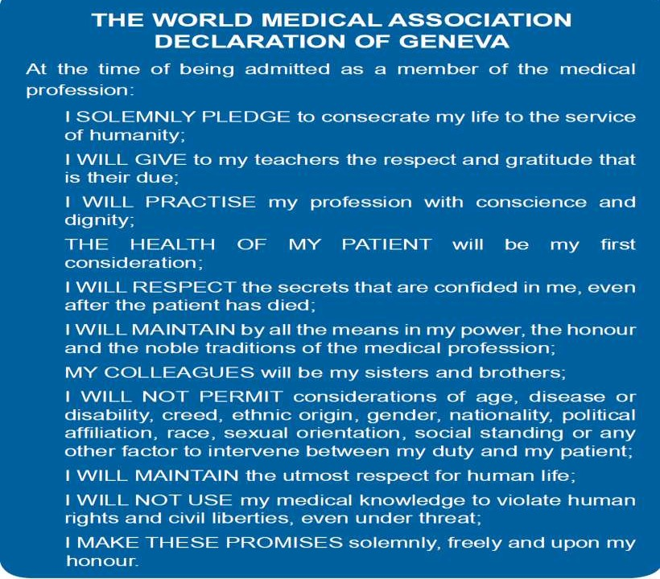

Slide 26
Helsinki Declaration
Set of ethical principles regarding human experimentation developed by the World Medical Association in 1964.
Undergone 6 revisions since then. Last revision in 2008.
More specifically addressed clinical research, reflecting changes in medical practice from the term 'Human Experimentation' used in the Nuremberg Code.

Slide 27
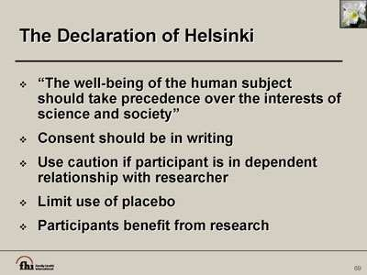

Slide 28
International Code of Medical Ethics -2006
Given by World Medical Association
The code applies both in peace and war.
It codifies the duties of physician in general, duties to patients and colleagues.

Slide 29
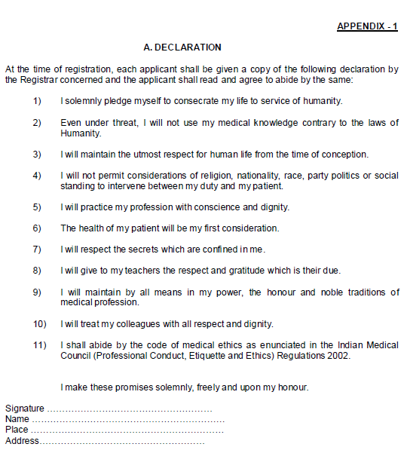
Declaration-
Each applicant, at the time of making an application for registration under the provisions of the Act, shall be provided a copy of the declaration and shall submit a duly signed Declaration.

Slide 30
Duties and responsibilities of physician in general
Character of Physician
  Uphold dignity and honour of his profession.
  Render service to humanity.
  Person with recognized qualification can only practice modern system of medicine.
Maintaining good medical practice.
  Render service to humanity with full respect for the dignity of profession and man.

Slide 31
Duties and responsibilities of physician in general
Maintenance of Medical records
  Maintain the medical records pertaining to his / her indoor patients for a period of 3 years.
  Records to be given within 72 hrs (if requested by patients/legal authorities).
  Maintain a Register of Medical Certificates giving full details of certificates issued.
Display of registration numbers.
Use of Generic names of drugs.

Slide 32
Duties and responsibilities of physician in general
Highest Quality Assurance in patient care
Exposure of Unethical Conduct
Payment of Professional Services
  Personal financial interests of a physician should not conflict with the medical interests of patients.
Evasion of Legal Restrictions
  Physician shall observe the laws of the country in regulating the practice of medicine.

Slide 33
Duties of Physician to their patients
Obligations to the sick
  Always respond to the calls of the sick.
  Ailment not within range of experience he can refuse treatment and refer.
Patience, delicacy & secrecy
  Patience and delicacy should characterize the physician.
  Secrecy of patients to be maintained except when required by laws of the state and to protect healthy individuals.

Slide 34
Duties of Physician to their patients
Prognosis
  Neither exaggerate or minimize gravity of patient’s condition
Do not neglect the patient
  Physician free to choose.
  Once undertaken should not neglect the case.
  Respond to request in emergency.

Slide 35
Duties Of Physician in consultation
Avoid un-necessary consultation
  Consulting pathologist, radiologist or asking for lab investigation should be done judiciously .
Consultation for patient benefit.
Punctuality in consultation.
Statement to patient after consultation.
Treatment after consultation.
Patient referred to specialist.
Fees and other charges.

Slide 36
Responsibilities To Each Other
Dependence of Physicians on each other
  Should consider it as a pleasure and privilege to render gratuitous service to all physicians and their immediate family dependants.
Conduct in consultation
  Respect should be observed towards the physician in-
charge of the case and no statement or remark be made.

Slide 37
Responsibilities To Each Other
Consultant not to take the charge of the case.
Appointment of the substitute
  only when he has the capacity to discharge the additional responsibility along with his / her other duties
Visiting another Physician's case-
  Avoid remarks upon the diagnosis or the treatment that
has been adopted.

Slide 38
Duties Of Physician To Public And Paramedical Staff
Physicians as citizens
  Should particularly co-operate with the authorities in the administration of sanitary/public health laws and regulations.
Public and community health
  Should enlighten the public concerning quarantine regulations and measures for the prevention of epidemic and communicable diseases.
Pharmacists/nurses
  Should promote and recognize their services and seek their cooperation.

Slide 39
Unethical Acts
• Printing of self photograph, or any
such material of publicity in the letter head or on sign board of the consulting room or any such clinical establishment shall be regarded as acts of self advertisement and unethical conduct on the part of the physician
• Not endorse any items
Advertising
Patent and Copy rights
Running an open shop and Appliances by Ph
Formal announcement in press
(1) On starting practice.
(2) On change of type of practice.
(3) On changing address.
(4) On temporary absence from duty.
(5) On resumption of another practice.
(6) On succeeding to another practice.
(7) Public declaration of charges
:
(Dispensing of Drugs ysicians)
on
• May patent the items, methods &
procedures
• But it shall be unethical if benefits are not made available in interest of society
• A physician shall not give, or receive,
any gift, gratuity, commission or bonus in consideration of or return for the referring, recommending or procuring of any patient for medical, surgical or other treatment
Should not prescribe or dispense secret
remedial agents of which he does not know (composition, manufacture, use, etc.
Rebates and Commissi •
Should not assist nor be a party to
either infliction of mental or physical trauma or concealment of torture by other person
Practicing euthanasia shall constitute
Secret Remedies
Human Rights
Euthanasia
unethical conduct.
However on specific occasion, the question of withdrawing supporting devices to sustain cardio-pulmonary function even after brain death, shall be decided only by a team of doctors and not merely by the treating physician alone

Slide 40

Misconduct
Violation of regulations
Adultery or improper conduct
Conviction in court of law
Sex determination test
Signing false professional certificates, reports & other documents
Any registered practitioner who is shown to have signed or given under his name and authority any certificate, notification, report or document which is untrue, misleading or improper, is liable to have his name deleted from the Register

Slide 41

Punishment & Disciplinary Action
Complaint is first heard by appropriate medical council .
During the enquiry the full opportunity is given to registered medical practitioner to be heard in person or by pleader.
The decision has to be taken within 6 months.
Appropriate medical council gives decision according to the case.
During the pendency of the complaint the appropriate council may restrain the physician from performing the procedure or practice which is under scrutiny.

Slide 42
Punishment & Disciplinary Action
Complaints heard by Medical & Dental Practitioners’ Investigative Panel (MDPIP) and the Medical & Dental Practitioners’ Disciplinary Tribunal (MDPDT)

Slide 43
Punishment & Disciplinary Action
The punishment given by the appropriate medical council or its Organs:
  Warning
  Reprimand – official action
  Cancellation of registration
    Temporary – for specific period of time.
    Permanent

Slide 44
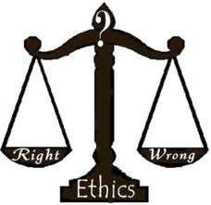
Public health ethics
Key issues in public health ethics
Disparities in health status, access to health care and to the benefits of medical research
Responding to the threat of infectious diseases
International cooperation in health monitoring and surveillance

Slide 45
Public health ethics
Key issues in public health ethics
Participation, transparency, and accountability
Exploitation of individuals in low-income countries
Health Promotion

Slide 46
Public Health Ethics
General Moral Considerations
Providing Benefits.
Avoiding, preventing, and removing harms.
Producing maximal balance of benefits over harms and other costs.
Distributing benefits and burdens fairly ( Distributive Justice) and ensuring public participation.

Slide 47
Public Health Ethics
Respecting autonomous choices and actions, including liberty of action.
Protecting privacy and confidentiality.
Keeping promises and commitments.
Disclosing information as well as speaking honestly and truthfully.
Building and maintaining trust.

Slide 48
Ethical principles in public health
Harm Principle
Principle of least restrictive means
Reciprocatory Principle
Transparency Principle

Slide 49
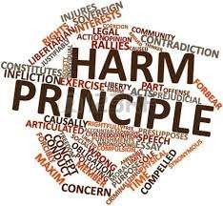
Harm Principle
“The only purpose for which power can be rightfully exercised over any member of a civilized community ,against his/her will, is to prevent harm to others. His/her own good, either physical or moral, is not a sufficient warrant”

Slide 50
Least Restrictive Means
A variety of means exist to achieve public health ends.
Education, facilitation and discussion should precede coercive methods.
More coercive methods should be employed only when less coercive methods have failed.
This principle has been enshrined in the Siracusa principles, a set of internationally agreed upon legal principles that establish the justified conditions for the restriction of civil liberty.

Slide 51
Reciprocatory Principle
Complying with public health requests may impose burdens on individuals – need to compensate.
Society must be prepared to facilitate individuals and communities in their efforts to discharge their duties.

Slide 52
Transparency Principle
Manner and the context in which decisions are made.
All legitimate stakeholders should be involved in the decision making process, have equal input into deliberations.
Decision making manner- clear and accountable.

Slide 53

Research ethics
Principles in Ethical Research
Social Value –
The study should help researchers determine how to improve people’s health or well-being.
Scientific Validity –
The research should be expected to produce useful results and increase knowledge .
Good research is reproducible and has minimum bias.

Slide 54
Research ethics
Fair Subject Selection
Favorable risk-Benefit ratio-
Any risks must be balanced by the benefits to subjects, and/or the important new knowledge society will gain.
Independent review –
A group of people who are not connected to the research are required to give it an independent review.

Slide 55
Research ethics
Informed consent –
  Subject must be competent.
  The researcher must give a full disclosure.
  Subjects must understand what the researcher tells them.
  The subject’s decision to participate must be voluntary.
Respect for enrolled Subject

Slide 56
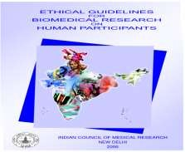
ICMR guidelines -2006
The statement of Ethical Guidelines for Biomedical Research on Human Participants shall be known as the ICMR Code and shall consist of the following:-
(a) Statement of General
Principles on Research using Human Participants in
Biomedical Research
(b) Statement of Specific Principles on Research using Human Participants in specific areas of Biomedical Research

Slide 57
Ethical Guidelines for Biomedical Research
All institutions in the country which carry out any form of biomedical research involving human beings should follow these guidelines in letter and spirit to protect safety and well being of all individuals.
It is mandatory that all proposals on biomedical research involving human subjects should be cleared by an appropriately constituted Institutional Ethics Committee (IEC)

Slide 58
General Principles
Principles of essentiality
Principles of voluntariness, informed consent and community agreement
Principles of non-exploitation
Principles of privacy and confidentiality
Principles of precaution and risk minimisation
Principles of professional competence

Slide 59
General Principles
Principles of accountability and transparency
Principles of the maximisation of the public interest and of distributive justice
Principles of institutional arrangements
Principles of public domain
Principles of totality of responsibility
Principles of compliance

Slide 60
Specific Principles
Clinical Trials of Drugs, Devices, Vaccines, Diagnostic agents, Herbal Drugs
Epidemiological Studies
Human Genetics and Genomic Research
Transplantation Research including Fetal tissue and Xeno- transplantation
Assisted Reproductive Technologies

Slide 61
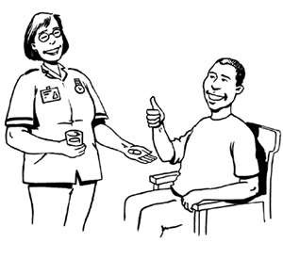
Legally valid Consent
given by person himself if above 12 years of age, conscious and mentally sound (Sec. 88 IPC). Or,
given by parent, guardian or friend if person is < 12 yrs. or is unconscious or is insane (Sec. 89 IPC).
is given freely, voluntarily and directly.
is given without fear, force or fraud.
is a written consent.
non-written consent is formally documented & witnessed by two witnesses.

Slide 62
Institutional Ethics Committee
Basic responsibilities-
Ensure competent review of proposals.
Ensure execution free of bias and influence.
Provide advice to researchers.
Chairperson
1-2 basic medical scientists.
1-2 clinicians from various Institutes
One legal expert or retired judge
One social scientist / representative of non- governmental voluntary agency
One philosopher / ethicist / theologian
One lay person from the community
Member Secretary
Composition-
8-12 members –
multidisciplinary.

Slide 63
Institutional Ethics Committee
➢ Review Process
• Through formal meetings
• Submission of application
• Prescribed format with study protocol
• At least 3 weeks in advance
➢ Decision Making Process
➢ Interim Review
➢ Record Keeping
INSTITUTIONAL ETHICS COMMITTEE, PGIMS ROHTAK
Chairman: Vice chancellor
Pro Vice chancellor
Director
Dean PGIMS
Sh. Ram Mehar (Retd. Engineer)
Dr. Nirmal Gulati (Ex HOD- Gynae)
Medical Supdt. PGIMS
Head of Dept of Law, MDU Rohtak
Dr. Pardeep Khanna (HOD Community Medicine)
Dr. M.C. Gupta (HOD Pharmacology)
Dr. Pradeep Garg (Sr. Professor Surgery)-Member Secretary

Slide 64
Case study I
Commercial Surrogacy and Fertility tourism In India – A case Study By Kenan Institute for Ethics, Duke University,USA
A Japanese couple traveled to India in late 2007 to hire a surrogate mother to bear a child for them. They contacted Dr. Patel in Anand , Gujarat
The doctor arranged a surrogacy contract with
Pritiben Mehta, a married Indian woman with children
Dr. Patel supervised the creation of an embryo from Japanese father’s sperm and an egg harvested from an anonymous Indian woman.

Slide 65
The embryo was then implanted into Mehta’s womb.
In June 2008, the Japanese couple divorced, and a month later Baby Manji was born to the surrogate mother.
Although the Japanese father wanted to raise the child, his ex-wife did not.
Baby Manji had three mothers—the intended mother who had contracted for the surrogacy, the egg donor, and the gestational surrogate—yet legally she had none.

Slide 66
Case study II
Aruna Shanbaug case- Karnataka
In 1973, while working as a junior nurse at King Edward
Memorial Hospital, Mumbai, she was sexually assaulted
by a ward boy
She has been in a vegetative state since the assault
A plea for euthanasia was filed in the Supreme Court by Pinki Virani , a writer and journalist.

Slide 67
Case study II
On 24 January 2011, after she had been in this status
for 37 years, the Supreme Court of India responded to
the plea for euthanasia
The court turned down the mercy killing petition on 7 March 2011
The debate on passive and active euthanasia continues.

Slide 68

References
Manual of Medical Ethics – World Medical Association(2009)
MCI ethical guidelines – 2002.
ICMR guidelines for biomedical research, 2006.
Research Ethics – National Institute of Health , USA.
Issues in Public Health Ethics – ICMR
The contribution of ethics to public health – Bulletin of WHO

Slide 69


