Slide 1
INFORMED CONSENT IN MEDICAL AND DENTAL PRACTICE
Oyintonbra Koroye
MB,BS, FWACS, FICS, FACS, Cert. Surgical Leadership (Harvard)
Consultant General Surgeon, NDUTH Okolobiri
Senior Lecturer in Surgery, NDU Wilberforce Island
30th March, 2023

Slide 2


Slide 3
OUTLINE
Hippocratic oath
Definitions (ethics, autonomy, consent, battery, manslaughter)
Introduction/ historical perspectives
Duty of care to patient
Type of consent
Elements of informed consent
Special considerations (Jehovah’s witnesses, life support, advance directive, DNR, emergencies, disclosure of uncertainty)
Informed consent in organ Transplantation
Informed consent in Research
Sociocultural influences
Improving informed consent

Slide 4
PHYSICIAN’S OATH
AS A MEMBER OF THE MEDICAL PROFESSION:
I SOLEMNLY PLEDGE to dedicate my life to the service of humanity;
THE HEALTH AND WELL-BEING OF MY PATIENT will be my first consideration;
I WILL RESPECT the autonomy and dignity of my patient;
I WILL MAINTAIN the utmost respect for human life;
I WILL NOT PERMIT considerations of age, disease or disability, creed, ethnic origin, gender, nationality, political affiliation, race, sexual orientation, social standing, or any other factor to intervene between my duty and my patient;
I WILL RESPECT the secrets that are confided in me, even after the patient has died;
I WILL PRACTISE my profession with conscience and dignity and in accordance with good medical practice;
I WILL FOSTER the honour and noble traditions of the medical profession;
I WILL GIVE to my teachers, colleagues, and students the respect and gratitude that is their due;
I WILL SHARE my medical knowledge for the benefit of the patient and the advancement of healthcare;
I WILL ATTEND TO my own health, well-being, and abilities in order to provide care of the highest standard;
I WILL NOT USE my medical knowledge to violate human rights and civil liberties, even under threat;
I MAKE THESE PROMISES solemnly, freely, and upon my honour.
©2017 World Medical Association Inc. All Rights Reserved. All intellectual property rights in the Declaration of Geneva are vested in the World Medical Association.

Slide 5

A medico-legal obligation

Slide 6
DEFINITIONS
ETHICS; Moral principles that control or influence a persons behavior
AUTONOMY; The ability to act and make decisions without being controlled by anyone else
CONSENT; To agree to something or give permission for something
CONFIDENTIALITY; A situation in which you expect someone to keep information secret
ASSAULT; The crime of attacking somebody physically
MANSLAUGHTER; The crime of killing somebody illegally but not intentionally
Oxford Learners Dictionary, 7th Edition

Slide 7
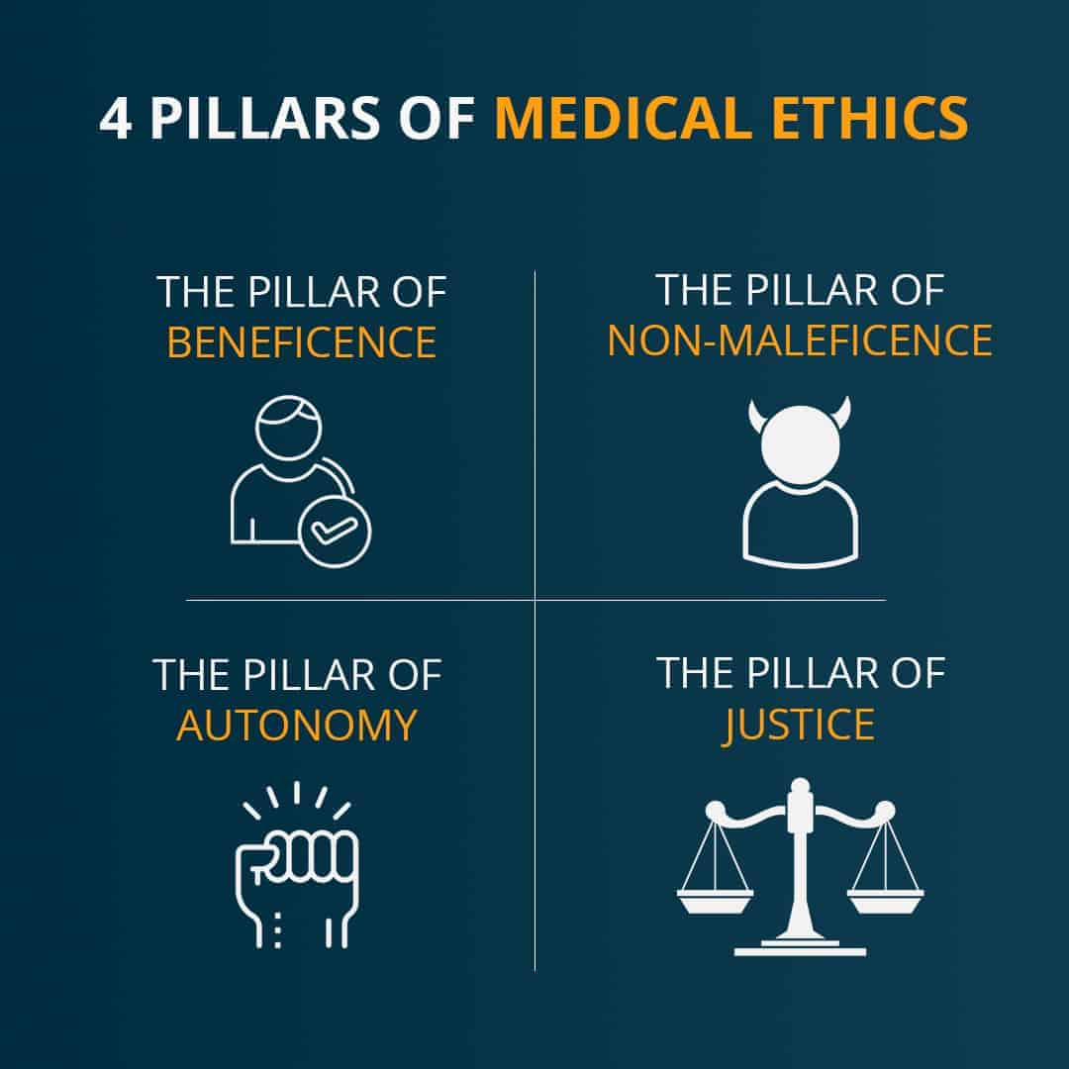
PILLARS OF MEDICAL ETHICS

Slide 8
INTRODUCTION
“Hold harmless document” in Medieval times
Mohr vs Williams in 1905. Did not keep to preop agreement. (Leclerq et al)
Shoendorf vs Society of New York Hospital, 1914. Justice Benjamin Cardozo made a landmark judgement. “Every adult human being of sound mind has a right to determine what will be done with his body, and the surgeon who performs an operation without a patient’s consent commits an assault for which he is liable in damages.”
Martin Salgo vs Leland Stanford Jr University Board of Trustees, 1957 the phrase “informed consent” was first used medicolegally. (Leclercq et al)

Slide 9
Informed consent (IC) is a legal term that is supported by jurisdiction and international laws and is described as “voluntary authorization, by a patient or research subject, with full comprehension of the risks involved, for diagnostic or investigative procedures, and for medical and surgical treatment” (Leclercq et al)

Slide 10
FROM A SURGEON’S PERSPECTIVE
More procedures are performed
Surgery requires harm to heal
Healing cannot occur without actions that would be illegal in any other context; criminal vs surgeon
Intimate physical relationship
Patients are maximally vulnerable at surgery
Litigations more in surgical subspecialties
NATURE OF RESPONSIBILITY IS DIFFERENT
https://www.facs.org/for-medical-professionals/membership-community/resident-and-associate-society/webinars/archive/surgical-ethics

Slide 11
FORGIVE AND REMEMBER: MANAGING MEDICAL FAILURE. Book by Charles Bosk, 1979
“ When a patient of an internist dies, the natural question his collagues ask is; what happened? When the patient of a surgeon dies, his colleagues ask; what did you do? By the nature of his craft and his beliefs about it, the surgeon is more accountable than other physicians and also has much more to account for.”

Slide 12
INTRODUCTION CONTD.
Informed consent is borne out of respect to human autonomy, one of the cornerstones of medical ethics
Backed by basic Human rights and the Hippocratic oath. Its adopted into Sections 37 and 38 the 1999 Constitution of the Federal Republic of Nigeria. Its also contained in the MDCN code of ethics and the patient bill of rights.
It should be obtained before any medical treatment, diagnostic or therapeutic procedures and surgical operations
A patient’s right to determine his medical treatment is superior to the surgeon’s duty to provide necessary care. (Lawal et al)
The patient’s wishes must be respected irrespective of surgeon’s preferences

Slide 13
TYPES OF CONSENT
IMPLIED
ORAL
WRITTEN
DOUBLE
ELECTRONIC

Slide 14
ELEMENTS OF INFORMED CONSENT
When is informed consent valid?
Preconditions
Competent patient
Voluntary, without coercion
Information
Consent
Accept or refuse
Give authorization. (Beauchamp et al, Leclercq et al)

Slide 15
COMPETENCE OR CAPACITY FOR INFORMED CONSENT
An adult above 18 years who can
Understand
Retain
Weigh benefits versus risks and arrive at a decision
Communicate the information
Children older than 16 years
Children less than 16 years
Bailey and Love

Slide 16
INFORMATION
Empathy, don’t just go through the motions
Conducive setting
Interpreter if necessary
Avoid medical jargon
Pamphlets, diagrams (visual aids)

Slide 17
INFORMATION continued
Inform patient of diagnosis and explain what it is
Tell the patient the proposed treatment and goal
Describe the treatment
Information of the benefits and risks
Disclose other alternatives to treatment
Enumerate the benefits and risks of the alternatives
Tell the patient the consequences of no treatment at all.

Slide 18
INFORMATION continued
Allow for questions
Voiced understanding (tell me what I have just said)
Allow time to come to terms with the situation
Should be done 3 times spanning 4 weeks for body changing operations (MDCN)
Documentation of communication
Communication of documentation
If it was not documented, it was not done.

Slide 19
HOW MUCH INFORMATION
Bolam test; Bolam vs Friern Hospital Management Committee, UK, 1957; reasonable doctor standard
Canterbury vs Spence 1972; reasonable patient standard
  {GMC new guidance on decision making}
Proportionate approach; the higher the risk, the more the information and time spent.
Urgency may limit information and time spent
Multidisciplinary team
should be tailored to the individual patient and guided by what is important to them,

Slide 20
CONSENT/AUTHORISATION
After receiving and synthesizing the information given by the Physician, the patient makes a decision to either;
  Accept (informed consent)
  Reject (informed refusal)
Can change mind at any time.

Slide 21
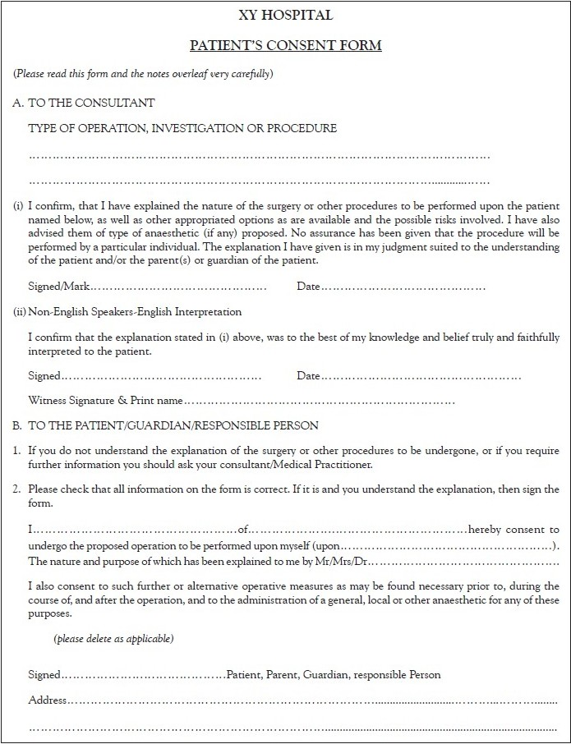

Slide 22
CONSENT FORM
Consent is more than a signature on a form (ref)
Too much reliance on signed forms (Ezeome et al)
A signed consent form is only evidentiary.
If notes are made in the case notes, it is acceptable as evidence. (Lawal et al)
Consent form content is very technical
46.2% of patients don’t understand it’s content (Ngim et al)
IN ADDITION TO THE SIGNED CONSENT FORM, THE PROCESS SHOULD BE DOCUMENTED IN THE PATIENT’S CASE NOTES.

Slide 23
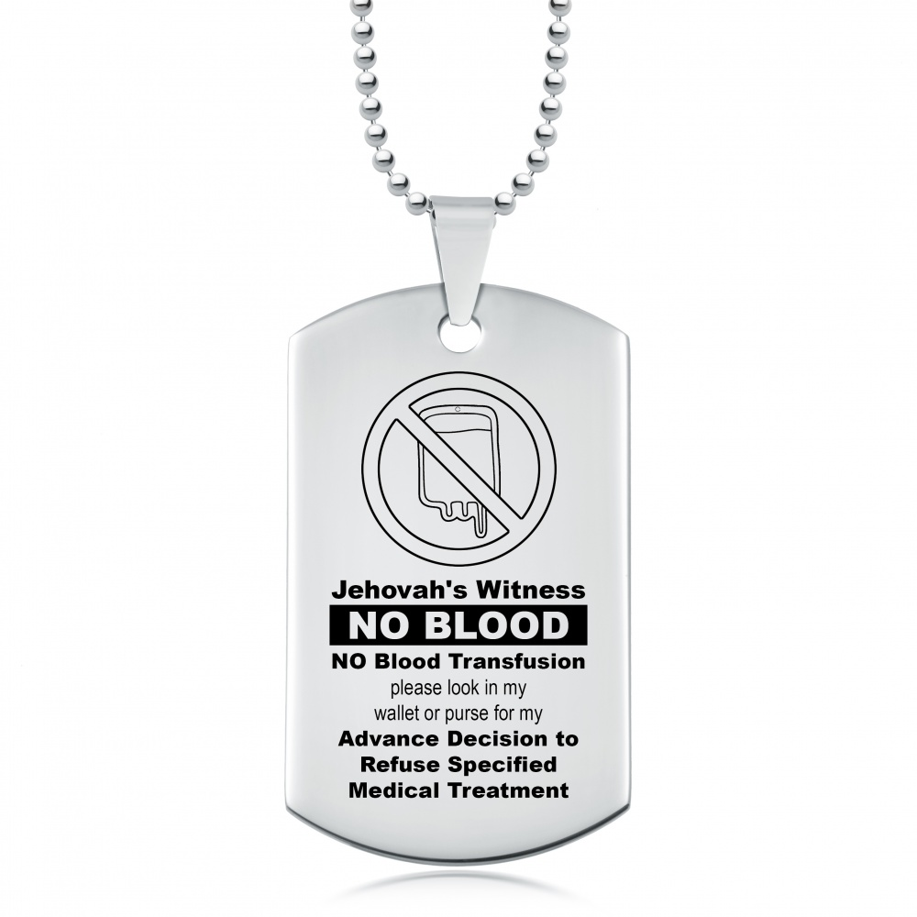
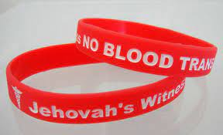
SPECIAL CONSIDERATIONS

Slide 24
SPECIAL CONSIDERATIONS
Jehovah’s witnesses
Emergencies; Doctrine of medical necessity, Beneficience
For life and limb saving procedures (Bailey and love)
Life support
DNR
Advanced directive

Slide 25
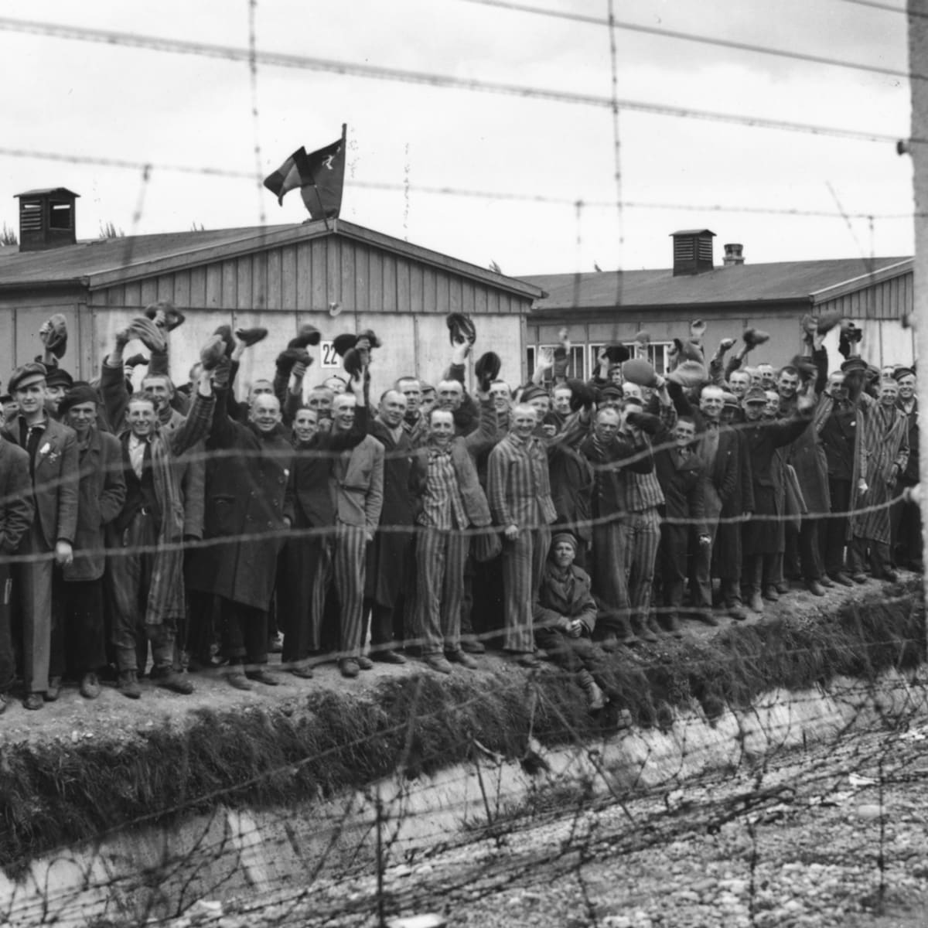

INFORMED CONSENT IN RESEARCH;
HUMAN RIGHTS ABUSES IN WWII

Slide 26
INFORMED CONSENT IN RESEARCH AND CLINICAL TIRALS
Informed consent is taken more information
More information and guidelines available
NUREMBERG CODE 1947
  Using human beings for experiments without consent .
  10 preconditions on human rights
DECLARATION OF HELSINKI 1964
  Thalidomide disaster. 22 preconditions of what is expected of researchers
Professional and academic pressures on Doctors to maintain a high research profile.
ROLE OF ETHICAL COMMITTEE (Rule 31 MDCN code of Ethics)

Slide 27
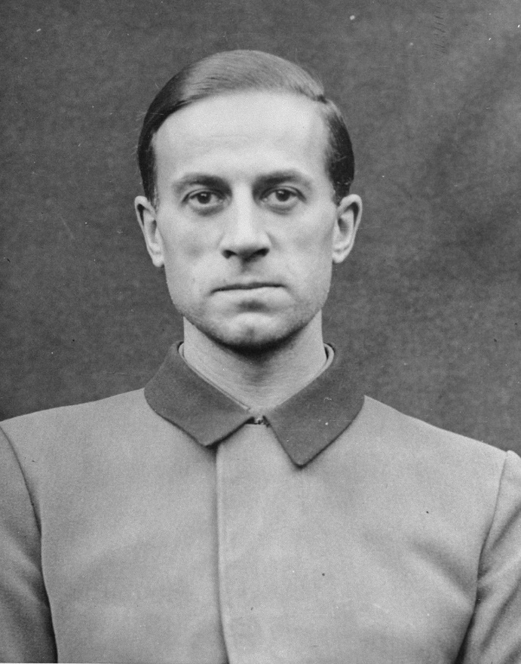
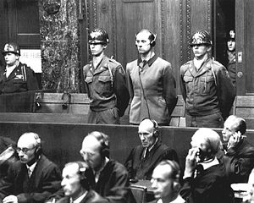

Slide 28
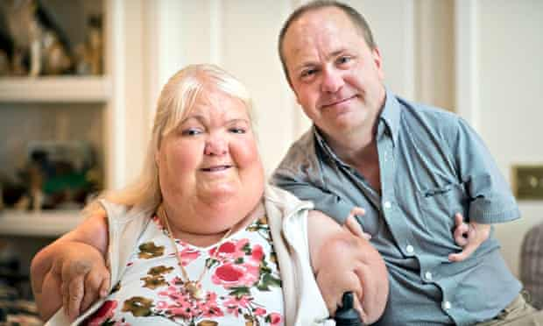

Slide 29
full information is presented in terms and forms they can understand. - full information about possible benefits and risk are given - participants have the opportunity to read and consider the - research information leaflet. - sufficient time is allowed for participants to make up their mind - participants' consent must be in writing - approval is obtained from properly constituted research ethics committee. (Rule 31 gives details on how to obtain the necessary approval).

Slide 30
INFORMED CONSENT IN ORGAN TRANSPLANT
Dead donor
Compensation for living donor
Organ transplantation market

Slide 31
SOCIOCULTURAL INFLUENCES
Multicultural, multisocial, multireligious country (Ezeome et al)
We live in an extended family system
68%of citizens are below poverty line
Payment for healthcare mainly out of pocket
Late presentation

Slide 32
SOCIOCULTURAL INFLUENCES CONTD.
FAMILY STRUCTURE
GENDER ISSUES
  Husband head of family
  Woman belongs to husband
  Some Physicians take consent from husbands, fathers and brothers instead of the female patient
  Worse in the rural areas and in the North
  changing with increasing level of education
RESPECT FOR ELDERS
RELIGION; illnesses are spiritual, denial, consent from Pastors, autopsy difficult in Muslims
HEALTHCARE FINANCE
LEVEL OF EDUCATION (Osime et al, Ezeome et al)

Slide 33
PHYSICIAN FACTOR IN OBTAINING INFORMED CONSENT
Reduced level of knowledge on informed consent by Physicians (Agu et al)
However, Adebamowo et al concluded that most Nigerian Surgeons have knowledge on informed consent but fall short in practice (Adebamowo et al)
Poor communication skills
Senior Doctors not being involved (Ngim et al)
Time constraints (Aisuodinoe – Shadrach et al)
Too much technical language (Ngim)
Too much reliance on signed forms.
No documentation in case notes (Ngim et al)

Slide 34


Slide 35
MDCN
Regulatory body for the practice of medicine, dentistry and alternative medicine
Informed consent is rule 19 of MDCN code of ethics
MDCN investigation panel
MDCN Disciplinary Tribunal ( status of a high court)
Flouting MDCN rules may be interpreted as infamous conduct and negligence
Depending on severity, a case may assume a criminal dimension.

Slide 36
IMPROVING INFORMED CONSENT
Encourage questions from patients
Patient education materials; pamphlets (Afolabi et al, Edwards et al), videos and animation (Jimison et al) and computer based materials (Leclercq)
Consent being taken by more senior Doctors (Afolabi et al, Agu et al)
Taking consent multiple times
Expanding consent forms to include benefits, risks and alternatives (Ogundiran et al)
Communication skills for surgeons (Ogundiran)
Ethics in medical school

Slide 37
CONCLUSION
Autonomy is a basic human right.
Informed consent is borne out of a patient’s right to autonomy
A signed consent form alone does not constitute informed consent
The primary aim is not to avoid litigation.
However as people are becoming more aware, information readily available, and with the brain drain of Doctors across international borders, it becomes imperative physicians preach and practice this fundamental principle of medical ethics.

Slide 38


Slide 39


Slide 40
Leclercq WK, Keulers BJ, Scheltinga MR, Spauwen PH, van der Wilt GJ. A review of surgical informed consent: past, present, and future. A quest to help patients make better decisions. World J Surg. 2010 Jul;34(7):1406-15. doi: 10.1007/s00268-010-0542-0. PMID: 20372902; PMCID: PMC2895877.
https://www.facs.org/for-medical-professionals/membership-community/resident-and-associate-society/webinars/archive/surgical-ethics/
FORGIVE AND REMEMBER: MANAGING MEDICAL FAILURE. Book by Charles Bosk, 1979
MDCN Code of Medical Ethics in Nigeria
Lawal YZ, Garba ES, Ogirima MO, Dahiru IL, Maitama MI, Abubakar K. The doctrine of informed consent in surgical practice. Ann Afr Med. 2011 Jan-Mar;10(1):1-5. doi: 10.4103/1596-3519.76558. PMID: 21311147.
Beauchamp TL. Methods and principles in biomedical ethics. J Med Ethics. 2003 Oct;29(5):269-74. doi: 10.1136/jme.29.5.269. PMID: 14519835; PMCID: PMC1733784.
GMC new guidelines on decision making
Ezeome, Emmanuel & Marshall, Patricia. (2008). Informed Consent Practices in Nigeria. Developing world bioethics. 9. 138-48. 10.1111/j.1471-8847.2008.00234.x.
Afolabi OA, Fadare JO, Ajiboye OT. Informed consent in otolargologic surgery: case scenario from a nigerian specialist hospital. Case Rep Otolaryngol. 2014;2014:120985. doi:10.1155/2014/120985
https://www.who.int/news-room/fact-sheets/detail/human-rights-and-health 19th June

