Slide 1

NIGERIAN MEDICAL ASSOCIATION
BAYELSA STATE BRANCH
ANNUAL GENERAL MEETING
THEME; THE IMPACT OF FUEL SUBSIDY REMOVAL ON EFFECTIVE HEALTH CARE DELIVERY IN BAYELSA STATE.
PROF. SEIYEFA BRISIBE

Slide 2

Prof. Seiyefa F. Brisibe
(MBBS (PH), Cert. Biz Analytics (Cambridge, USA), Exec. MBA (Metropolitan Univ. UK), Dip. Adaptive leadership-Africa (Harvard-USA), Dip. Voice of Leadership (Aga Khan Univ. Nairobi), Cert. Development Mgt. (Coventry Univ. UK), M.sc, Health Economics and Health Policy (Birmingham-UK), FMCFM (NGR))

Slide 3
PRESENTATION OUTLINE
Introduction
Understanding Fuel Subsidy and Its Removal
Impact of Fuel Subsidy Removal on Nigeria's Economy
Overview of Healthcare System in Nigeria
Utilizing Data to Showcase the Effects of Fuel Subsidy Removal
Key Messages and Insights
Call to Action
Conclusion

Slide 4
Introduction
1
Background and Context
The Journey with Fuel Subsidy

Slide 5
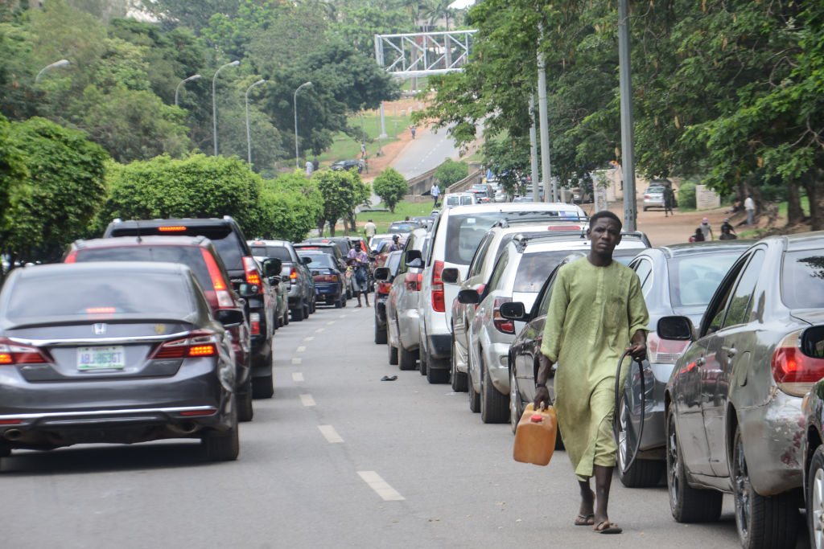
The Journey with Fuel Subsidy: A Personal Experience

Slide 6
"Subsidies are not just about economics; they reflect a government's commitment to care for its citizens."

Slide 7
" I have maintained the position that the fuel subsidy had to go, this once beneficial measure had outlived its usefulness. It cost us Trillions yearly, that would have been better spent on public transportation, healthcare, Education and housing etc. instead of being funneled to deep pockets of few"

Slide 8
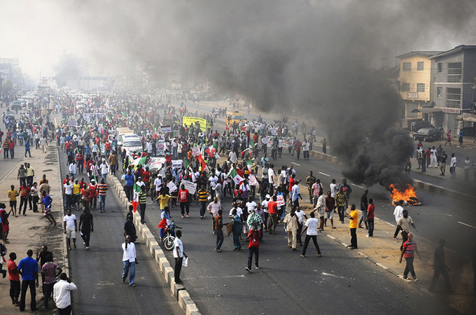

Big concept
Occupy Nigeria 2012
Bring the attention of your audience over a key concept using icons or illustrations

Slide 9
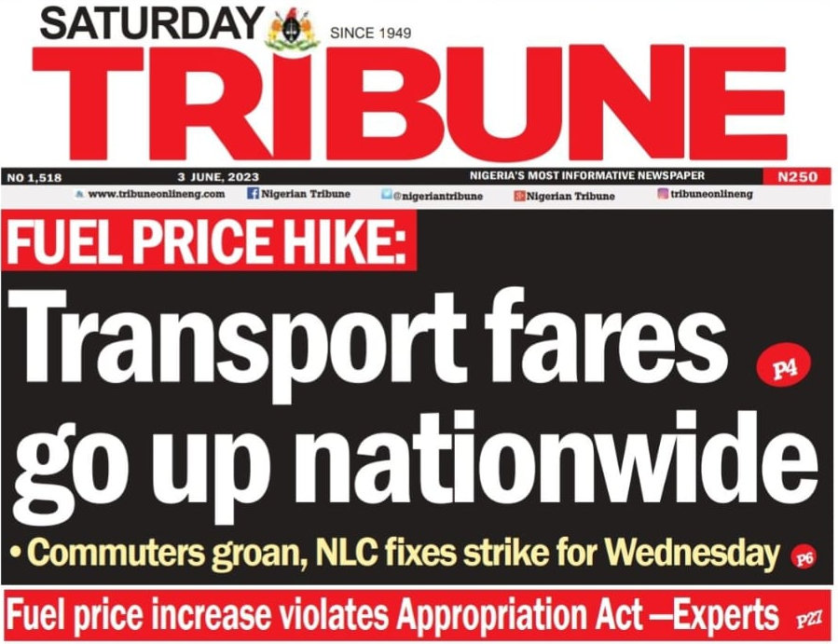
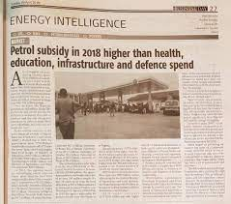
NEWSPAPER HEADLINES

Slide 10
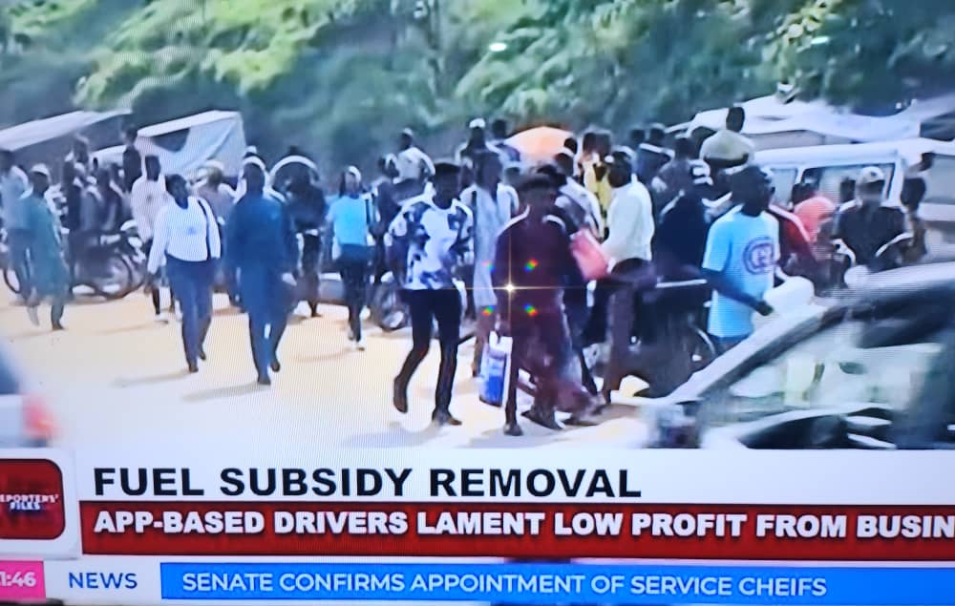
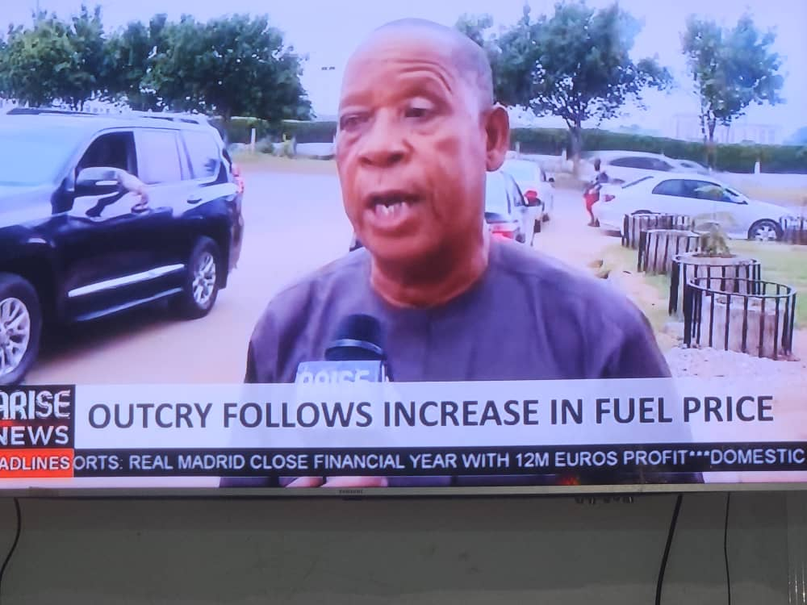
REACTION FROM EVERYDAY COMMUTERS AND COMMERCIAL VEHICLE DRIVERS

Slide 11
History and Background of Fuel Subsidy in Nigeria
2
Growth in Cost of Petroleum Products due to Subsidy
Effect on GDP and the Nigerian Economy

Slide 12
  Brief History of Fuel Subsidy in Nigeria
Fuel subsidies began in Nigeria as part of the broader economic subsidization efforts. The Price Control Act of 1977 institutionalized subsidies and regulated prices, including petroleum products like petrol.
President Olusegun Obasanjo's administration attempted to deregulate the downstream oil sector and remove fuel subsidies. However, public resistance and protests led to the abandonment of the plan.
1970s
1999
Diesel was deregulated in 2009 with an initial price of N100 per litre, and from 2009 till date, Nigerians have witnessed a rising percentage increase in the price of the product. It is being sold for about 780 Naira per litre.
President Goodluck Jonathan's partial fuel subsidy removal led to a sharp increase in prices, triggering the "Occupy Nigeria" protests. Citizens' discontent and demonstrations forced the government to reverse the decision.
2009
January 2012
President Muhammadu Buhari's administration announced the partial removal of fuel subsidies, which led to a substantial increase in fuel prices. While the subsidy removal was partial, it included the complete removal of subsidy on kerosene, a commodity commonly used by the poorest of the poor. This decision had an impact on the affordability of kerosene for vulnerable segments of the population.
Newly sworn-in President Bola Ahmad Tinubu announced in his inaugural speech that "subsidy is gone. Subsidy can no longer justify its ever-increasing cost in the wake of dying resources."
May 2016
May 29, 2023

Slide 13
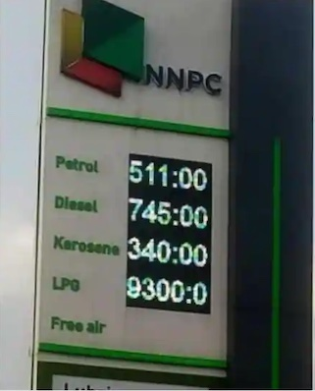
Historical Price Changes In Petrol Prices
Year | Approximate Price of Petrol (Naira per liter) | Leader in Charge
1978 | 0.05 | General Olusegun Obasanjo
1980 | 0.15 | President Shehu Shagari
1985 | 0.20 | General Ibrahim Babangida
1990 | 0.70 | General Ibrahim Babangida
1995 | 11.00 | General Sani Abacha
2000 | 20.00 | President Olusegun Obasanjo
2005 | 65.00 | President Olusegun Obasanjo
2010 | 65.00 | President Goodluck Jonathan
2012 | 97.00 | President Goodluck Jonathan
2016 | 145.00 | President Muhammadu Buhari
2021 | 165.00 | President Muhammadu Buhari
2022 | 195.29 | President Muhammadu Buhari
2023 | 617 | President Bola Ahmad Tinubu

Slide 14
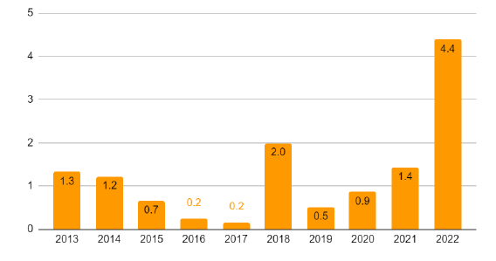
Nigeria’s Fuel Subsidy Payment (Trillion)

Slide 15






Subsidy Negative Effect on the GDP
The removal of fuel subsidy aimed to address economic challenges and promote a more equitable distribution of resources. It intend to open up opportunities for a sustainable and inclusive economic future for Nigeria. However, the positive effects are still being hoped for, as some may argue that the moneys saved from kerosene/diesel subsidy removal are not transparently accounted for and careful evaluation is needed to ensure positive impacts on the nation's GDP and overall economic landscape.
Strained national budget due to substantial financial commitment
Misallocation of resources, benefiting wealthier segments over the impoverished masses
Diverted resources from critical sectors like education, infrastructure, and healthcare
Corruption and mismanagement of subsidy scheme
Market distortions and hindered growth of a competitive downstream oil sector
Reduced transparency and accountability in the use of public funds

Slide 16


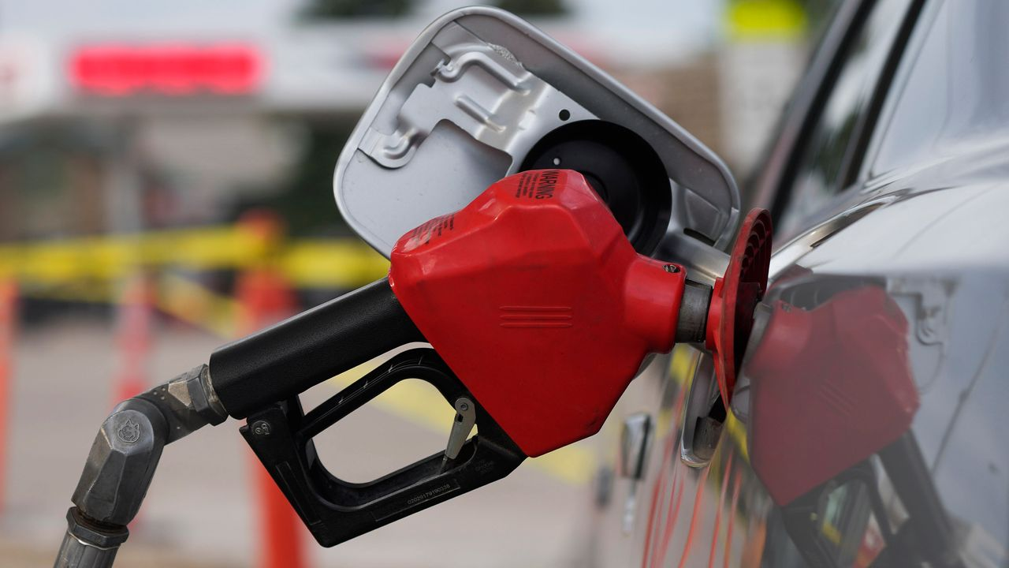


Subsidy Effect on the GDP
Financial Unsustainability of Fuel Subsidy
Economic Distortions Arising from Fuel Subsidy Implementation
According to a report by PwC, the financial cost of fuel subsidy in Nigeria is not sustainable. Over the past 18 years, the government has spent over USD 30 billion on subsidies, impacting critical sectors like infrastructure, education, and health. In 2022 alone, the government had to borrow N1 trillion to finance the subsidy, leading to a rise in public debt.
Fuel subsidy in Nigeria led to economic distortions, as the majority of fuel consumption was by private firms, public transportation, and businesses, not the poorest households. Even kerosene, used by the poor, was no longer subsidized. The implementation needs review to benefit the intended recipients.
    Corruption, Smuggling and Illicit Trade
    Inadequate Investment
Fuel subsidy removal exposed the problem of smuggling, with an estimated 58 million liters of PMS smuggled daily. Price differentials make smuggling profitable, leading to widespread corruption in the petroleum sector. Addressing this corruption is vital for efficient fund utilization.
Nigeria's downstream sector faces challenges, including inadequate investment due to the subsidy regime and legal framework. This hampers growth and development. Addressing these issues is essential to attract investments and boost the petroleum industry.

Slide 17

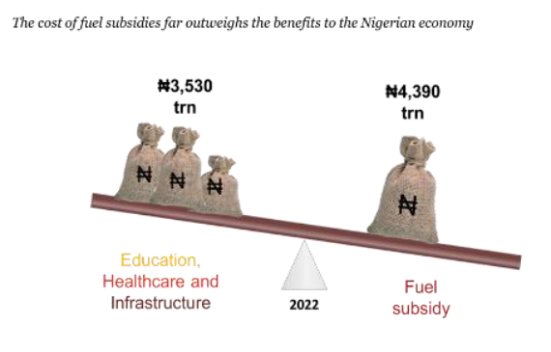
Want big impact? Use big image.
Fuel Subsidy vs Expenditure

Slide 18
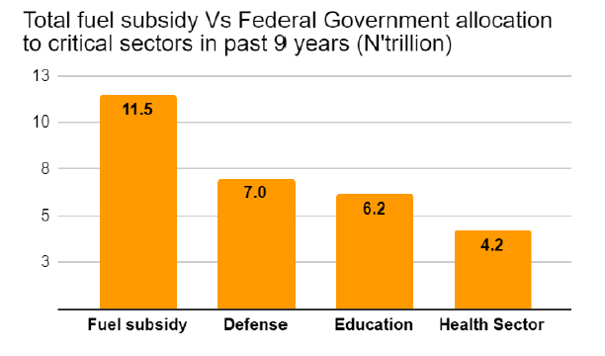
Want big impact? Use big image.

Slide 19
Impact of Subsidy Allocation on Other Sectors Over the Past 9 Years
If the government had not spent 11.5 trillion on subsidies over the past 9 years, 40.23% of that amount could have gone to the Defence sector, which is approximately 4.63 trillion. The total allocation for Defence would have summed up to 11.6 trillion.
Similarly, the Education sector could have received 35.63% of the total subsidies, amounting to approximately 4.10 trillion. The total allocation for Education would have summed up to 10.3 trillion.
Allocation over the Past 9 Years | Initial Budget Allocation (trillion) | Percentage of Initial Budget | Subsidies Allocation (trillion) | Percentage of Subsidies (trillion) | Revised Allocation (trillion)
Defense | 7.0 | 40% | 11.5 | 4.63 | 11.6
Education | 6.2 | 36% | 11.5 | 4.10 | 10.3
Health Care | 4.2 | 24% | 11.5 | 2.78 | 6.98
Total | 17.4 | 100% | 11.5 | 11.5 | 28.88
The Healthcare sector could have been allocated 24.14% of the subsidies, which would have been around 2.78 trillion. The total allocation for Healthcare would have summed up to 6.9 trillion.

Slide 22
HEALTHCARE DELIVERY IN NIGERIA AND THE FOCUS ON BAYELSA STATE
3
Overview of the Healthcare System in Nigeria
Specifics of Healthcare Delivery in Bayelsa State

Slide 23



Nigerian HealthCare Service Delivery
Healthcare service delivery is the provision of medical care, treatments, and preventive measures to individuals and communities to promote health and treat illnesses, ensuring equitable access and quality of care.
Healthcare delivery in Nigeria is both a private and government business.
Effective healthcare delivery is usually a function of the quality, accessibility and affordability of the services
Service delivery reflects the immediate outputs of the health system, i.e. the availability and distribution of care.

Slide 24

  Overview of the Healthcare indices in Nigeria
Brief Overview
Nigeria's healthcare system faces challenges like high maternal and infant mortality rates, communicable diseases, and rising non-communicable diseases. Efforts are underway to revitalize primary healthcare and achieve universal health coverage to improve healthcare delivery and address these issues effectively.
High maternal mortality ratio: 814 per 100,000 live births
Infant mortality rate: 70 per 1,000 live births
Under-five mortality rate: 104 per 1,000 live births
Communicable diseases (malaria, tuberculosis, HIV/AIDS) are prevalent
Increasing cases of non-communicable diseases (hypertension, diabetes)
Ongoing public health emergencies
Challenged primary healthcaresstem
Pursuing universal health coverage is still very low at 17% of over 200million people.

Slide 25
WHO Report on the Overview of the Nigerian Health Sector
Indicator | Value
Infants exclusively breastfed for the first six months (2013) | 17.4%
Diphtheria tetanus toxoid and pertussis immunization coverage among 1-year-olds (2016) | 49%
Life expectancy at birth (years) (2015) | 55.6 (Female), 53.4 (Male), 54.5 (Both sexes)
Population (in thousands) (2015) | 182,202
Population under 15 (2015) | 44%
Population over 60 (2015) | 4.5%
Poverty headcount ratio at $1.25 a day (PPP) (% of population) (2011) | 54.4%
Literacy rate among adults aged >= 15 years (%) (2007-2012) | 61%
Gender Inequality Index rank (2014) | ...
Human Development Index rank (2014) | 152
Total expenditure on health as a percentage of gross domestic product (2014) | 3.67%
Private expenditure on health as a percentage of total expenditure on health (2014) | 74.85%
General government expenditure on health as a percentage of total government expenditure (2014) | 8.17%
Physicians density (per 1000 population) (2009) | 0.376
Nursing and midwifery personnel density (per 1000 population) (2008) | 1.489
Neonatal mortality rate (per 1000 live births) (2016) | 34.1
Under-five mortality rate (probability of dying by age 5 per 1000 live births) (2016) | 104.3
Maternal mortality ratio (per 100,000 live births) (2015) | 814
Births attended by skilled health personnel (%) (2013) | 35.2%
Population using safely managed drinking water services (%) (2015) | 19% (Total)
Note: Data obtained from the Global Health Observatory 2017, World Health Organization (WHO).

Slide 26
Bayelsa Health Indicators at a glance
Health Indicator | Value
Population (GlobalDataLab, 2018) | 2,537,400
Poverty Rate (The Guardian, Nov. 2022) | 88.5% (In terms of the proportion of poor people and the intensity of their poverty)
Infant Mortality Rate (UNICEF, March 2021) | 95 deaths per 1,000 live births
Maternal Mortality Rate (The Tribune, 2017) | 1,870 per 100,000
Immunization Coverage (PUNCH, Dec 2018) | <47% (presently above 65%)
Insurance Coverage of children under the age of 5 (Dataphyte July, 2023) | <2%

Slide 27
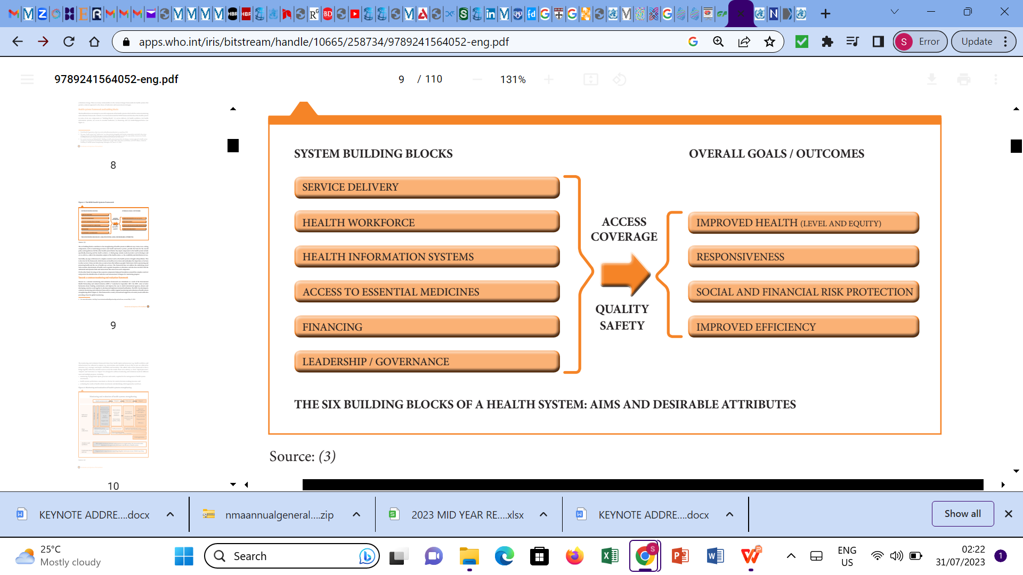
Health System Building Blocks

Slide 28
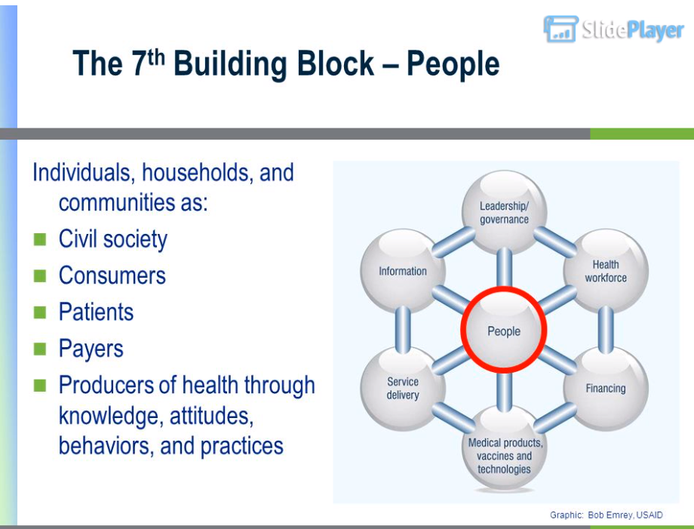

Leadership and Governance
  Introduction
Governance in health is a critical aspect of the development agenda, emphasizing the need for strategic policy frameworks and effective oversight to build a robust health system. This involves managing relationships among various stakeholders, ensuring accountability, and delivering quality healthcare services.
Key Aspects of Governance and Accountability:
Delegation: Clarifying how healthcare services are provided and by whom, either implicitly or explicitly.
Financing: Ensuring adequate resources are available to deliver essential health services.
Performance: Focusing on the actual supply of services and evaluating their effectiveness.
Information: Receiving relevant data to monitor and assess healthcare performance.
Enforcement: Implementing measures like sanctions or rewards to enforce accountability for performance.

Slide 29

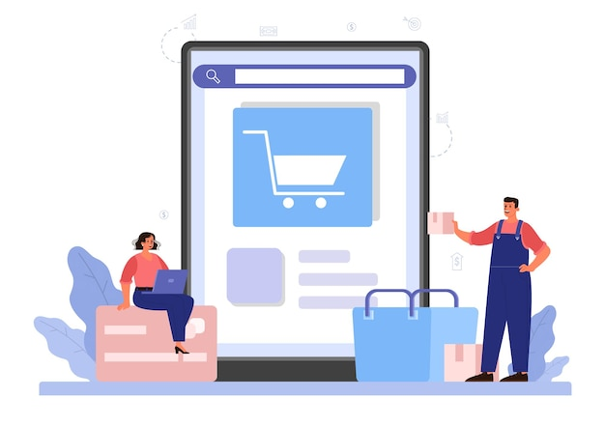


Key Characteristics of Good Service Delivery
Comprehensiveness
A comprehensive range of health services is provided, appropriate to the needs of the target population
Services are directly and permanently accessible with no undue barriers of cost, language, culture, or geography. Health services are close to the people, with a routine point of entry to the service network at primary care level
Accessibility
Coverage
Service delivery is designed so that all people in a defined target population are covered
Accountability and efficiency
Health services are well managed so as to achieve the core elements described above with a minimum wastage of resources

Slide 30
Key Characteristics of Good Service Delivery Cont’d
Continuity
Service delivery is organized to provide an individual with continuity of care across the network of services, health conditions, levels of care, and over the life-cycle.
Health services are of high quality, i.e. they are effective, safe, centred on the patient’s needs and given in a timely fashion.
Quality
Services are organized around the person, not the disease or the financing. Users perceive health services to be responsive and acceptable to them. There is participation from the target population in service delivery design and assessment. People are partners in their own health care.
Person-centredness
Local area health service networks are actively coordinated, across types of provider, types of care, levels of service delivery, and for both routine and emergency preparedness. The patient’s primary care provider facilitates the route through the needed services
Coordination

Slide 31

Health Workforce
The health workforce is diverse and comprehensive, consisting of physicians, nursing and midwifery personnel, dentistry personnel, pharmaceutical personnel, laboratory health workers, environmental and public health workers, community and traditional health workers, and other health service providers, as well as health management and support workers. Together, they collaborate to deliver quality healthcare services to the population.

Slide 32
Access to Essential Medicines/Technologies
Objective: To provide a user-friendly and seamless onboarding experience for customers, ensuring swift activation of Vendy's payment platform, and differentiating Vendy from competitors in the online payment business..
Access to essential medical products, vaccines and technologies of assured quality, safety, efficacy and cost effectiveness, and their scientifically sound and cost-effective use. To achieve these objectives, the following are needed
National policies, standards, guidelines and regulations that support policy
Information on prices, the status of international trade agreements and the capacity to set and negotiate prices
Reliable manufacturing practices when they exist in-country and quality assessment of priority products
Support for rational use of medicines, commodities and equipment, through guidelines and strategies to assure adherence, reduce resistance, maximize patient safety and training
Procurement, supply and storage, and distribution systems that minimize leakage and other waste

Slide 33

What is Health Financing?
  Introduction
Health financing refers to the “function of a health system concerned with the mobilization, accumulation and allocation of money to cover the health needs of the people, individually and collectively,
In the health system…
the purpose of health financing is to make funding available,
as well as to set the right financial incentives to providers,
to ensure that all individuals have access to effective public health and personal health care”

Slide 34
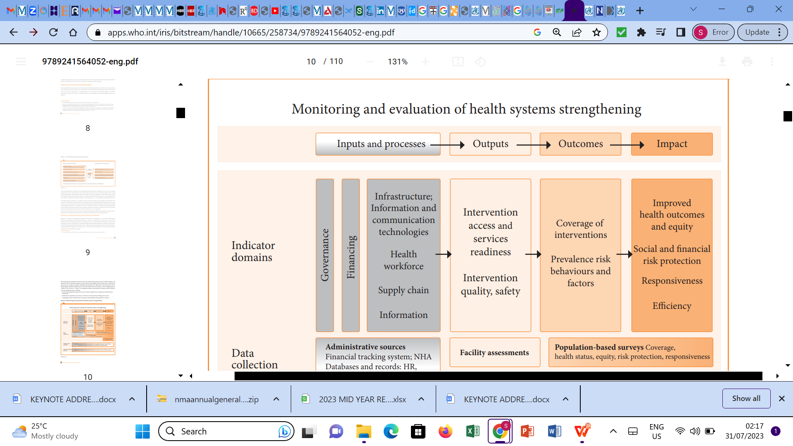
Health system Performance

Slide 35
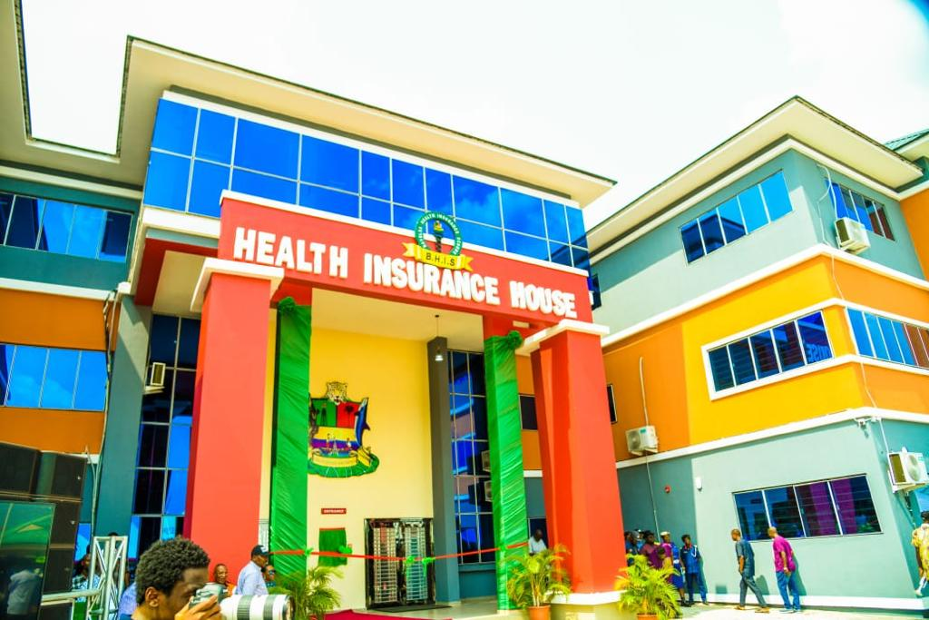
Specifics on Healthcare systems of Nigeria & Bayelsa State
Brief Overview
Our health system delivers preventive, promotive, curative and rehabilitative interventions through a combination of public health actions and the pyramid of health care facilities(Primary,Secondary,Tertiary) that deliver personal health care — by both State and non-State actors.
Our health system can be described as one that doesn’t function properly because of the challenges to the building block of the health sustem that we had discussed earlier.

Slide 36






    Workforce
Nigerian health workforce is understaffed, with a low doctor-to-population ratio. As of the last available data in 2021, the World Health Organization (WHO) recommended a minimum of 1 doctor per 600 people to ensure adequate healthcare coverage. However, Nigeria falls significantly short of this standard, with an estimated ratio of 1 doctor per 5,000 people
The distribution of health workers in Nigeria is heavily skewed towards urban areas, leaving rural regions with limited access to essential healthcare services. Approximately 70% of Nigeria's population resides in rural areas, but only 30% of the country's healthcare workforce is deployed in these regions.
The brain drain in Nigeria's healthcare sector is a growing concern, especially in Bayelsa state. According to a report by Punch newspaper in 2023, the emigration rate of doctors leaving the country is alarmingly high, with approximately 60% of trained doctors opting to seek better opportunities abroad. This significant loss of skilled professionals further strains the already fragile healthcare system in Nigeria.
Training spaces for health-related fields, including physiotherapy and other allied professions, are insufficient to meet the growing demand for healthcare services. The limited availability of training programs contributes to a shortage of qualified health workers, hinders efforts to address the healthcare needs of the population.

Slide 37

Service Delivery
Healthcare Service Delivery in Nigeria
Nigerian healthcare service delivery is lacking in key aspects such as equity, universal access, and patient satisfaction, highlighting the need for significant improvements.
The healthcare system faces multiple challenges, including poor organizational culture, negative work attitudes, frequent strikes, and decaying infrastructure, which collectively impede its effectiveness.
A fractured health-seeking behavior among the population, with a preference for chemists (Mix or Guwadiri), traditional bone setters, herbalists, and religious houses, contributes to delayed or inappropriate treatment
Primary healthcare services often suffer from a shortage of resident doctors or experienced medical professionals, leading to potential delays in diagnosis and timely interventions. Addressing these issues is vital to building a more efficient and equitable healthcare delivery system in Nigeria and Bayelsa State.

Slide 38

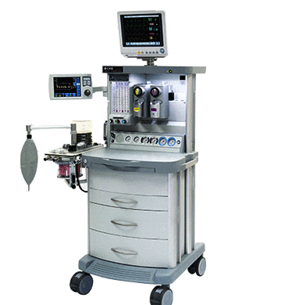
    Availability of Medical Products & Technology
The Nigerian health system faces numerous challenges in the availability of medical products, particularly pharmaceuticals. Many hospitals suffer from out of stock syndrome, resulting in inadequate supplies of essential medications.
Diagnostic products are severely inadequate, with an estimated ratio of 1 MRI/CT Scan service for every 2 million people. Moreover, the available diagnostic equipment often malfunctions or becomes outdated, further limiting access to accurate and timely diagnoses.
Interventional radiology products and technology are grossly insufficient as we cannot be able to boast of, with a scarcity of functional interventional radiotherapy facilities and equipment. The few available facilities, mainly in the private sector, are often out of reach for many patients, and some are outdated, posing challenges in maintaining and fixing them.
Transportation and logistics present significant challenges in healthcare delivery, particularly in Bayelsa where most communities are riverine. Dependence on water transportation complicates the timely and efficient distribution of medical supplies and access to healthcare services in remote areas.

Slide 39
Finance
Healthcare Service Delivery in Nigeria
The health budget in Nigeria is significantly lower than the recommended 15%, with allocations typically ranging from 4% to 6%. Despite reaching double digits during the pandemic in 2020, there has been a decline in health spending since then
Health services in the country are primarily paid for through out-of-pocket payments, with approximately 60-70% of healthcare costs borne directly by individuals. Only a small proportion of the population has health insurance coverage.
Bayelsa State ranked second in the Health Preparedness Index, with Delta, Anambra, and Lagos State following closely behind.
Fund mobilization remains suboptimal in Nigeria, leading to heavy reliance on international donors to support vertical programs like HIV/AIDS, vaccination, tuberculosis, and other rare diseases. This dependency on external funding limits the country's ability to invest in health infrastructure and other social determinants of health.
The inadequate allocation and mobilization of funds adversely affect Nigeria's healthcare system, hindering investments in crucial areas such as health infrastructure and health information systems. This situation has broader implications for the overall health and well-being of the population.

Slide 40
UNDERSTANDING THE IMPACT OF FUEL SUBSIDY REMOVAL ON HEALTHCARE DELIVERY
4
  Purpose and Objectives of the Speech
  Exploring the Effects of Fuel Subsidy Removal on Healthcare
  Overview of Healthcare Delivery in Bayelsa State

Slide 41

UNDERSTANDING THE IMPACT OF FUEL SUBSIDY REMOVAL ON HEALTHCARE DELIVERY
Purpose
In this section, we will highlight the consequences of fuel subsidy removal on healthcare delivery visavis heath systems in Bayelsa State and Nigeria. highlighting access, affordability, and quality challenges, and propose solutions for improved healthcare delivery.

Slide 42
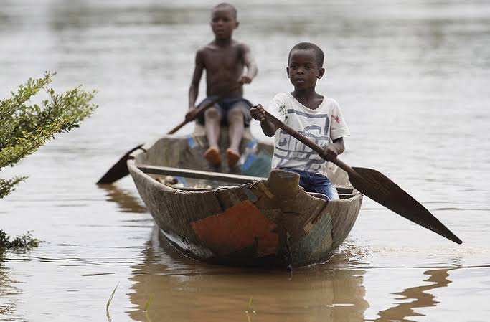
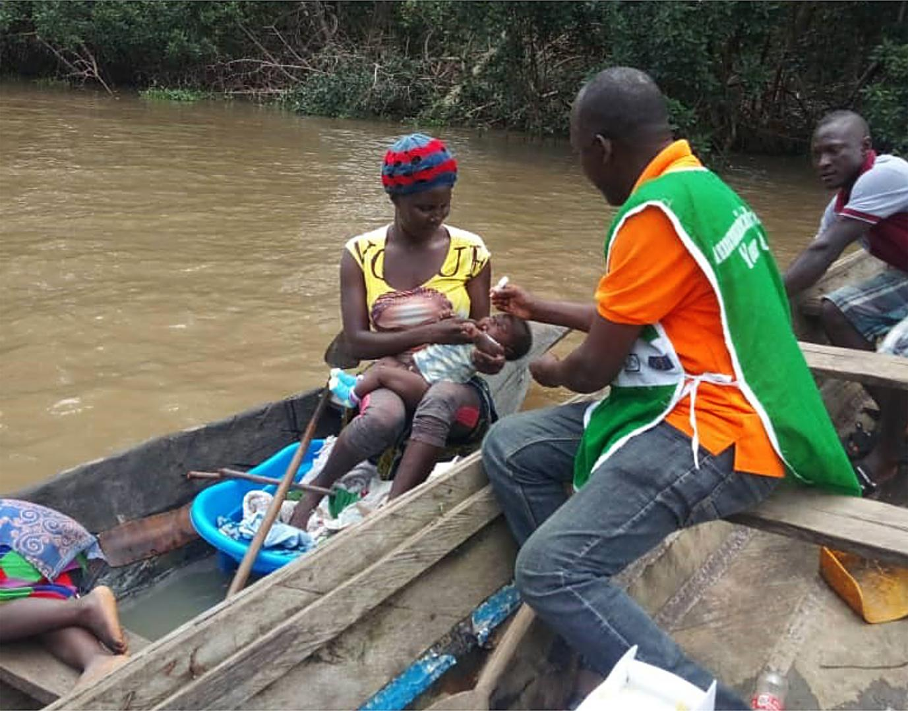

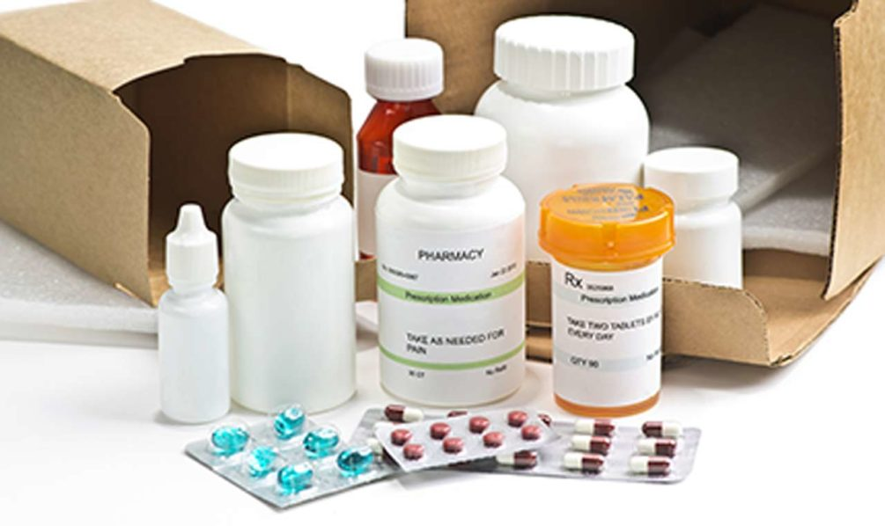

Impacts of Fuel Subsidy Removal on Healthcare Delivery in Bayelsa State
Fuel subsidy removal has far-reaching impacts on healthcare delivery in Bayelsa State, Nigeria. The following points illustrate the effects on access, affordability, and quality of healthcare services in the region.
Some Impacts of fuel subsidy removal on Healthcare in Bayelsa State include:
    Increased Transportation Costs and Access Barriers
    Affordability Challenges and Limited Access to Healthcare Products
    Quality of Healthcare Delivery
    Impact on Rural Healthcare and Infrastructure
    Healthcare Workforce Shortage and Brain Drain
Throughout this discourse, we will outline key impacts of fuel subsidy removal and how they affect the health care sector in Bayelsa State.

Slide 43
    Increased Transportation Costs and Access Barriers
With the recent removal of fuel subsidy in Bayelsa State, transportation costs for accessing healthcare services are beginning to increase.
Residents in remote riverine communities are starting to face barriers to timely healthcare access due to higher fuel prices.
Healthcare seeking is already showing signs of being impacted, potentially leading to delayed or inadequate care for some individuals in Bayelsa State.
The reliance on unsupervised self-care or care by less qualified individuals is starting to increase as a consequence of the fuel subsidy removal.
Health inequality is furr deepened by the unique geographical terrain of our State, this poses challenges to delivering timely and effective healthcare services.

Slide 44

    Affordability Challenges and Limited Access to Healthcare Products
The removal of fuel subsidy in Bayelsa State is leading to an increase in healthcare product costs. As fuel prices rise, transportation expenses for the delivery of medical supplies also surge, impacting the overall cost of healthcare products.
Essential medications for prevalent diseases like malaria, infections, hypertension, and diabetes may become more expensive. For example, drugs like artemisinin-based combination therapies (ACTs) for malaria, antibiotics for infections, antihypertensive medications, and insulin for diabetes might experience price hikes.
Limited affordability and accessibility of drugs could hinder proper management of health conditions. Vulnerable communities in Bayelsa State may struggle to afford medications, leading to challenges in managing chronic illnesses effectively.
Higher healthcare product costs may lead to delayed or inadequate treatment, worsening health outcomes.
Policymakers must closely monitor and strategize to ensure steady supply and mitigate negative impacts on healthcare delivery.

Slide 45


    Quality of Healthcare Delivery
As Bayelsa State is predominantly riverine, accessing healthcare services in remote communities may become more challenging and costly due to the increased transportation expenses, affecting timely medical intervention for those in need. The full implications of fuel subsidy removal on healthcare quality are yet to unfold, warranting continuous monitoring and proactive measures to ensure sustainable and high-quality healthcare services for all residents.
Healthcare facilities heavily rely on consistent electricity supply to operate medical equipment effectively and provide quality care to patients.
Higher fuel prices can strain healthcare budgets, leading to challenges in maintaining and upgrading critical medical equipment.
This increase in operational costs may also affect the availability and affordability of essential medical supplies and medications, potentially leading to higher treatment expenses for patients.

Slide 46
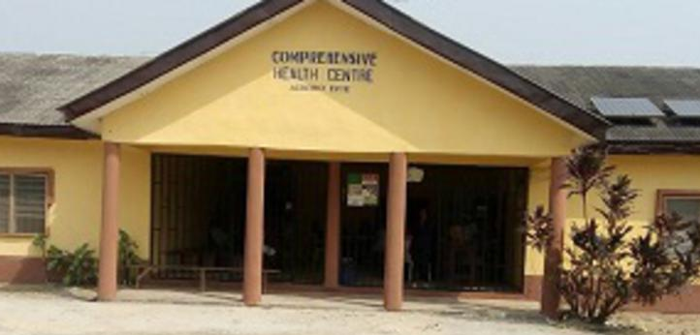
    Impact on Rural Healthcare and Infrastructure
Increased transportation costs due to higher fuel prices act as a significant barrier to accessing healthcare services, especially in remote riverine areas
Delayed access to healthcare facilities can worsen health outcomes and exacerbate existing disparities between urban and rural populations.
Healthcare infrastructure may face adverse effects, with limited financial resources hindering maintenance and upgrades, potentially limiting access to specialized medical services.
The full impact of fuel subsidy removal on healthcare infrastructure and access in Bayelsa State is still unfolding, as it is a recent change in policy. Continuous monitoring and strategic interventions are essential to mitigate potential negative consequences and ensure the provision of quality healthcare services.

Slide 47


    Healthcare Workforce Shortage and Brain Drain (Japa Syndrome)
Bayelsa State's healthcare sector already faces workforce shortages, and the removal of fuel subsidy may lead to increased hardships, driving healthcare professionals to seek better opportunities elsewhere.
The "Japa syndrome," a colloquial term for the brain drain phenomenon, can exacerbate the healthcare workforce shortage in the state with doctors leaving for greener pastures.
Healthcare infrastructure may face adverse effects, with limited financial resources hindering maintenance and upgrades, potentially limiting access to specialized medical services.
As operational costs rise and resources become limited, healthcare facilities may struggle to offer competitive salaries and benefits, leading to demotivation and a higher likelihood of seeking opportunities elsewhere.
As more healthcare professionals migrate to urban centers or other regions with better opportunities, rural areas may experience a further shortage of qualified medical personnel, making it even more challenging for rural residents to access timely and quality healthcare services.

Slide 48
DATA TO SHOWCASE THE EFFECTS OF FUEL SUBSIDY REMOVAL
5
  Presenting Data-driven Insights on Healthcare Delivery
  Statistical Analysis and Visualizations of the Impact
  Enhancing Understanding through Data Visualization

Slide 49

DATA TO SHOWCASE THE EFFECTS OF FUEL SUBSIDY REMOVAL
Presenting Data-driven Insights on Healthcare Delivery
To better understand the impact of fuel subsidy removal on healthcare delivery, we conducted a survey at two healthcare facilities in Bayelsa State: a Public Health Facilities in Bayelsa and a Private Health Facility in Bayelsa The survey focused on comparing patient attendance before and after the subsidy removal.
Here is a breakdown of the data collected:
Health Facility | Before Subsidy Removal (Apr 29th - May 29th) | After Subsidy Removal (May 30th - Jun 30th)
Public Health Facility (PHF) GOPD | 240 patients | 322 patients
PHF GOPD - Bayelsa Health Insurance Scheme (BHIS) | 386 patients | 374 patients
Private Health Facility | 3334 patients | 3068 patients
Note: Data obtained from the public and private health centres in Bayelsa State

Slide 53
Willingness to pay for extra health products amongst bayelsan in June
Health Facility | After Subsidy Removal (May 30th - Jun 30th) | Willingness to Pay
Public Health Facility (PHF) GOPD | 52 patients | 12%
PHF GOPD - Bayelsa Health Insurance Scheme (BHIS) | 58 patients | 5%
Private Health Facility | 100 patients | 21% - Private Patients 2% - Insured Patients

Slide 55
KEY MESSAGING AND INSIGHTS
6
  Clear Articulation of the Impact on Healthcare Delivery
  Summarizing Key Challenges and Opportunities
  Discussing Possible Positives of Fuel Subsidy Removal

Slide 56
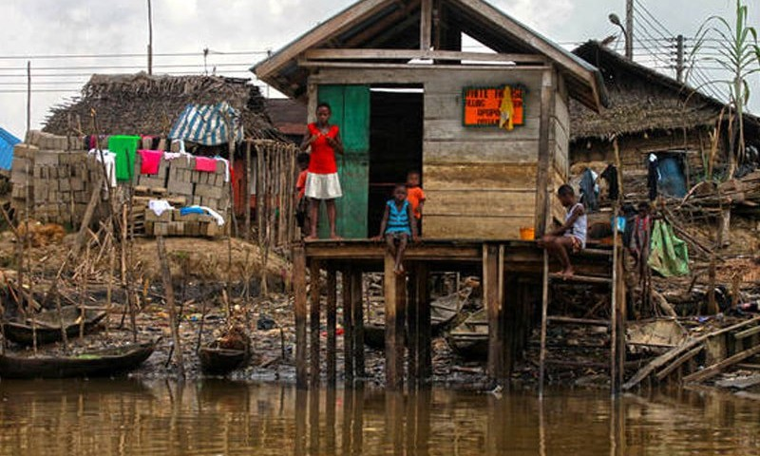
KEY MESSAGES AND INSIGHTS
  Clear Articulation of the short term Impact on Healthcare Delivery
The removal of fuel subsidy has had significant implications for healthcare delivery in Bayelsa State. The data analysis and insights gathered demonstrate a shift in patient attendance at healthcare facilities, indicating potential challenges in access, affordability, and quality of healthcare services. It is crucial to understand and address these impacts to ensure the well-being of the population.
Key Impacts of Fuel Subsidy Removal on Healthcare Delivery in Bayelsa State:
Slight drop Shift in Patient Attendance
Clear reduction in willingness to pay for extra health services
Challenges in Healthcare Access
Affordability Concerns
Potential Decline in Healthcare Quality
Worsening health Workforce challenges

Slide 57
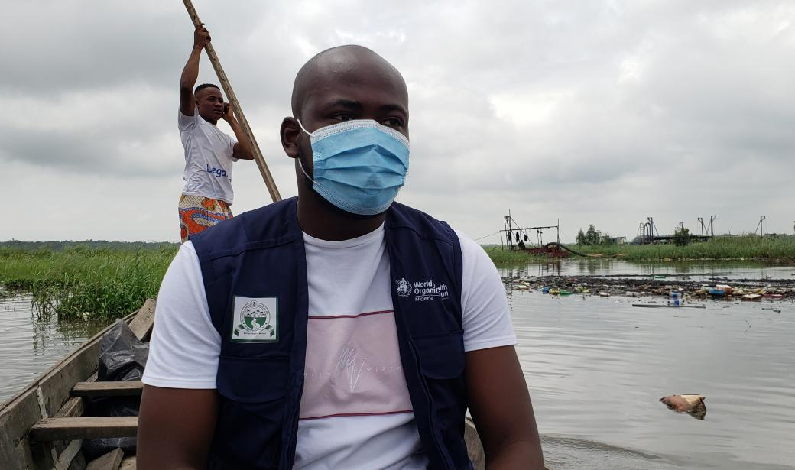
Want big impact? Use big image.
Key Challenges and Opportunities
Notes:
Key Challenges and Opportunities

Slide 58

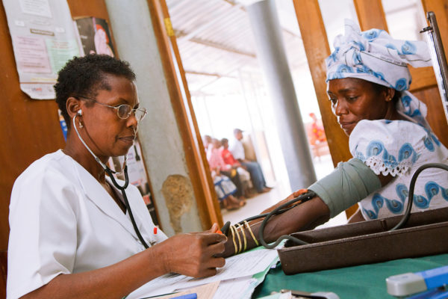
    Projected Worsening Challenges in Bayelsa State Health Sector due to Fuel Subsidy Removal:
Increased Healthcare Costs: The removal of fuel subsidy can lead to increased transportation costs, making healthcare services more expensive. This can create a financial burden for patients, particularly those from low-income backgrounds, who may struggle to afford essential healthcare services and medications.
Limited Healthcare Access: Bayelsa State, being a riverine area, faces unique geographical challenges. The increased transportation costs resulting from fuel subsidy removal can further limit access to healthcare facilities, especially for individuals residing in remote and underserved areas. This can hinder timely access to healthcare services and exacerbate existing health disparities.

Slide 59

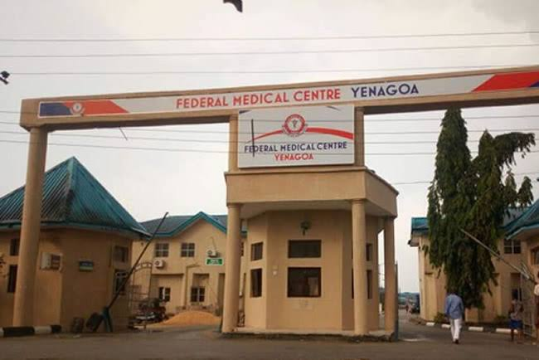
    Projected Worsening Challenges in Bayelsa State Health Sector due to Fuel Subsidy Removal:
Reduction in Healthcare Workforce: The removal of fuel subsidy may impact the retention and recruitment of healthcare professionals in Bayelsa State. Healthcare workers, facing increased financial challenges due to higher transportation costs and potential salary constraints, may seek opportunities in other regions or countries with more favorable conditions. This can lead to a shortage of skilled healthcare professionals in the state.
Infrastructure/Data Limitations: Bayelsa State already faces infrastructure and resource limitations in its healthcare sector. The removal of fuel subsidy may strain the already limited resources, making it challenging to maintain and upgrade healthcare facilities, procure necessary medical equipment, and ensure a sufficient supply of medications and essential healthcare supplies.

Slide 60




    ProjectedOpportunities for the Health Sector in Bayelsa State due to Fuel Subsidy Removal
Diversification/Innovative Healthcare Financing: The removal of fuel subsidy creates an opportunity to explore alternative sources of healthcare financing in Bayelsa State. This includes the establishment of health insurance schemes, public-private partnerships, and innovative financing models to ensure sustainable funding for healthcare services.
Improved Health System Efficiency: The removal of fuel subsidy can incentivize healthcare providers to optimize resource utilization and enhance overall system efficiency. This may involve adopting cost-effective measures, streamlining administrative processes, and promoting innovative healthcare delivery models to improve the quality and accessibility of healthcare services.
Collaboration and Partnerships: The challenges posed by fuel subsidy removal can create an opportunity for increased collaboration and partnerships within the health sector in Bayelsa State. This includes collaboration between government agencies, healthcare institutions, community organizations, and private sector entities to find innovative solutions, share resources, and collectively address the challenges faced by the health sector.

Slide 61

Want big impact? Use big image.
Possible Positives of Fuel Subsidy Removal
Short and long term Benefits of Fuel Subsidy Removal in the Health Sector

Slide 62
Possible Short-term Benefits of Fuel Subsidy Removal in the Health Sector
Increased Healthcare Funding: The removal of fuel subsidy allows the government to redirect funds previously allocated to subsidy payments towards healthcare. This infusion of resources can lead to increased investment in healthcare infrastructure, medical equipment, and the recruitment of healthcare professionals.
Enhanced Quality of Care: With additional funding, healthcare facilities can improve the quality of care they provide. This includes upgrading medical equipment, expanding diagnostic capabilities, and ensuring the availability of essential medicines and supplies. Ultimately, patients can receive better healthcare services, leading to improved health outcomes.
Strengthened Health System Resilience: The removal of fuel subsidy can contribute to strengthening the resilience of the health system. Increased funding can be allocated to emergency preparedness, disease surveillance, and response systems, ensuring that healthcare facilities are better equipped to handle public health emergencies and provide timely and effective interventions.

Slide 63
Possible Short-term Benefits of Fuel Subsidy Removal in the Health Sector
Exercise and Healthy Living: With improved resources, we can encourage and support programs that promote exercise and healthy living among the population, leading to better overall health and reduced risk of chronic diseases.

Slide 64
Long-term Benefits of Fuel Subsidy Removal in the Health Sector
Sustainable Healthcare Financing: The removal of fuel subsidy creates an opportunity for the government to explore alternative and sustainable sources of healthcare financing. This includes implementing health insurance schemes, exploring public-private partnerships, and promoting innovative financing models to ensure long-term funding for healthcare services.
Improved Healthcare Access: Over time, the reallocation of funds from fuel subsidy can lead to improved healthcare access, particularly in underserved areas. Investments in healthcare infrastructure and the expansion of healthcare facilities can bring healthcare services closer to communities, reducing geographical barriers and ensuring equitable access to care.
Strengthened Healthcare Workforce: With increased funding, the health sector can invest in training programs, incentives, and retention strategies to attract and retain qualified healthcare professionals. This can help address the shortage of healthcare workers and improve the overall quality of healthcare delivery.

Slide 65
Long-term Benefits of Fuel Subsidy Removal in the Health Sector
Enhanced Health Outcomes: By allocating resources to preventive healthcare programs, health education initiatives, and early intervention measures, the removal of fuel subsidy can contribute to improved health outcomes. This includes reducing the burden of communicable diseases, preventing chronic illnesses, and promoting overall population health.
Environmental Health: With the removal of fuel subsidy,we can explore cleaner and sustainable energy alternatives, contributing to improved air quality and a healthier environment, thereby reducing the burden of diseases.

Slide 66

Call To Action

Slide 67





Inspiring Actions for Improved Healthcare Delivery
Increasing investment in healthcare workforce training and development
Strengthening healthcare infrastructure and facilities in Bayelsa State
Enhancing access to healthcare services in rural and remote areas
Implementing innovative healthcare delivery models to improve efficiency and effectiveness

Slide 68

Providing Practical Recommendations
Advocate Health-In-ALL Policy ; Diversify Health Promotions: Health should be intergrated into all government policies and investment, especially in critical sectors that constitute social detrminants of health.The government should ensure that health considerations are integrated into decision-making processes
Promote and implement innovative investment in critical sectors such as education,infrastructure, Power and social safety nets/Protection.Instead of relying solely on cash palliatives, explore sustainable investment strategies that will great middle class, eradicate poverty and improve purchasing power.
Revitalise the economy to that of manufacturing from consumer status as we are presently. So the refinaries need to work.
Prioritize Health Investments: The removal of fuel subsidy highlights the importance of prioritizing health policies/investment. .
Advocate for Public Health Measures: Everyone should actively advocate for effective public health measures and invest in initiatives to improve the overall health of the population.
Encourage Public-Private Partnerships: Innovative measures should be implemented to promote public-private partnerships in the health sector. Collaboration between the government and private healthcare providers can enhance access to quality healthcare services.
Subsidized Transportation for Rural Residents: To improve healthcare access for rural inhabitants, the government should provide subsidized and readily available transportation to nearby health centers. This can ensure timely access to medical services and reduce healthcare disparities in remote areas
Notes:
Incomplete

Slide 69
Providing Practical Recommendations 2
Implementing targeted interventions to mitigate the negative effects of fuel subsidy removal on healthcare access and affordability
Developing comprehensive health insurance schemes to provide financial protection for citizens
Strengthening healthcare data collection and analysis framework for evidence-based decision-making
Collaborating with international partners and organizations to leverage resources and expertise for healthcare improvement
Prioritizing research and innovation in healthcare to address emerging challenges and improve service delivery.
Notes:
Incomplete

Slide 70

Thank You For Listening
!

