Slide 1
MANAGEMENT OF NEONATAL JAUNDICE(NNJ)
BY
DR MESIOBI ANENE, N. J
(MBBS,FWACP)
27/06/23

Slide 2
OUTLINE
• Definition
Epidemiology/Burden
• Pathogenesis
Classification
Aetiology/Risk factors
• Principle of Management
Conclusion
References

Slide 3
DEFINITION OF NNJ
Neonatal Jaundice is yellowness of the sclera/skin/ mucous membrane from deposition of bilirubin(hyperbilirubinaemia) that occurs in the newborn (≤28 days)

Slide 4
EPIDEMIOLOGY/BURDEN OF NNJ
Neonatal jaundice is associated with serious neonatal health consequences, especially in resource-limited settings.
The disease also imposes a substantial burden on the healthcare resources.
It affects 60% of full-term newborns and 80% of preterm newborns on a global scale.

Slide 5
EPIDEMIOLOGY/BURDEN OF NNJ
The incidence of neonatal jaundice is reported to be highest in the African region, with 667.8 per 10 000 live births, followed by 251.3 per 10 000 in Southeast Asia
According to a world survey, about 1.1 million new-borns would develop severe jaundice annually and majority of them resides in sub-Saharan Africa and South Asia

Slide 6
EPIDEMIOLOGY/BURDEN OF NNJ
Prevalence of NNJ in Nigeria is 23-60%
Prevalence of NNJ in Bayelsa is 17.9%
NNJ accounts for 1309.3 deaths per 100 000 and is identified as the seventh most common cause of neonatal mortality globally,

Slide 7
PATHOGENESIS OF NNJ
BILIRUBIN METABOLISM
Derived principally from haemoglobin (75-80%)
Other sources of bilirubin contribute 20-25%
➢Meconium
➢Myoglobin
➢Ineffective erythropoiesis

Slide 8
PATHOGENESIS OF NNJ
BILIRUBIN METABOLISM
Heme is degraded in a 2-step process involving 2 enzymes
➢ -Heme oxygenase (rate limiting)
➢ -Biliverdin reductase
Bilirubin is toxic to tissues therefore transported in plasma tightly but reversibly bound to albumin to liver for the process of conjugation.
To Bilirubin Monoglucorunide (secreted into bile) then to Diglucuronide in the bile ducts and gall bladder and later secreted into the intestine through the common hepatic ducts

Slide 9
PATHOGENESIS OF NNJ
BILIRUBIN METABOLISM
Common hepatic duct empties into 2nd part of duodenum
The gut flora hydrolyze bilirubin diglucuronide and reduce
free bilirubin to the colorless urobilinogen.
Urobilinogen is further processed to produce stercobilin,
which gives feces their characteristic brown color.
Some urobilinogen is reabsorbed from the gut and removed
from the circulation in urine as urobilin; this is responsible for
the amber color of urine
Some deconjugation and reabsorption occur through
enterohepatic circulation

Slide 10
PATHOGENESIS OF NNJ
Bilirubin production (8 to 10 mg/kg/day) in newborn is > twice adult rate
Catabolism of 1 g of hemoglobin yields 35 mg of bilirubin.
One molecule of CO and biliverdin (and, subsequently, bilirubin) is formed for each molecule of heme degraded

Slide 11
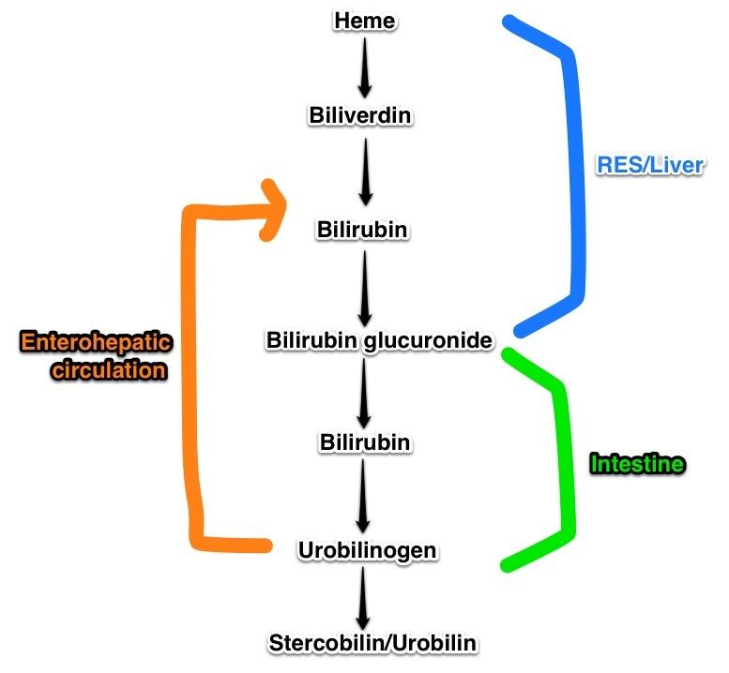
BILIRUBIN METABOLISM

Slide 12
PATHOGENESIS OF NNJ
Unbound bilirubin can cross the intact BBB
Factors that reduces binding of bilirubin to
serum albumin:
Free fatty acids
Reduced PH, Acidosis, Hypoxia, Dehydration, premturity..
Drugs e.g Diazepam, Ceftriazone, Chloramphenicol etc
Clinical status of the neonate (ill neonates)

Slide 13
PHYSIOLOGIC MECHANISMS OF NNJ
Increased bilirubin load on liver cell due to Short rbc life span, ineffective erythropoiesis etc
Increased red cell mass
Decreased hepatic uptake of bilirubin from plasma
Low Y, Z Protein liganding

Slide 14
PHYSIOLOGIC MECHANISMS OF NNJ
Decreased bilirubin conjugation
Reduced enzymes activities
Defective or slow bilirubin excretion
Enhanced enterohepatic circulation (fewer bacteria & greater activity of beta-glucuronidase

Slide 15
CLASSIFICATION OF NNJ
Time of occurrence: Early (<36hrs) or Late outset (>36hrs)
Type: Conjugated or unconjugated, Mixed
Physiologic and Pathologic
To Liver: Prehepatic (Unconjugated), Posthepatic(Conjugated),Hepatic (Mixed)
Severity: mild, moderate, severe

Slide 16
CLASSIFICATION OF NNJ
PHYSIOLOGIC JAUNDICE
Diagnosis of exclusion
Involves unconjugated bilirubin
Can only be made after exhaustive investigation.
Occurs in 50 – 60% of full term babies and up to 80% of preterms but diagnosis cannot be made in a Preterm baby

Slide 17
CLASSIFICATION OF NNJ
PHYSIOLOGIC JAUNDICE CONT’D
Begins at >36 hrs (usually not earlier than 24 hours)
Peaks at < 12.0 mg/dL at 3-5 days in term and at <15.0 at 5-7 days in preterm infants
Direct bilirubin < 1.5-2mg/dl or < 15% of total SBR
Requires no active management. Reassurance to parents (caregivers) is sufficient.

Slide 18
CLASSIFICATION OF NNJ
PATHOLOGIC JAUNDICE
Onset before 36 hours of age (Early outset NNJ).
A rise in serum bilirubin levels of >0.5 mg/dL/hr or 5mg/dl/day
Term infant with SBR > 12.9mg/dl.
Preterm infant with SBR > 15mg/dl.
Direct bilirubin > 1.5-2mg/dl. or >15%

Slide 19
CLASSIFICATION OF NNJ
PATHOLOGIC JAUNDICE
Jaundice persisting after 10 -12 days in a term
infant or after 14 days in a premature infant.
Jaundice in a sick child

Slide 20
CLASSIFICATION OF NNJ
BREASTFEEDING JAUNDICE
Breastfed infants have higher risk of NNJ – about x 3.
Increased enterohepatic circulation (higher activity of beta glucuronidase)
Early onset (2-4 days) – breastfeeding-associated jaundice
Enhanced enterohepatic circulation
Decreased fluid and caloric intake.
Bilirubin levels fall as feeding become adequate

Slide 21
CLASSIFICATION OF NNJ
BREAST MILK JAUNDICE
Late onset (4-7 days) – breast milk jaundice
Inhibitory factors in breast milk.
Jaundice may prolong
Cessation of BF leads to fall in bilirubin levels
Recommencement of BF does not lead to recurrence of jaundice

Slide 22
RISK FACTORS FOR NNJ
Male sex
Black race
prolonged labour,
premature rupture of the membrane,
weight loss >10%,
Use of ictorogenicagent e.g naphthalene ball
family history of jaundice,

Slide 23
AETIOLOGY OF NNJ
COMMON
Glucose-6-phosphate dehydrogenase (G6PD) deficiency
Bacterial sepsis (Haemolysis, depressed hepatic function)
ABO blood group(Mother is O, Baby A/B)
Low birth weight/Prematurity
Rhesus haemolytic disease (Mother Rh Neg, Baby +)

Slide 24
AETIOLOGY OF NNJ
Uncommon
Extravasated blood - cephalohaematomas extensive bruising (breech delivery)
Dehydration and starvation
Drugs that bind albumin (ceftriaxone, sodium salicylate, sulphonamides)

Slide 25
CAUSES OF CONJUGATED HYPERBILIRUBINEMIA
Extrahepatic biliary disease (Choluric jaundice)
Biliary atresia
Choledochal cyst
Bile duct stenosis
Spontaneous perforation of the bile duct
Cholelithiasis

Slide 26
CAUSES OF CONJUGATED HYPERBILIRUBINEMIA
Viral:
Idiopathic hepatitis B virus; non-A, non-B hepatitis virus;
cytomegalovirus; herpes simplex virus; coxsackie virus;
Epstein-Barr virus; adenovirus
Bacterial: Treponema pallidum, Escherichia coli, group B streptococcus, Staphylococcus aureus, Listeria.

Slide 27
CAUSES OF CONJUGATED HYPERBILIRUBINEMIA
• Others: Toxoplasma gondii
Intrahepatic biliary disease
Intrahepatic bile duct paucity (syndromic or non-syndromic)
Progressive intrahepatic cholestasis
Inspissated bile

Slide 28
CAUSES OF CONJUGATED HYPERBILIRUBINEMIA
Hepatocellular disease
Bacterial Infections (Often Mixed Cong, Uncong) • a1-antitrypsin deficiency, cystic fibrosis,
Zellweger's syndrome,
Dubin-Johnson and Rotor's syndromes,
Total parenteral nutrition
Idiopathic neonatal hepatitis
Neonatal hemochromatosis

Slide 29
MIXED HYPERBILIRUBINEMIA
• Infection –TORCHES
• Sepsis
• UTI
• Hepatitis
• Galactosemia
• Hypopituitarism
Congenital Hypothyroidism

Slide 30
PRINCIPLE OF MANAGEMENT OF NNJ
History and Physical examinations
Investigations
Phototherapy ???Sunlight
Exchange blood transfusion
Medical management
Prevention

Slide 31
Management of Non-conjugated hyperbilirubinaemia
History and Physical examinations: Evaluation of course, causes and complications
Investigations: Rapid diagnosis, Blood, Urine
Phototherapy: Conventional, LED/Bilitrum,
Biliblanket/ Double setup (Intensive & Non Intensive
Exchange blood transfusion
Intravenous immunoglobulin

Slide 32
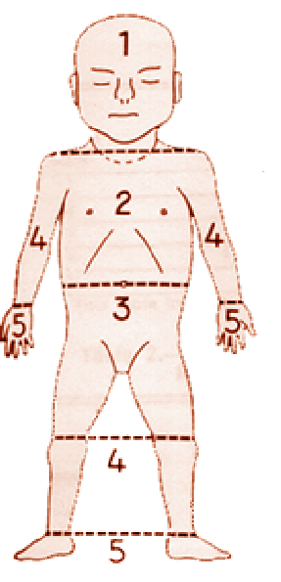
EXAMINATION
Zone SBR mmol/L
• 1 = 100 mmol/L
• 2 = 150 mmol/L
• 3 = 200 mmol/L
• 4 = 250 mmol/L
• 5 > 250 mmol/L

Slide 33
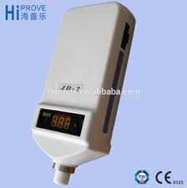
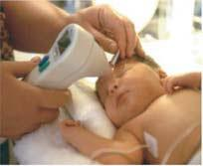
INVESTIGATION:BILIRUBINOMETER

Slide 34
INVESTIGATION OF NNJ
NOTE
Use a transcutaneous bilirubinometer in babies with a gestational age of 35 weeks or more and postnatal age of more than 24 hours
If a transcutaneous bilirubinometer measurement indicates a bilirubin level greater than 250 micromol/litre check the result by measuring the serum bilirubin

Slide 35
INVESTIGATION OF NNJ
NOTE
Always use serum bilirubin measurement to determine the bilirubin level in babies with jaundice in the first 24 hours of life
Always use serum bilirubin measurement to determine the bilirubin level in babies less than 35 weeks gestational age
If a transcutaneous bilirubinometer is not available, measure the serum bilirubi

Slide 36
INVESTIGATION OF NNJ
• Serum bilirubin levels (conjugated and unconjugated)
NOTE-Sampling technique-lab manuals recommend that blood samples protected from light till the serum is analyzed.
Mother & baby’s blood groups: ABO & Rh
type antibodies
FBC +reticulocyte count
Coomb’s test
G6PD status

Slide 37
INVESTIGATION OF NNJ
Other investigations that may be necessary as indicated
Total serum protein and electrolytes
Infection screen including LP for CSF analysis when indicated
Stool pigments
Thyroid screen
Abdominal ultrasound, Liver USS

Slide 38
TREATMENT OF NNJ
Treat underlying cause
Phototherapy: Conventional, Led Emitting Diode/Bilitrum,
Biliblanket/ Double setup (Intensive & Non Intensive
Exchange blood transfusion
Pharmacotherapy

Slide 39
TREATMENT OF NNJ
Types of Phototherapy light
Conventional Photo stands with Fluorescent Tubes
– White, blue; Special blue tubes more effective
Halogen lamps
Fibreoptic systems
Light emitting diodes (LEDs)/ Bilitrum
Sunlight (Filtered sunlight)

Slide 40
TREATMENT OF NNJ
Dose-response relationship(decline in TSB levels).
The more the light, the more the effectiveness!
Continuous vs intermittent (Duration of exposure)
Nude vs covered
Monitor SB and Hct 4-6hrly in haemolytic disease, less frequently in older healthy neonates

Slide 41
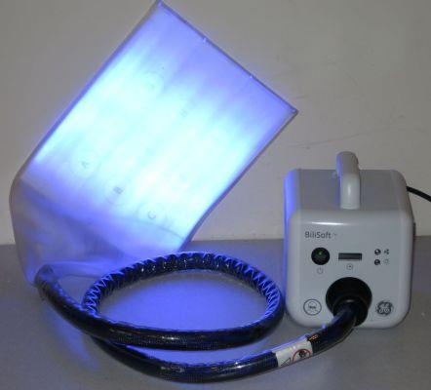
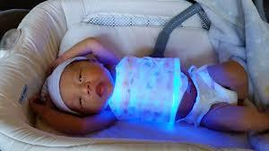
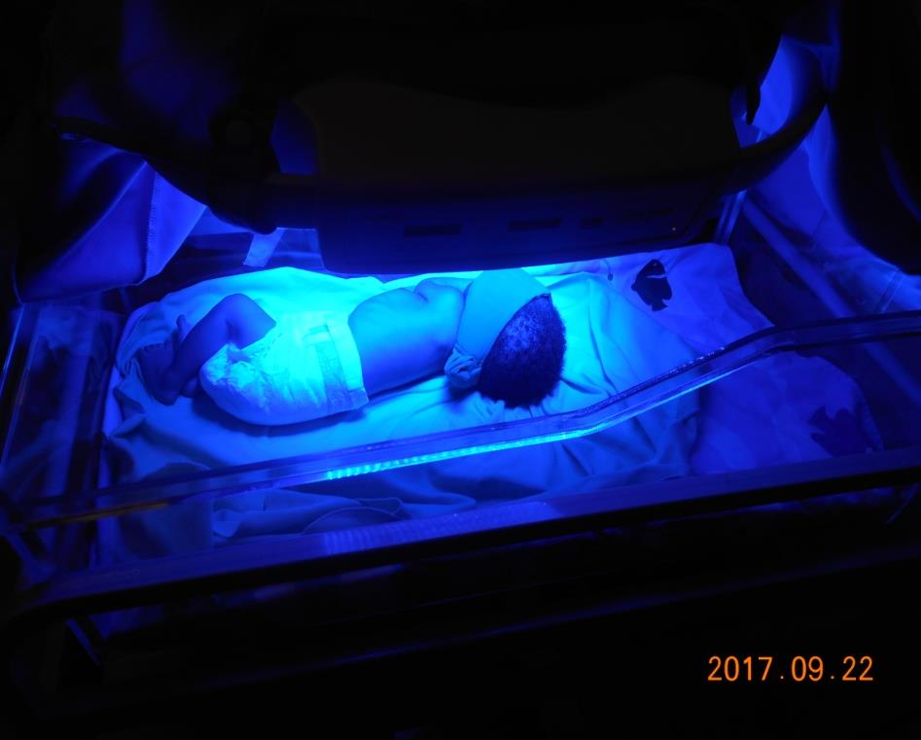
BILIBLANKET

Slide 42
Phototherapy decision levels umol/l
Gest.Age(wks) | At birth | 24 hrs | 48hrs | 72hrs
28 | 40 | 90 | 130 | 170
30 | 40 | 90 | 150 | 200
32 | 40 | 100 | 160 | 220
34 | 40 | 110 | 170 | 240
36 | 40 | 110 | 190 | 260
38 and above | 100 | 200 | 250 | 300

Slide 43
How does Phototherapy work?
Photo-oxidation? Theoretically true but the process is too slow to be useful.
Isomerization (configurational)? Very rapid
process resulting in conversion of 20% to
25% of bilirubin to water soluble isomers which are easily excreted and thus total bilirubin is reduced
Isomerization (structural)? Results in the
formation of lumirubin. The higher the
intensity of light, the more effective the process.

Slide 44
Phototherapy: factors determining dose
Light spectrum
Blue-green spectrum. Bilirubin absorbs light in 450-460 nm. Longer wavelengths penetrate skin better.
Irradiance
Radiant power incident on a surface per unit area of the surface.
Irradiation level of 30-40 uW/cm2/nm more effective. The more the irradiant, the more effective

Slide 45
Phototherapy: factors determining dose
Distance b/w infant and light source.
Should not be >50 cm. but note concern about thermal burn. 10 – 15 cm ideal. The more the light, the closer to light, the better
Surface area
The larger the surface area the better.
Reflective materials maybe used to increase area of irradiation.

Slide 46
Phototherapy: factors determining dose
Design of the phototherapy unit
May affect energy delivery. Narrow spectrum light sources are more efficient but more expensive
White linen cot covers and aluminum foil are helpful as they reflect light and thus enhance irradiation
Babies under phototherapy should be down to diapers.

Slide 47
PHOTOTHERAPY
Fluid management should be individualized: there is no evidence-based indication for extra IVF in every patient
Monitor light energy with Radiometer
Practice of exposing jaundiced infants to direct sunlight as a form of treatment has potential dangers from infrared and ultraviolet rays and sunburn.
It should be avoided except Filtered Phototherapy for it is dificult to monitor, erratic source, more cold…etc

Slide 48
COMPLICATION OF PHOTO THERAPY
Rashes
Diarrhoea
Skin bronzing( grey baby syndrome)

Slide 49
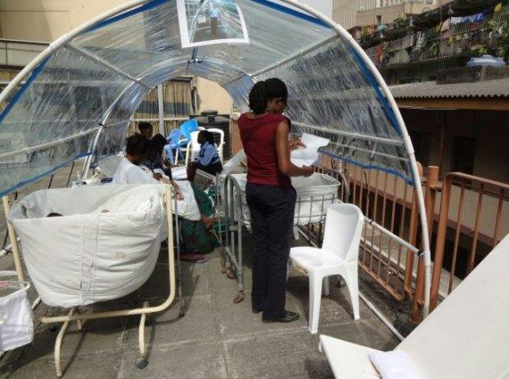
SUNLIGHT TREATMENT

Slide 50
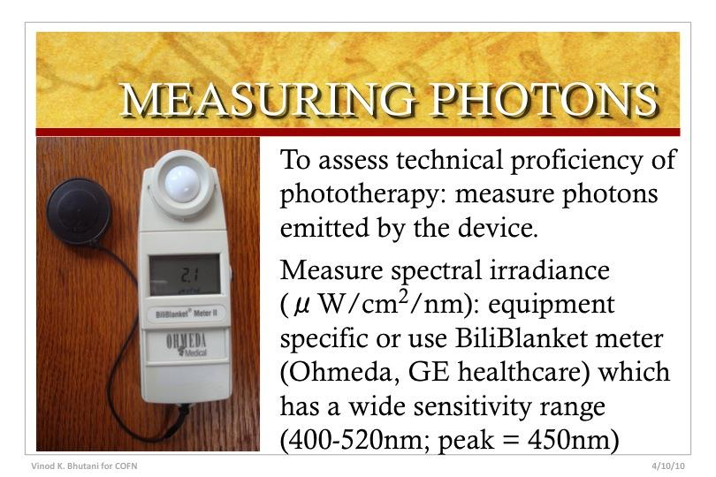
RADIOMETER

Slide 51
Exchange blood transfusion (EBT)
Second line of treatment when phototherapy fails
Used in conjunction with phototherapy if bilirubin level is very high or there are features of ABE
Indicated for erythroblastosis fetalis and hydrops fetalis
In Extreme hyperbilirubinemia is TSB of

Slide 52
25mg/dl with or without haemolytic disease
Its use may be minimal where there is effective phototherapy with high Irradiance
Dilutional reduction of bilirubin
Dilution of triggers of haemolysis - antibodies, infective agents

Slide 53
Exchange blood transfusion
Removes bilirubin-laden blood from circulation and replaces it with donor blood
Reduces antibody-coated RBCs
Corrects anaemia
Removal as much of maternal antibody
Removal as much of other potential toxic byproducts of the haemolytic process.

Slide 54
Decision levels umol/l for EBT (NICE)
Gest.Age(wks) | At birth | 24 hrs | 48hrs | 72hrs
28 | 80 | 140 | 220 | 280
30 | 80 | 150 | 230 | 300
32 | 80 | 160 | 240 | 320
34 | 80 | 160 | 250 | 340
36 | 80 | 170 | 270 | 360
38 and above | 100 | 290 | 450 | 450

Slide 55
EBT
• To rapidly lower SBR concentration
• Overall morbidity of 0.1- 0.3/100 procedures but even lower in term and near-term healthy infants.
• Stabilize baby before procedure
• Factors to consider:
Age of the infant,Birthweight,GA,Rate of bili rise >5mg/dl/day or >0.5mg/dl/hr,Presence / absence of stress factors that ↑ risk of ABE
Presence of significant anemia (Hb < 12gm/dL)

Slide 56
Technique of EBT
Take consent and explain procedure to parents.
Use EBT pack; push and pull method using a single
Catheter passed into the UV should be discouraged.
Other methods include catherization of the UA and UV and simultaneously withdrawing and pushing in blood

Slide 57
Technique of EBT
Use of peripheral veins
Strict asepsis
Accurate documentation of volumes exchanged/cycle
PCV of the blood

Slide 58
Efficiency of EBT
Volume of donor blood as a fraction of infant’s blood
Rate of exchange- 60 to 90mins
Post-EBT SB about 60% pre-exchange levels
Rebound could be as high as 70-80% pre exchange levels because of the re-equilibration of bilirubin btw vascular and extravascular compartments

Slide 59
Blood for EBT
Crossmatch against the infant and the
mother’s serum
Double volume exchange 160mls/kg
Whole blood should be used.
ACD, CPD anticoagulant
Never more than 4days old
Heparinized blood ideal

Slide 60
EBT complications.
Complications of blood tx.- infections,
transfusion reactions, etc.
Complications of catheter Placement
-perforation, wrong placement, vasospasm,
and necrotizing enterocolitis, etc
Complications of EBT - haemodynamic
changes ffg the push-pull process, electrolyte changes- hypocalcaemia, hyperkalaemia etc.
–

Slide 61
EBT complications.
Others- hypothermia, hypoglycaemia
Morbidity, Mortality risks may be significant
esp in sick preterm infants (apnea,
bradycardia, cyanosis, resp, cardiac arrest,
pulmonary oedema.)

Slide 62
Pharmacotherapy
Intravenous immunoglobulin
Very useful for reducing the need for EBT in NNJ secondary to blood group incompatibilities
Used in combination with intense phototherapy
Mechanism of IVIG action is unclear, may be, non specific blockade of Fc receptors resulting in a decline in carboxy-haemoglobin levels

Slide 63
Pharmacotherapy contd
Carboxyhaemoglobin levels are a sensitive index of haemolysis and hence immunoglobulin could decrease
haemolysis.
Dose is intra-venous gamma globulin (0.5-1.0g/kg) over 2hrs daily X 3days is recommended
Limited in use because of Non-availability, cost and skill in use

Slide 64
Pharmacotherapy contd
The use of tin-mesoporphyrin to inhibit heme
oxygenase has shown promise in clinical trials
Reduces TSB and requirement for phototherapy
Side effect-transient non-dose-dependent erythema.

Slide 65
Pharmacotherapy contd
Phenobarbitone-augments hepatic uptake of jaundice and increases the activity of glucoronyl-transferase (UDPG-T) enzyme.
Thus stimulating bilirubin conjugation and eventual excretion
Use limited because of slow onset of action(48-72hrs) to reach therapeutic levels in the blood
May be given in adequate doses to mother prepartum Or the baby soon after birth, or both

Slide 66
COMPLICATION OF NNJ
Bilirubin induced neurologic deficit(BIND)- Kernictrus/ acute bilirubin encephalopathy (ABE)
cerebral palsy

Slide 67
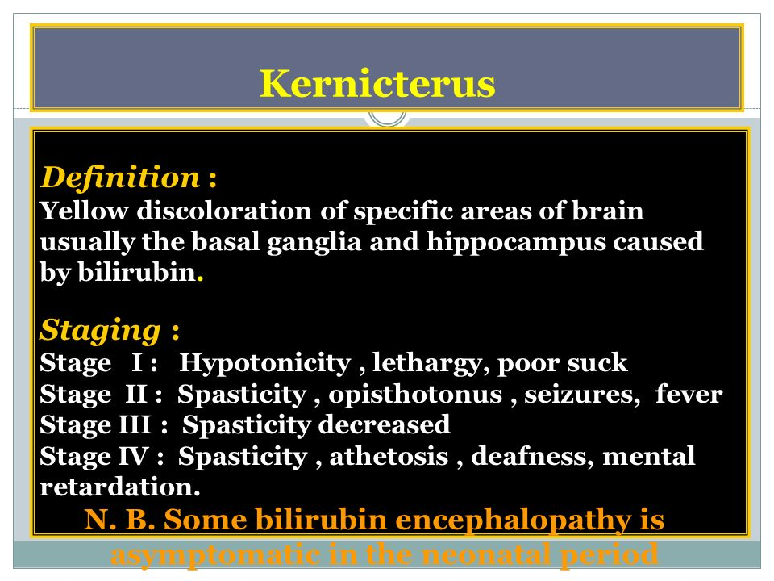
COMPLICATION OF NNJ

Slide 68
CONCLUSION
The occurrence of neonatal jaundice and its related morbidity/mortality cannot be overlooked.
Healthcare centres need to be equipped with adequate treatment facilities to effectively manage the disease burden.

Slide 69
REFERENCE
NelsoN Textbook of Paediatrics of Paeditrics: 20th ed.
Hansen T. The epidemiology of neonatal jaundice. Pediatric Medicine. 2021;5(18):18
World Health Organization . Effective perinatal care: facilitator guide 2010. Available from: https://www.euro.who.int/__data/assets/pdf_file/0003/127902/EPC_facilitators_guide.pdf [accessed 20 May 2022].
Olusanya BO, Teeple S, Kassebaum NJ. The contribution of neonatal jaundice to global child mortality: findings from the GBD 2016 study. Pediatrics. 2018 Feb 1;141(2).

Slide 70
Yu TC, Nguyen C, Ruiz N, Zhou S, Zhang X, Böing EA, Tan H. Prevalence and burden of illness of treated hemolytic neonatal hyperbilirubinemia in a privately insured population in the United States. BMC pediatrics. 2019 Dec;19(1):1-5.
Slusher TM, Zamora TG, Appiah D, Stanke JU, Strand MA, Lee BW, Richardson SB, Keating EM, Siddappa AM, Olusanya BO. Burden of severe neonatal jaundice: a systematic review and meta-analysis. BMJ paediatrics open. 2017;1(1).

Slide 71
Thank you!

