Slide 1
BASIC NEWBORN RESUSCITATION(NR) SKILLS NEEDED BY THE GENERAL PRACTITIONER
BY
DR MESIOBI ANENE, N. J
(MBBS,FWACP)
27/06/23

Slide 2
OUTLINE
INTRODUCTION
PATHOGENESIS/FETAL AND TRANSITIONAL CIRCULATION
PREPARATION FOR BIRTH/RESUSCITATION
CARE OF THE NEWBORN AT BIRTH
APGAR SCORE
lnitial Steps of Newborn Care
Positive-Pressure Ventilation
Endotracheal lntubation
Chest Compressions
Important Points
Conclusion
References

Slide 3
INTRODUCTION
Most newborns make the transition to extrauterine life without intervention.
Within 30 seconds after birth, approximately 85% of term newborns will begin breathing.
An additional 10% will begin breathing in response to drying and stimulation.
To successfully transition, approximately 5% of term newborns will receive positive-pressure ventilation (PPV).
2% of term newborns will be intubated.
One to 3 babies per 1,000 births will receive chest compressions or emergency medications.

Slide 4
INTRODUCTION
The likelihood of requiring these lifesaving interventions is higher for babies with certain identified risk factors and those born before full term.
Before birth, pulmonary blood vessels in the fetal lungs are tightly constricted, and the alveoli are filled with fluid, not air.
After birth, the baby's lungs must take over respiratory function.
They must be filled with air to exchange oxygen and C02
Respiratory failure can occur if the baby does not initiate or cannot
maintain effective breathing effort.

Slide 5
INTRODUCTION
If respiratory failure occurs either before or after birth, the primary
problem is a lack of gas exchange.
Therefore, the focus of neonatal resuscitation is effective ventilation of the baby's lung
Newborn resuscitation is usually needed because of respiratory failure.
Very few newborns will require chest compressions or medication.
Teamwork, leadership, and communication are critica! to successful resuscitation of the newborn.

Slide 6
Why do newborns require a dif f erent approach to resuscitation than adults?
Most often, adult cardiac arrest is a complication of coronary artery
disease.
At the time of arrest, the adult victim's blood oxygen and C02 content is usually normal and the lungs remain filled with air.
During adult resuscitation, chest compressions maintain circulation until electrical defibrillation or medications restore the heart's function.
In contrast, most newborns requiring resuscitation have a healthy
heart.
When a newborn requires resuscitation, it is usually because
respiratory failure interferes with oxygen and C0 2 exchange.

Slide 7
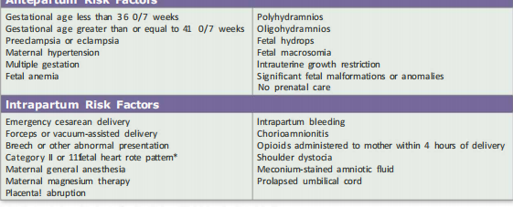
RISK FACTORS INCREASING LIKELIHOOD OF NR

Slide 8
PATHOGENESIS
Before birth, the fetal lungs are filled with fluid, not air, and theydo not participate in gas exchange.
All of the oxygen used by the fetus is supplied from the mother's blood by diffusion across the placenta. The oxygenated fetal blood leaves the placenta through the umbilical vein.
Blood vessels in the fetal lungs (pulmonary vessels) are tightly constricted and very little blood flows into them.
Most of the oxygenated blood returning to the fetus from the placenta via the umbilical vein flows through the foramen ovale or ductus arteriosus and bypasses the lungs..

Slide 9
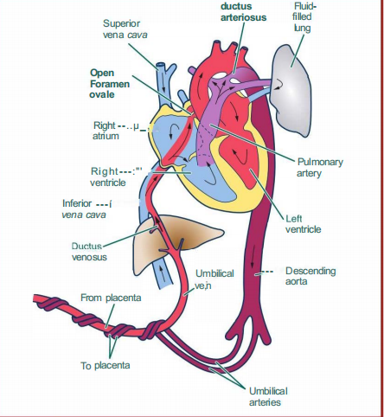
FETAL CIRCULATION

Slide 10
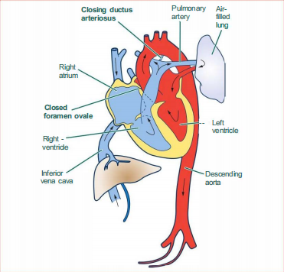
TRANSITIONAL CIRCULATION

Slide 11
PATHOGENESIS
This allows the most highly oxygenated blood to flow directly to the fetal brain and heart.
After birth, a series of events culminate in a successful transition from fetal to neonatal circulation.
As the baby takes deep breaths and cries, fluid is absorbed from the air sacs (alveoli) and the lungs fill with air.
Air in the lungs causes the previously constricted pulmonary vessels to relax so that blood can flow to the lungs and reach the alveoli where oxygen will be absorbed and C02 will be removed

Slide 12
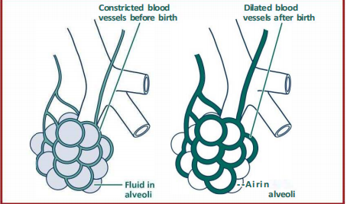
PATHOGENESIS

Slide 13
PATHOGENESIS
When placental respiration fails, the fetus receives an insufficient supply of oxygen and C02 cannot be removed.
Acid increases in the fetal blood as cells attempt to function without oxygen and C02 accumulates.
Fetal monitoring may show a decrease in activity, loss of heart rate variability, and heart rate decelerations.
If placental respiratory failure persists, the fetus will make a series of reflexive gasps followed by apnea and bradycardia.

Slide 14
PATHOGENESIS
If the fetus is born in the early phase of respiratory failure, tactile stimulation may be sufficient to initiate spontaneous breathing and recovery.
If the fetus is born in a later phase of respiratory failure,stimulation alone will not be sufficient and the newborn will require assisted ventilation to recover.
The most severely affected newborns may require chest compressions and epinephrine.
At the time of birth, you may not know if the baby is in an early or a late phase of respiratory failure.

Slide 15
PATHOGNESIS
If normal transition does not occur, the baby's organs will not receive enough oxygen, acid will accumulate in tissues, and blood vessels in the baby's intestines, kidneys, muscles, and skin may constrict.
Temporarily, a survival reflex maintains blood flow to the baby's heart and brain to preserve function of these vital organs.
If inadequate gas exchange continues, the heart begins to fail and blood flow to all organs decreases.
The lack of adequate blood flow and oxygen may lead to organ damage.

Slide 16
CLINICAL FINDINGS OF ABNORMAL TRANSITION
Irregular breathing, absent breathing (apnea), or rapid breathing(tachypnea)
Slow heart rote (bradycardia) or rapid heart rate (tachycardia)
Decreased muscle tone
Pale skin (pallor) or blue skin (cyanosis)
Low oxygen saturation
Low blood pressure

Slide 17
PREPARATION FOR BIRTH
Ensure skilled worker on duty
Identify a helper/form a team
Ensure equipment are available, complete and functionin eg glooves, dry and warm linings, scissors,cord clamp, light source, chlorhexidine gel, suction device, stop watch, stethoscope, laryngoscope, ventilation bag mask, glucometer, 10% D/W, syringe, injection water, N/S, cannula etc.
Ensure clean and warm surfaces for delivery and resuscitation
Ensure warm environment
Good handwashing

Slide 18

PREPARING AND ANTICIPATING

Slide 19
PREPARING AND ANTICIPATING
Identify risk factors by asking the obstetric provider these 4 questions before birth:
( 1) What is the expected gestational age?
(2) Is the amniotic fluid clear?
(3) Are there any additional risk factors?
(4) What is our umbilical cord management plan?
Some newborns without any apparent risk factors will require resuscitation.

Slide 20
PREPARING AND ANTICIPATING
If risk factors are present, at least 2 qualified individuals should be present solely to manage the baby.
The number and qualifications of these individuals will be determined by the risk factors.
All supplies and equipment necessary for a complete resuscitation must be readily available and functional for every birth.
Every birth should be attended by at least 1 qualified individual who can initiate resuscitation and whose only responsibility is management of the newly born baby.

Slide 21
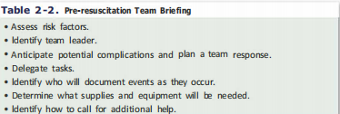
PREPARING AND ANTICIPATING

Slide 22
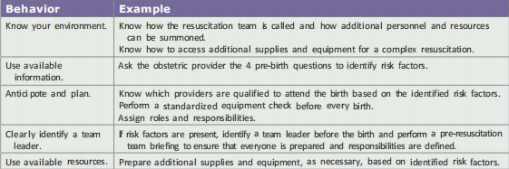
PREPARING AND ANTICIPATING

Slide 23
AT BIRTH
At the delivery of the head, clean nostrils
Deliver below the mother
Crying vigorously-Delay cord clamping
-Deliver on to mothers chest/abdomen in skin to skin
contact
-Dry and wrap well around the mother
-Check breathing
- Cut cord
-Encourage breastfeeding

Slide 24
AT BIRTH(GOLDEN MINUTE)
Not crying - Dry thoroghly
- Put under resuscitaire or in a warm blanket
-Position the head
-Clear the airway
-Stimulate breathing
Still not crying - Reassess/APGAR Scoring

Slide 25
APGAR SCORE
SIGN | 0 | 1 | 2
APPEARANCE(COLOUR) | Blue or Pale | Peripheral cyanosis | pink
PULSE(HEART RATE) | Absent | <100 | >100
GRIMACE(REFLEXES) | No response | Grimace | Cry or active withdrawal
ACTIVITY(MUSCLE TONE) | Limp | Some flexion | Active motion
RESPIRATION | Absent | weak cry | Normal RR or crying

Slide 26
APGAR SCORE
APGAR scoring system was a rapid method of assessing the clinical status of the newborn infant at 1 and 5 minute of age and the need for prompt intervention to establish breathing
The Apgar score does not predict individual neonatal mortality or neurological outcomes, and thus should not be used for that purpose
It is useful for conveying information about the newborn infant’s overall status and response to resuscitation.
It is not used to determine the need for initial resuscitation, what resuscitation steps are necessary, or when to use them.

Slide 27
APGAR SCORE
GRADING OF ASPHYXIA USING APGAR SCORE
1-3 SEVERE
4-6 MILD
7 AND ABOVE - NORMAL

Slide 28
effective team WORK
Every resuscitation team needs to have a team leader.
Any team member who has mastery of the NRP Algorithm and effective leadership skills can be the team leader.
The leader does not have to be the most senior member of the team or the individual with the most advanced degree.
That person may have technical skills that will be required during the resuscitation and may not be able to maintain their full attention on the baby's condition.
If you are the person with sole responsibility for management of the baby at birth and the baby unexpectedly requires resuscitation, you become the team leader and direct your assistants to help you until the full resuscitation team

Slide 29
effective team WORK
Direct the request to a specific individual.
Call your team member by name.
Make eye contact.
Speak clearly.
After giving an instruction, ask the receiver to report back as soon
the task is completed.
After receiving an instruction, repeat the instruction back to the sender

Slide 30
effective team WORK
NOTE:
each team member shares responsibility for ongoing assessment and ensuring that interventions are performed in the correct sequence with the correct technique.
Successful coordination requires team members to share information
and communicate with each other
Complete and accurate documentation is important for clinical decision-making andas a source for quality improvement data.
Use a single time reference

Slide 31
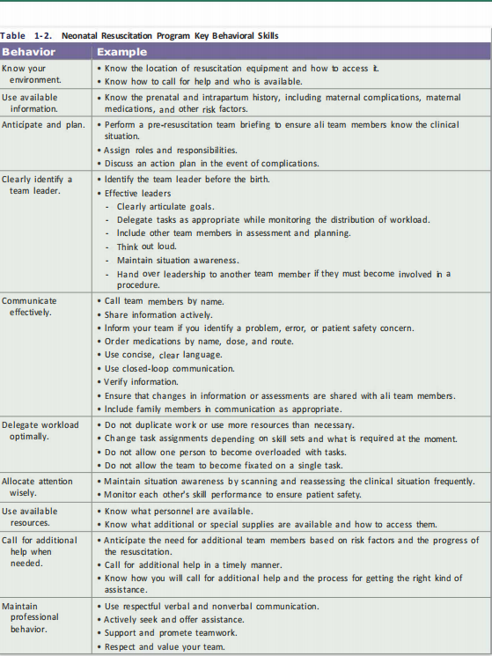
effective team WORK

Slide 32
effective team WORK

Slide 33

RAPID EVALUATION
Determine if the newborn can remain with the mother or should be moved to a radiant warmer for further evaluation.

Slide 34
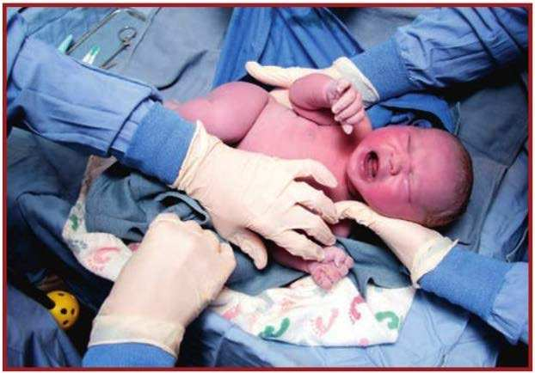
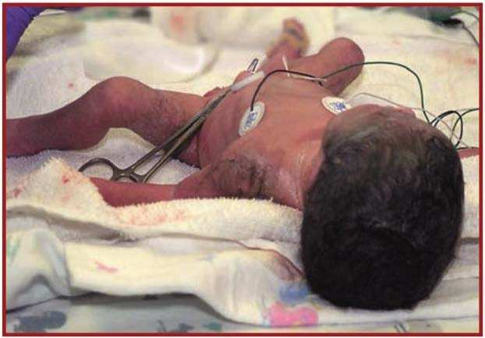
RAPID EVALUATION

Slide 35
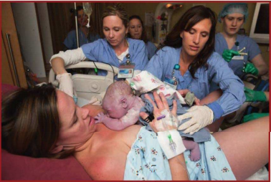
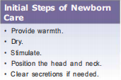
INITIAL STEPS OF NEWBORN CARE FOR VIGOROUS BABY

Slide 36
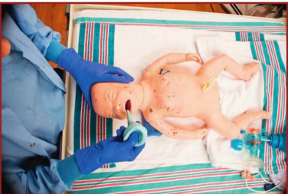
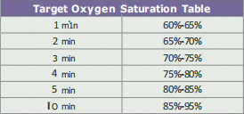
INITIAL CARE FOR NON VIGOROUS BABY-

Slide 37
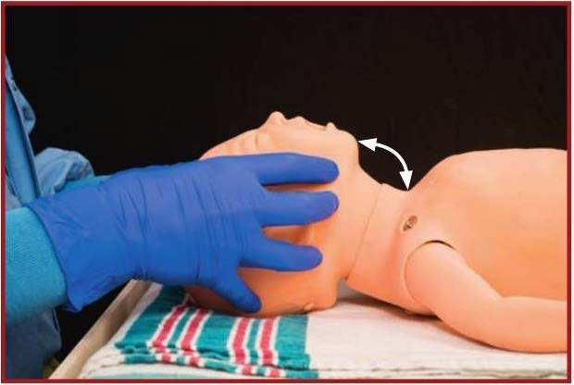
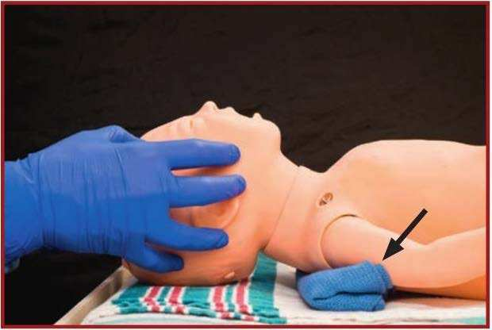
INITIAL CARE FOR NON VIGOROUS BABY-
Notes:
Correct sniffing position and Optional shoulder roll for maintaining the
sniffing position

Slide 38
VENTILATION
What are the indications for positive-pressure ventilation?
After completing the initial steps, PPV is indicated if the baby is not
breathing ( apneic), OR if the baby is gasping, OR if the baby's heart rate is less than 100 bpm .
When indicated, PPV should be started within 1 minute of birth.

Slide 39
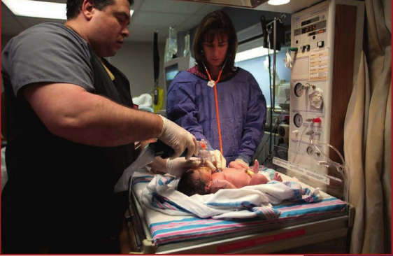
VENTILATION-IPPV(40breaths/min)

Slide 40
VENTILATION
Ventilation of the newborn's lungs is the single most important and most effective step in neonatal resuscitation.
It is indicated if the baby is not breathing, OR if the baby is gasping, OR if the baby's heart rate is less than 100 beats perminute (bpm).
During PPV, the initial oxygen concentration for newborns greater than or equal to 35 weeks' gestation is 21 %. The
for preterm newborns less than 35 weeks' gestation is 21 % to 30%.
The ventilation rate is 40 to 60 breaths per minute and the initial ventilation pressure is 20 to 25 cm H20 .
The most important indicator of successful PPV is a rising heart rate.
If the heart rate is not increasing within the first 15 seconds of PPV and you do not observe chest movement, start the ventilation corrective steps.

Slide 41
CORREECTIVE STEPS- MR SOPA
a. Mask adjustment.
b. Reposition the head and neck.
c. Suction the mouth and nose.
d. Open the mouth.
e. Pressure increase.
f. Alternative airway.

Slide 42
VENTILATION
If the baby cannot be successfully ventilated with a face mask and intubation is unfeasible or unsuccessful, a laryngeal mask may provide a successful rescue airway.
If the heart rate remains less than 60 bpm despite at least 30 seconds of face-mask PPV that inflates the lungs ( chestmovement), reassess your ventilation technique, consider performing the ventilation corrective steps, adjust the oxygenmas indicated by pulse oximetry,
insert an alternative airway( endotracheal tube or laryngeal mask), and provide 30 seconds of PPV through the alternative airway.
After these steps, if the heart rate remains less than 60 bpm, increase the oxygen to 100% and begin chest compressions.

Slide 43
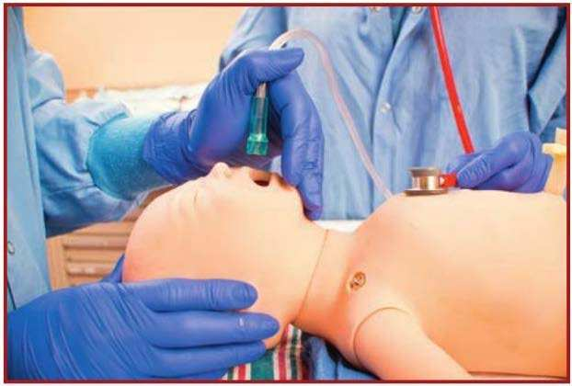
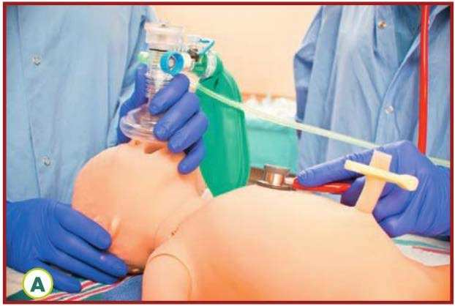
OXYGEN ADNMISTRATION

Slide 44
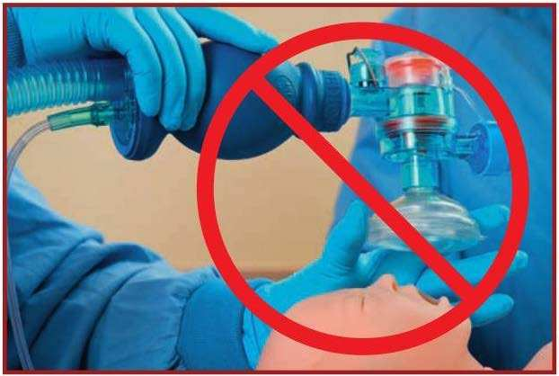
OXYGEN ADNMISTRATION

Slide 45
CHEST COMPRESSION
This is indicated if after providing 30 seconds of PPV through the alternative airway and the heart rate remains less than 60 bpm
3:1compression to ventilation i.e 90:30 in a minute.

Slide 46
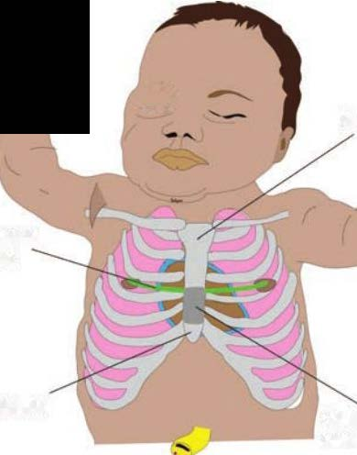
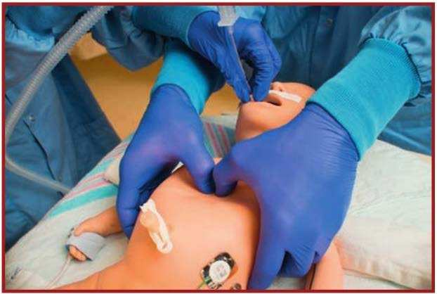
CHEST COMPRESSION

Slide 47
Meconium-stained fluid and newborn
If the baby is vigorous with good respiratory effort and muscle tone, the baby may stay with the mother to receive the initial steps of newborn care.
If a baby is born through meconium-stained amniotic fluid and has depressed respirations or poor muscle tone, bring the baby to the radiant warmer and perform the initial steps of newborn care as described in this lesson. You will use a bulb syringe to clear secretions from the mouth and nose.

Slide 48
If the baby is breathing and the heart rate is less than 100 bpm after the initial steps are completed, proceed with PPV.
Routine laryngoscopy with or without intubation for tracheal suction is not suggested. Historically, routine intubation and suction immediately after birth was recommended in an effort to reduce the chance of developing meconium aspiration syndrome; however, a
recent systematic review found no evidence to support this practice.
Intubation and tracheal suction may be necessary if PPV does not ínflate the lungs and airway obstruction is suspected

Slide 49
DELAYED CORD CLAMPING
In preterm newborns, potential benefits of delayed cord clampingcompared with immediate cord clamping include decreasing thechance of needing medications to support blood pressure after birth,requiring fewer blood transfusions during hospitalization, and possibly improved survival.
In term and late preterm newborns, delayed cord clamping may improve early hematologic measurements and, although uncertain,there may be benefits for neurodevelopmental outcomes. However,there may also be an increased chance of needing phototherapy for hyp erbilirubinemia.

Slide 50
Case 1: Preparing for a birth with risk factors
A 30-year-old woman enters the hospital in labor at 36 weeks' gestation. She has insulin-requiring gestational diabetes and hypertension.
She is found to have ruptured membranes with clear amniotic fluid.
Fetal heart rate monitoring shows a Category II pattern(indeterminate pattern requiring evaluation, surveillance, and possibly other tests to ensure fetal well-being).
Labor progresses rapidly and a vaginal birth is imminent.
The obstetric provider calls your resuscitation team to attend the birth.

Slide 51
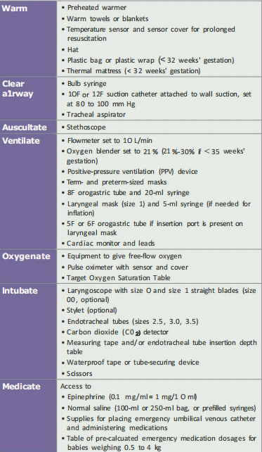

Slide 53
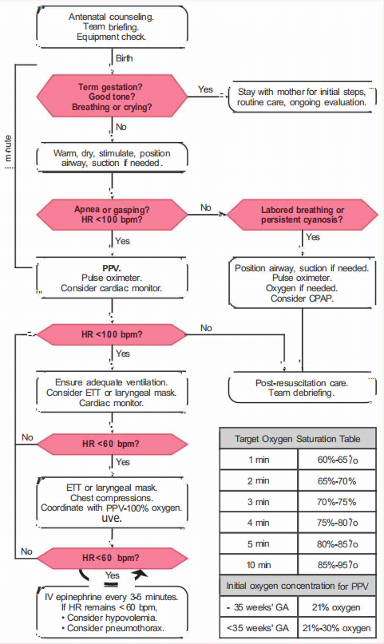

Slide 55
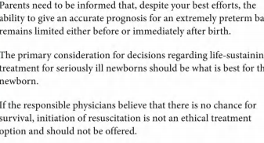
ETHICS IN NR

Slide 56
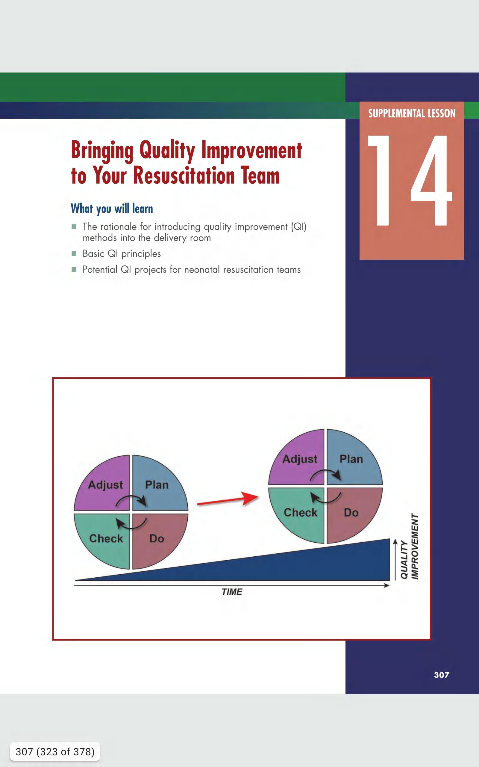
ROOM FOR IMPROVEMENT

Slide 57
CONCLUSION
Even though the majority of newborns do not require intervention, some still do and the large number of births each year means that timely intervention can save many newborn lives.
The need for assistance cannot always be predicted, health care providers need to be prepared to respond quickly and efficiently at every birth.

Slide 58
REFERENCES
1. NelsoN Textbook of Paediatrics of Paeditrics: 20th ed.
2. Text book of Neonatal Resuscitation: th Ed
3. Apgar V. A proposal for a new method of evaluation of the newborn infant. Curr Res Anest Anal. 1953;32(4):260–267[PubMed]
4. Apgar V, Holaday DA James LS, Weisbrot IM, Berrien C. Evaluation of the newborn infant; second report.J Am Med Assoc. 1958;168(15):1985–1988[PubMed]
5. Forfar and Arneil Textbook of Paediatrics,7th Ed
6. Helping Baby Breathe prvider guide, module 2: 2nd Ed. 2018
7.Essential Newborn care course, Provider guide, module 1:22nd Ed. 2018
8. Macones GA, Hankins GD, Spong CY, Hauth J, Moore T. The 2008 National Institute of Child Health and Human Development workshop report on electronic fetal monitoring: update on definitions, interpretation, and research guidelines. Obstet Gynecol.2008;112(3):661-666

Slide 59
Thank you!

