Slide 1
REGULATION OF MEDICAL AND
DENTAL PRACTICES IN NIGERIA
PRESENTED
BY
DR. NGOWARI TORUNANA
DIRECTOR MEDICAL SERVICES, MINISTRY OF HEALTH, YENAGOA

Slide 2
What is Regulation
It is art of instituting guiding principles in the practice of a profession.

Slide 3
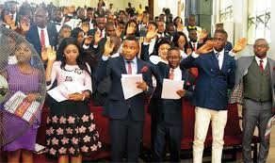

Slide 4
The Medical and Dental Professions in Nigeria are regulated by the Medical and Dental Practitioners Act Cap 221 Laws of Federation of Nigeria, 1999 (as amended), which set up the Medical and Dental Council of Nigeria.
The Act was reviewed and became Medical and Dental Practitioners Act Cap M8 Laws of Federation of Nigeria, 2004.

Slide 5
The Responsibilities of Medical and Dental Council Of Nigeria (MDCN)
Determining the standard of knowledge and skills to be attained by persons seeking to become members of the Medical or Dental profession and reviewing those standards from time to time as circumstances may permit.
Securing in accordance with provisions of the Act, the establishment and maintenance of register of persons entitled to practice as members of the Medical and Dental professions and the publications from time to time of list of those persons.
Reviewing and preparing from time a statement as to the code of conduct which the Council considers desirable for the practice of the professions in Nigeria.
Performing the other functions conferred on the Council by the Act.

Slide 6
LEGAL BASIS FOR MEDICAL AND DENTAL PRACTICES
(a) Registration:
Any one who does not register and is practicing contravenes the law and so does his or her employer.
Categories of Registration:
i Provisional Registration
ii Full Registration
iii Limited or Temporary Registration
iv Registration as a Specialist.

Slide 7
(b) Practicing Fees and Annual Licensing
i In the case of first offence, to a fine of twice the prescribed practicing fee.
ii In the case of second or subsequent offence, to a fine of not less than ten (10)
times the prescribed practicing fee.
iii Late payment attracts a surcharge as may be determined by the Council from
time to time without prejudice to any other penal provisions in the statute.
iv All Doctors are advised to meet this commitment promptly as conviction under
this section will be viewed seriously by the Council.

Slide 8
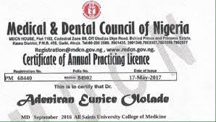
Image of MDCN License

Slide 9
The law further stipulates as follows:
Where a practitioner who is in employment has defaulted from payment of the practicing fee, and if the medical practitioner or dental surgeon is in the employment of any person, that person shall also be guilty of an offence and punished in like manner as the medical practitioner or dental surgeon unless he proves that the failure to pay the practicing fee was without his knowledge, consent or connivance.
All members of the medical and dental professions who employ medical doctors or dental surgeons or who are professional heads of medical institutions, either public or private, are to take due notice of this aspect of the law.

Slide 10
GUIDELINES FOR NON-INDEGINOUS MEDICAL
AND DENTAL PRACTITIONERS
Non-indigenous medical and dental practitioners by this nomenclature means those that acquired their medical and dental degrees outside the shores of Nigeria and shall be accorded all benefits due to them as to their Nigerian counterparts
A. Registration:
All foreign qualified Doctors wishing to practice in Nigeria must sit and pass the Assessment
(proficiency) Examination before seeking registration with the Medical and Dental Council of
Nigeria (MDCN).
B. Limited Registration:
A success in the proficiency examination qualifies foreign trained Doctors to proceed to
Provisional Registration for Nigerian Citizens and a Limited Registration for non-Nigerian Citizens.

Slide 11
C. Humanitarian Doctors:
A limited registration and current practicing license for expatriate doctors. It is the responsibility of the organization or the individual bringing them in for the humanitarian service to ensure that they are registered with the Nigerian Medical and Dental Council of Nigerian (MDCN).
D. Exchange programme Doctor:
A limited registration is required.
Failure to comply with General Guidelines if reported may amount to infamous conduct for which the affected practitioner may, if found guilty, be punished.

Slide 12
Tribunal case between MDCN & the Court
Medical and Dental Practitioners Disciplinary Tribunal v Dr John Emewulu Nicholas Okonkwo
Supreme Court, 2 March 2001
Judges: Belgore JSC, Onu JSC, Achike JSC, Uwaifo JSC and Ayoola JSC
Previously reported: [2001] WRN 1
Emmanuel Olayinka Ayoola JSC
[1.] Of the several issues raised by this appeal the central issue is whether a medical
practitioner is guilty of infamous conduct when, in deference to the patient's religious
objection to blood transfusion, he failed either to adopt such course of treatment;
terminate his medical contract; or refer the patient to another health institution or another medical doctor.

Slide 13
Mrs Okorie, a 29-year-old woman, having had a delivery at a maternity hospital on 29 July 1991, was admitted as a patient at Kenayo Specialist Hospital for a period of nine days from 8 August to 17 August 1991. She had complained of difficulty in walking and severe pain in the pubic area. At Kenayo Hospital the diagnosis disclosed a severe anaemia and a day after her admission blood transfusion was recommended. The patient and her husband refused to give their consent to blood transfusion.

Slide 14
The Charge
(a) Although it was clear from the referral letter from Kenayo specialist hospital, Onitsha, where the patient had been previously admitted, that the patient was severely anaemic, which said diagnosis you confirmed upon the patient being admitted in your hospital, you nevertheless made no plans and in fact failed to transfuse blood to the patient until she died on 22/8/91;
(b) Although you claimed inhibition for your failure to apply an obviously correct treatment to the patient, you failed to transfer the patient to a bigger centre where such inhibition would not operate to the patient's disadvantage.

Slide 15
The respondent was charged before the Medical and Dental Practitioners Disciplinary Tribunal (the tribunal) in 1993 in two counts. In the first count he was charged with attending to the patient in a negligent manner and thereby conducting himself infamously in a professional respect contrary to medical ethics' and punishable under section 16 of the Medical and Dental Practitioners Act (the Act). In the second count he was charged with acting contrary to his oath as a medical practitioner and thereby conducting himself infamously in a professional respect contrary to the same section of the Act.
The allegations in the first count were that:

Slide 16
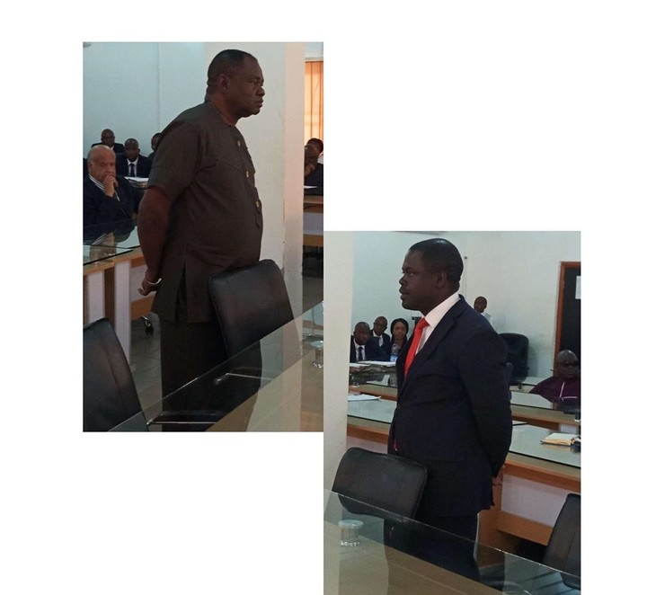

Slide 17
The Trial
The respondent pleaded not guilty to the charge. At the trial, witnesses who gave
evidence for the prosecution were an officer of the Medical and Dental Council (the
council), who tendered certain documents, the uncle of the patient, and the mother of the
patient. Apparently, the last two were the persons who lodged a complaint against the
respondent. The respondent, who gave evidence in his own defense, testified that the
patient and her husband objected to blood transfusion and persisted in their objection
even after he had made them to understand the gravity of their decision. It was at that
stage that the patient's husband signed the document (exhibit G) releasing him and his
hospital from liability. He gave the following evidence concerning his willingness to
transfer the patient to another hospital:

Slide 18
I then invited the husband to my office and made it clear to him that I am not used
to trouble and that I think the best thing I was going to do was to move them over
to the Teaching Hospital, so as to wash my hand off the trouble. And the husband
said to me that he was no more prepared to go to anywhere and that he had
confidence that whatever the outcomes, he would take it.
Under cross-examination he said that if the patient consented to a blood
transfusion he would have arranged for it. He gave evidence that he was not influenced
by any consideration other than the patient's refusal to give consent for a blood
transfusion in his failure to provide a blood transfusion. He said that he had obeyed the
request of the patient's husband not to transfer the patient despite his offering them a
transfer. The patient's husband, Loveday Okorie, the only other witness for the defense,
corroborated the evidence of the defendant in material particulars, particularly in regard
to the refusal of the patient and himself to consent to a blood transfusion even after being
warned by the defendant of the possible consequence of their decision

Slide 19
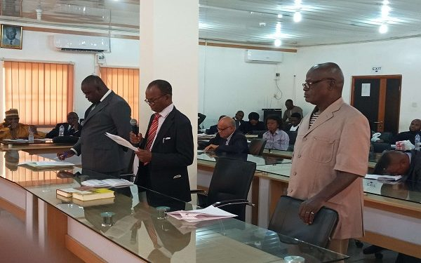
Dr. Arraigned for trial

Slide 20
Religious objection to medical treatment: limit of practitioner's responsibility
The scope and limit of the duty of a practitioner faced with a patient's refusal to give informed consent to life-saving medical treatment cannot be considered in isolation of the right of the patient. Although, there is a dearth of local authorities in this area of our law, there are ample provisions of our Constitution which show the basis on which the Court should proceed in these matters.

Slide 21
It is expedient at the outset to recognize that a consideration of a religious objection to medical treatment involves a balancing of several interests, namely: the constitutionally protected right of the individual, state interest in public health, safety and welfare of society; and, the interest of the medical profession in preserving the integrity of medical ethics and, thereby, its own collective reputation. To give undue weight to one of these interests over others may infringe on the rights of the competent adult patient and may constitute a threat to liberty of the individual, unless legally recognized circumstances justify that weight should be ascribed to one over the others. Where, for instance, the health and safety of society is under threat, for instance in an epidemic.

Slide 22
Medical and Dental Practitioners Disciplinary Tribunal v Dr. Jamilu Muhammad
The count reads: “That you Dr. Jamilu Muhammad, registered medical practitioner, practicing as such on 19th April, 2017 at the Martha Bamaiyi General Hospital, Zuru, Kebbi state, while managing one Malama Fatima Danjuma (F) as a pregnant woman under your care, were grossly negligent In her management when you assessed her in a manifestly incompetent manner, erroneously diagnosed her to have intrauterine foetal death, and proceeded to carry out a destructive surgery, only to realize that the baby was alive after amputating the prolapsed upper limb, thereby conducted yourself infamously in a professional respect contrary to Rules 29.4b, 29.4c, 29.4t, 29.4h and 31 of the Code of Medical Ethics In Nigeria,2008 Edition, and punishable under Section 16 (T) (o) and (2) of the Medical and Dental Practitioners’ Act, CAP M8 LFN, 2004 (as amended).”

Slide 23
According to the charge sheet, No MDODT/4/2018, Dr. Muhammad erroneously diagnosed that the baby in the womb of the victim was dead and said there was a need to carry out a surgery to evacuate the dead baby “only to realize that the baby was alive after amputating the baby’s upper limb.”
The charge was based on the affidavit issued by Elisha Nona Ajoyi dated and filed on May 8, 2017, alleging unethical behaviour against the respondent.
Delivering ruling, the chairman of the tribunal, Abba Hassan ordered the suspension of Dr. Muhammad for six months.
He said the panel reached the conclusion that a prima facie case had been established against the respondent.

Slide 24
“After due consideration of the facts ….the maximum punishment prescribed by the Act, this Honourable Tribunal hereby makes the following order: An order suspending Dr. Jamilu Muhammad from practice. Accordingly, Dr. Jamilu Muhammad is ordered not to engage in practice as medical practitioner for a period of six months.
“However, having been on suspension for a period longer than this sentence, he is hereby accordingly deemed to have served and exhausted the prescribed term of suspension herein imposed.”
Dr. Muhammad is one of the 14 doctors arraigned on Monday for trial by the MDCN for various offences.

Slide 25
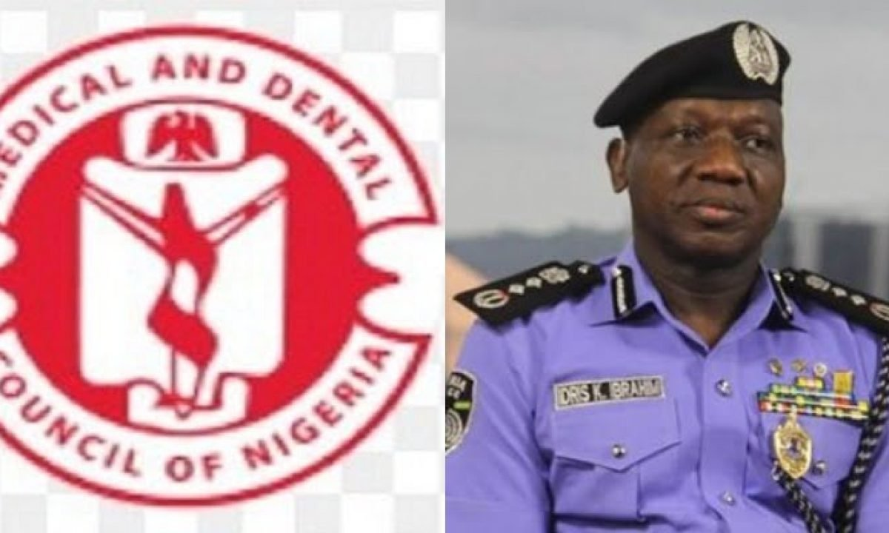

Slide 26
Maradona’s Death
Eight medical Staff to undergo trial due to negligence. This cuts across to all cadre of medical personnel.

Slide 27
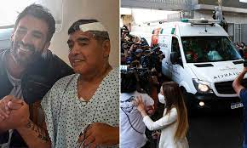
Image of maradona

Slide 28

Thank you for listening

