Slide 1
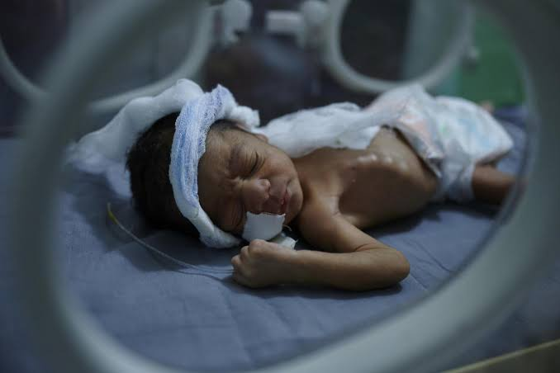
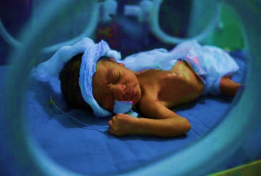
Problems and care of the preterm including kangaroo mother care.
By
Prof. Onyaye Edgar Kunle Olowu. MBBS, FWACP (Paed)

Slide 2
WHY ARE WE CONCERNED?
SUSTAINABLE DEVELOPMENT GOALS
Goal 3: Ensure healthy lives and promote well-being for all at all ages
Target 3.2 By 2030, end preventable deaths of newborns and children under 5 years of age, with all countries aiming to reduce neonatal mortality to at least as low as 12 per 1,000 live births and under-5 mortality to at least as low as 25 per 1,000 live births.
Indicator 3.2.1: Under-five mortality rate(117 per 1,000 live births)
Indicator 3.2.2: Neonatal mortality rate(34.9 per 1000 births)

Slide 3
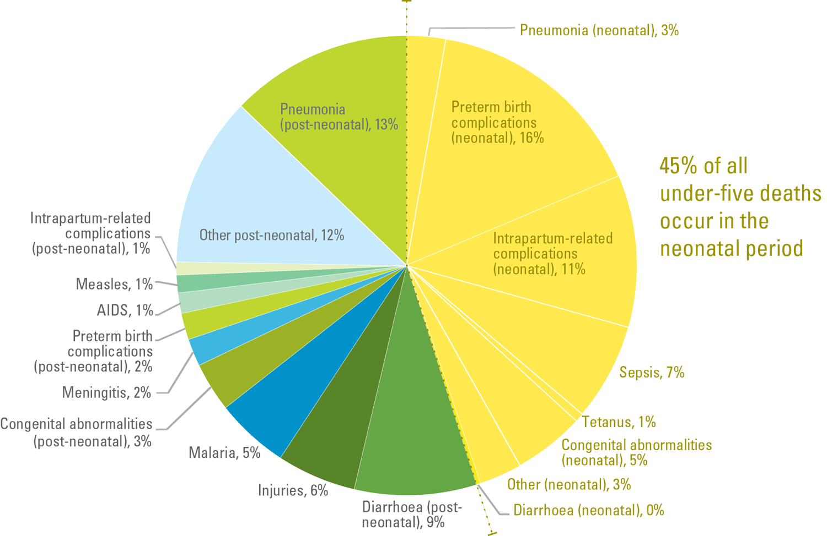
Leading causes of under-5 mortality.

Slide 4
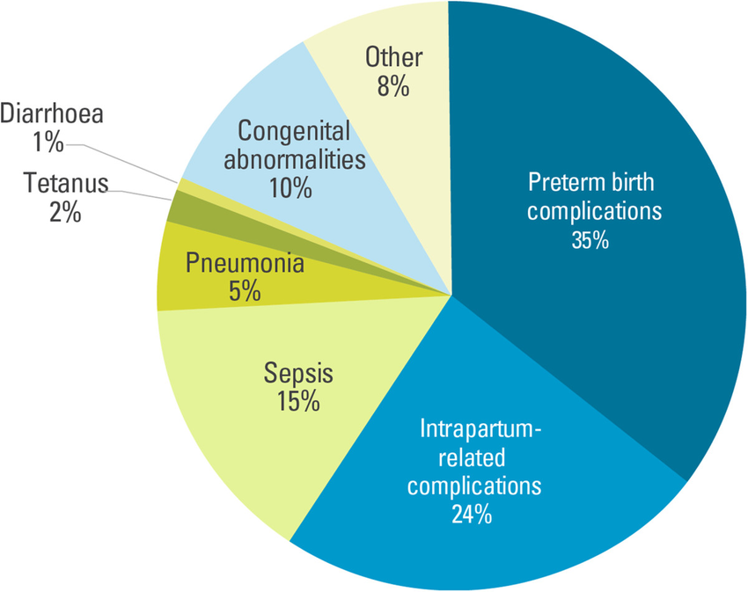
CAUSES OF NEONATAL DEATHS

Slide 5
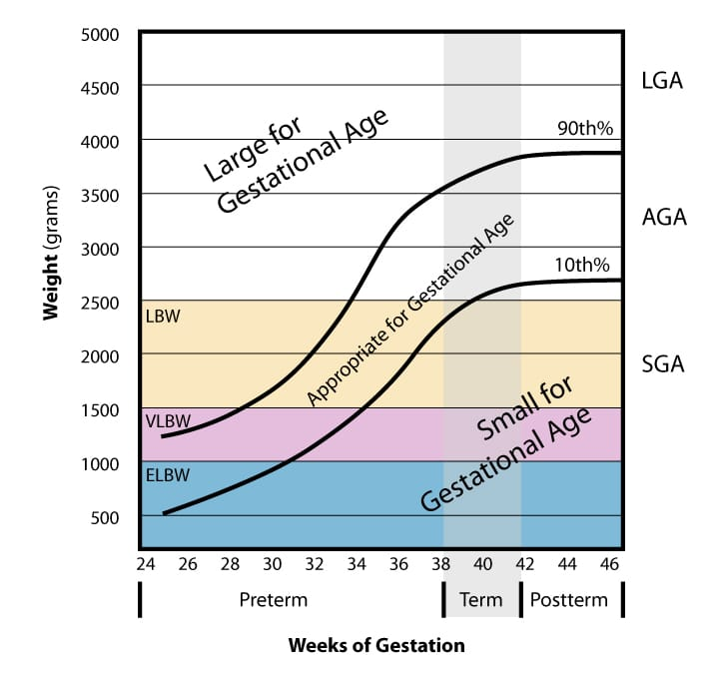
DEFINITIONS
PRETERM BIRTH:
A baby born alive before 37 weeks of pregnancy.
before 259 days,( from the first day of LMP) WHO classification.

Slide 6
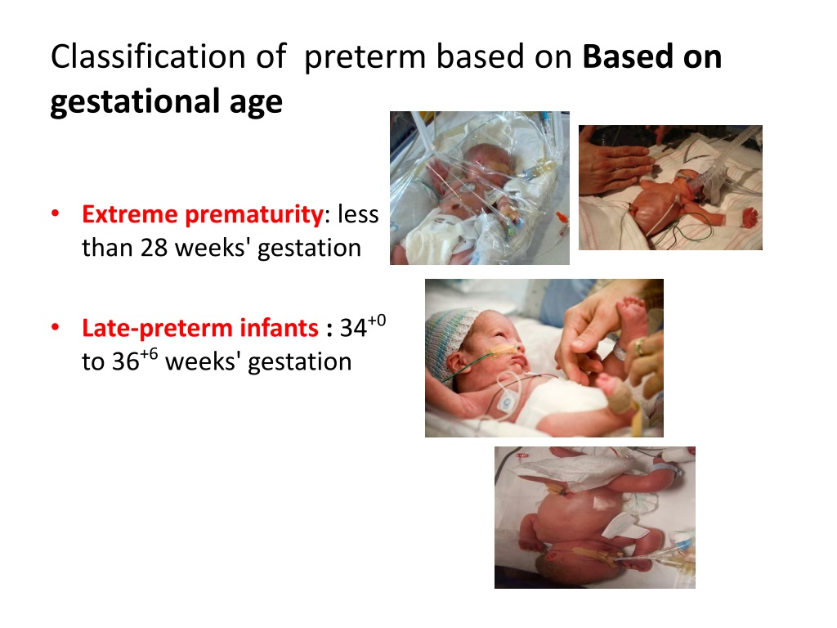
Very –preterm:28 to 32 weeks of gestation.
Moderate- preterm: 32 to 34 weeks gestation
The earlier the preterm is delivered, the more severe the problems faced may be.

Slide 7
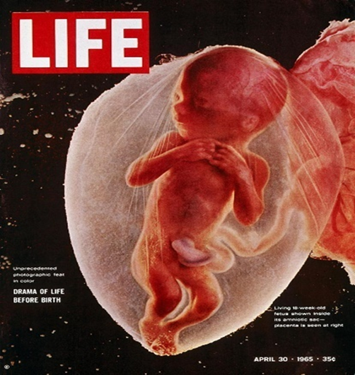
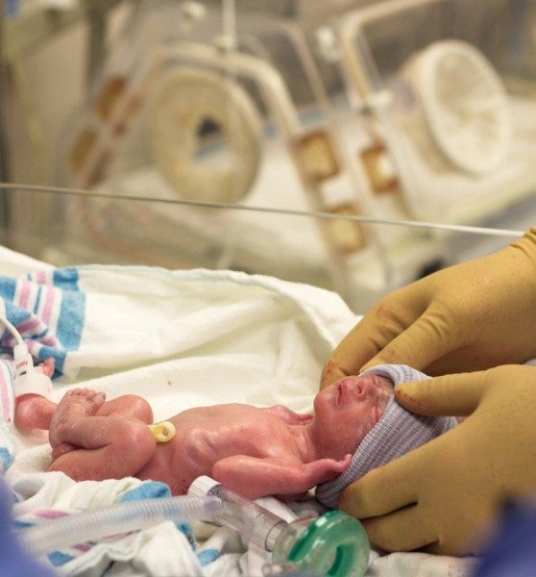
THE TRANSITION- AT WHAT COST?

Slide 8
PROBLEMS OF THE PRETERM
Problems of the preterm
Baby
Family
Society

Slide 9
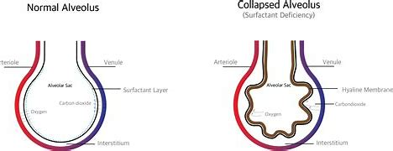
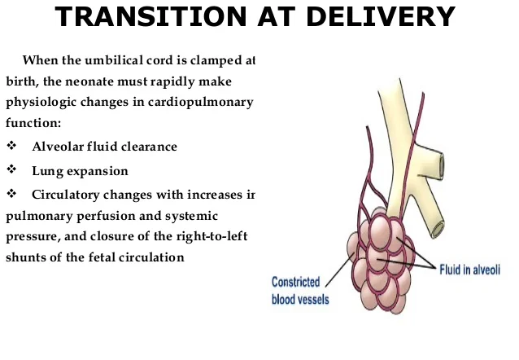
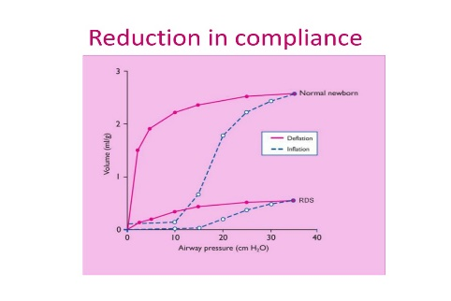
PROBLEMS OF THE PRETERM
 |  | Pathology
Respiratory distress syndrome (RDS) Apnea <30 weeks Chronic lung disease | Lack of surfactant, air sacs cannot stay open. Wet lungs, increased fluid in the lungs Brain and lungs are not fully developed, and apnea, or periods where breathing stops, occurs in 85% of babies born before 34 weeks. Apnea may come with periods of bradycardia where the heart slows down. Chronic lung condition caused by airway inflammation. It affects infants who were on a ventilator for long periods of time and can cause difficulty breathing and low blood oxygen levels.

Slide 10
METABOLIC &BLOOD PROBLEMS
Neonatal jaundice: | Immaturity of liver & gastrointestinal tract | They are also at risk of kernicterus as their body develops this at a lower level of bilirubin than a more mature baby.
Temperature instability | large surface area-body weight ratio, little or the absence of brown fat for non-shivering thermogenesis
Anaemia
Electrolyte inbalance | Hypoglycaemia, hypocalcaemia. | Both can cause convulsions that may produce long-term brain damage.

Slide 11
CARDIOVASCULAR & GASTROINTESINTESTINAL PROBLEMS
Hypotension | Hypovolaemia, cardiac dysfunction, sepsis-induced vasodilation
PDA | Left-Right shunt( circulatory changes immediately after birth) This may lead to pulmonary over-circulation and diastolic hypotension. | A PDA, which occurs in 8% of infants born between 30 and 32 weeks and more often in younger preterm, causes abnormal circulation.
Intraventricular brain haemorrhage (especially those born before 30 weeks): ) | They have fragile blood vessels in their brains. If those vessels break, an intraventricular hemorrhage (IVH) may occur. This bleeding into the brain may be mild or severe. | Severe bleeds can have serious consequences, such as developmental delays. Mild bleeds usually have no long-term effects.
Necrotizing Enterocolitis (NEC): | Deficiencies of both humoral and cellular response
Difficulty in feeding | Unable to coordinate suck & swallow before 35 weeks | Prone to aspiration, regurgitation
Gastroesophageal reflux (GERD), | Immature gastroesophageal sphincter | Reflux affects up to half of premature babies. They may vomit, lose weight, or have respiratory problems like a cough or pneumonia

Slide 12

OTHERS
Renal | Immature kidneys Low glomerular filtration rate Inability to handle water, solutes, and acid loads | Close monitoring is required.
Ophthalmologic | Retinopathy of Prematurity (ROP): Hyperoxia, hypoxia, or hypotension, at a critical point in retinal vascularization Vasoconstriction Decreased blood flow Arrest in vascular development

Slide 13
POSSIBLE LONG-TERM PROBLEMS (BABY)
As weight and gestational age increase, the risks decrease.
Risks include:
  Learning problems
  Vision and hearing problems
  Feeding and digestive problems
  Respiratory problems
  Cerebral palsy

Slide 14
PROBLEMS OF THE PRETERM (FAMILY)
Psychological: stress, anxiety, and fear are just a few of the emotions the family goes through. This may go beyond the period of admission, extending to years after birth.
Emotional: Poor bonding with the child, difficulties feeding.
Financial: Cost of care especially if out of pocket may run into millions. Higher initial hospital costs (insurance)

Slide 15
PROBLEMS OF THE PRETERM (SOCIETY)
There are also incalculable costs. “Who are we losing when a baby dies? A community leader? A Nobel prize winner? These deaths lead to a need to care for the survivors.” –Wendell Young

Slide 16
CARE OF THE PRETERM INFANT
Thermal care
Feeding support
Kangaroo mother care
Appropriate respiratory support
Antibiotics for infections.
WHO’s feasible cost-effective strategies for the care of preterm infants.

Slide 17
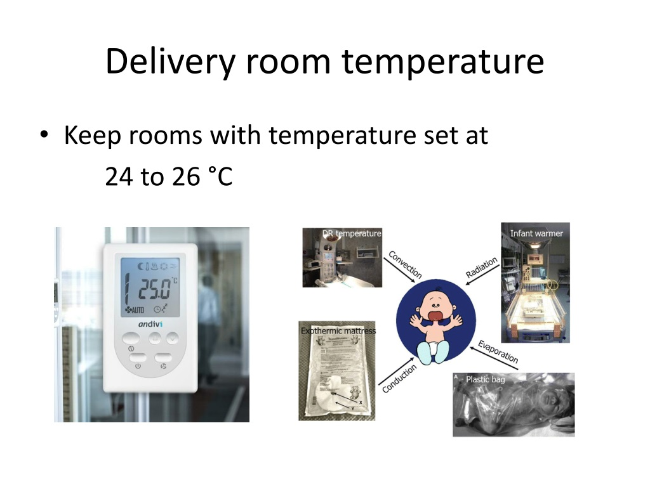
CARE OF THE PRETERM
PHYSICS

Slide 18
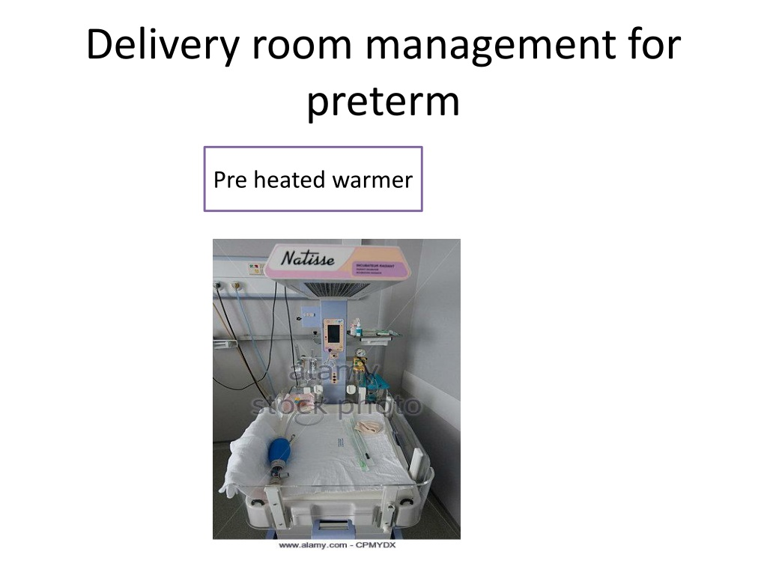
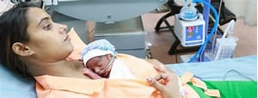
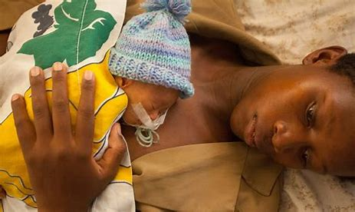
THERMAL CARE

Slide 19
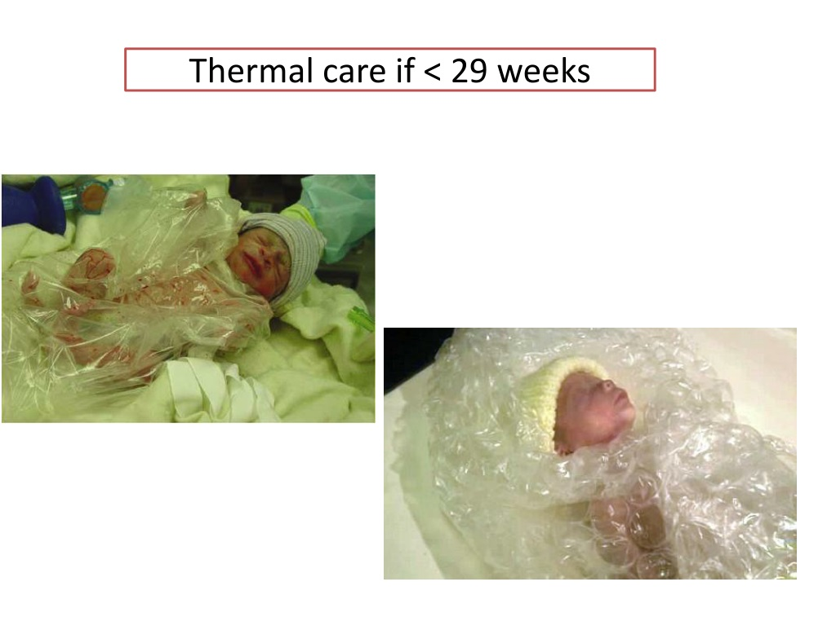
Bubble wrap to retain body heat.

Slide 20
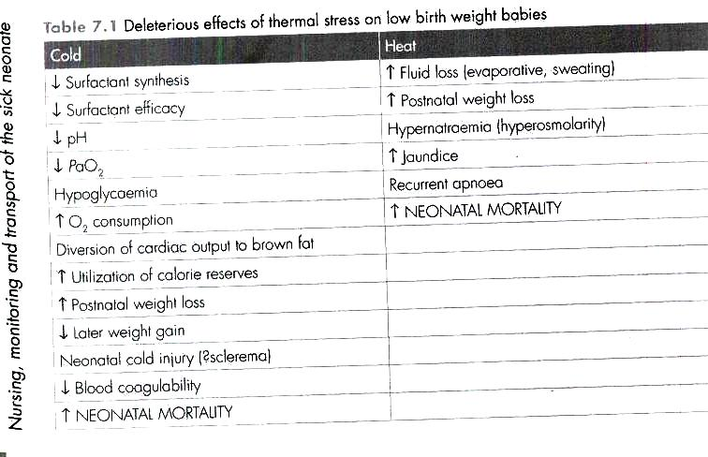

Slide 21
NUTRITION
Goals of nutritional support in the Preterm
Meeting growth rates and body composition compared to normal fetuses of the same gestational age.
Achieving acceptable standards of short-term growth.
Meeting recognized nutritional requirements of the preterm infant.
Prevent feeding-related morbidities, especially prevention of Necrotizing Enterocolitis (NEC).
Optimizing long-term outcomes.

Slide 22
ADVANCEMENT OF FEEDINGS
 | HIGH-RISK | MODERATE RISK 28+1 weeks – 31+6 weeks (no ‘high risk’ clinical indicators) | STANDARD RISK ≥32 weeks (no ‘high risk’ clinical indicators)
COMMENCE | Trophic feeds ASAP after delivery, for 24 hours and/or until well tolerated. Benefits Risk | 24ml/kg/day, divided into 1- 2hly feeds, as soon after delivery as possible. | 60-90ml/kg/day divided into 3hly feeds as soon after delivery as possible.
ADVANCE | increments equivalent to 30ml/kg/day | increments of 30-40ml/kg/day | 30-40ml/kg/day, as tolerated, until the maximum required feed volume is achieved.
ASSESS FEED TOLERANCE | . frequently for evidence of intolerance. | at least twice daily, before making each increment in the feed volumes. | daily before making each increment in feed volumes
No evidence that slower advancement in feeds reduces the risk of NEC, even in those infants thought to be at “high risk”

Slide 23
APPROPRIATE RESPIRATORY SUPPORT
Perinatal Depression- transition to breathing in the delivery room.
RDS-Surfactant deficiency and pulmonary immaturity.
Apnea due to immaturity in the mechanism controlling breathing.
Chronic Lung Disease

Slide 24
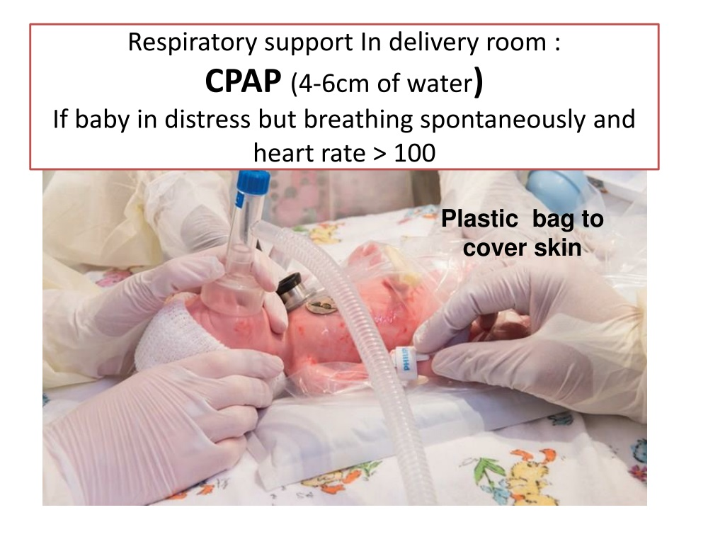

Slide 25
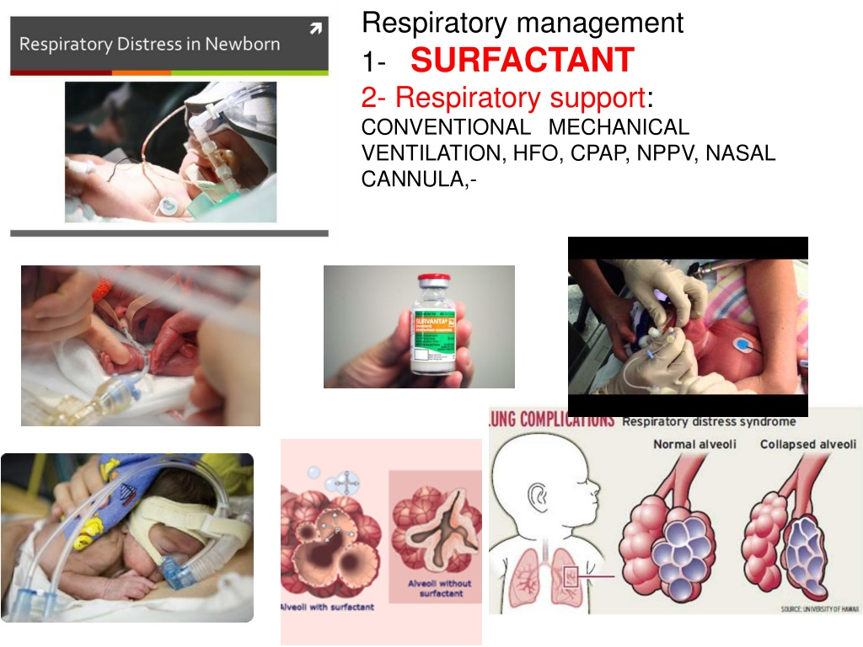

Slide 26
APPROPRIATE ANTIBIOTIC

Slide 27
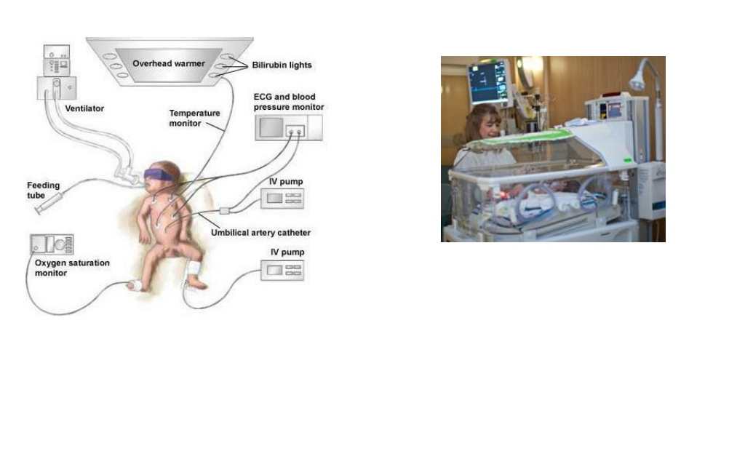
CURRENT

Slide 28
KANGAROO MOTHER CARE
Kangaroo mother care (KMC) is the care of preterm infants carried skin-to-skin with the mother.
It is a powerful, easy-to-use method to promote the health and well-being of infants born preterm as well as full-term
It was first presented by Rey and Martinez, in Bogotá, Colombia, where it was developed as an alternative to inadequate and insufficient incubator care for those preterm newborn infants who had overcome initial problems and required only to feed and grow.
The technique and intervention is the recommended evidence-based care for low birth weight infants by the World Health Organization (WHO) since 2003.

Slide 29
KANGAROO MOTHER CARE
Kangaroo Mother Care (KMC), which involves skin-to-skin contact (SSC), is an intervention to care for premature or low birth weight infants (LBW).
Almost two decades of implementation and research have made it clear that KMC is more than an alternative to incubator care. It has been shown to be effective for thermal control, breastfeeding, and bonding in all newborn infants, irrespective of setting, weight, gestational age, and clinical conditions.
Its key features are:
  Early, continuous, and prolonged skin-to-skin contact between the mother and the baby
  Exclusive breastfeeding (ideally)
It is initiated in the hospital and can be continued at home.

Slide 30

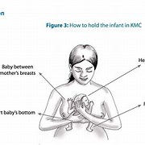
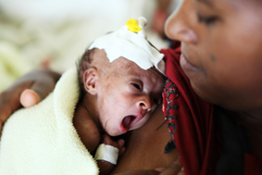
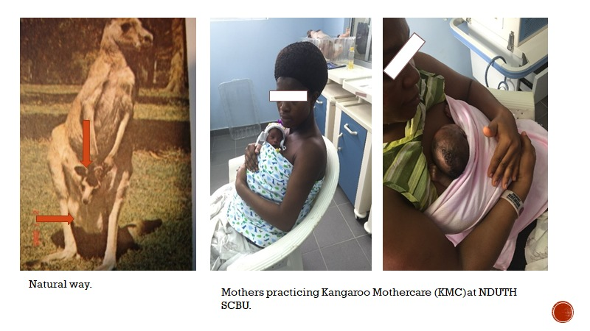
KANGAROO MOTHER CARE

Slide 31
In a meta-analysis of eight hospital trials involving a total of 1736 infants, infants who received kangaroo mother care after stabilization had a 40% lower mortality than those who received conventional care in an incubator or a radiant warmer (3.2% vs. 5.3%; risk ratio, 0.60; 95% CI, 0.39 to 0.92).6 This meta-analysis also showed that infants who received kangaroo mother care had fewer infections, higher rates of exclusive breastfeeding, and better weight gain than those who did not.
It helps in stabilizing the heart rate of your baby,
Body temperature – Studies have shown that a mother has thermal synchrony with her baby and that if her baby was cold, her body temperature would increase to warm up the baby and vice-versa.
Improves the breathing pattern of your baby
Rapid weight gain: Kangaroo care allows the baby to fall into a deeper sleep allowing it to direct more energy to other bodily functions.

Slide 32
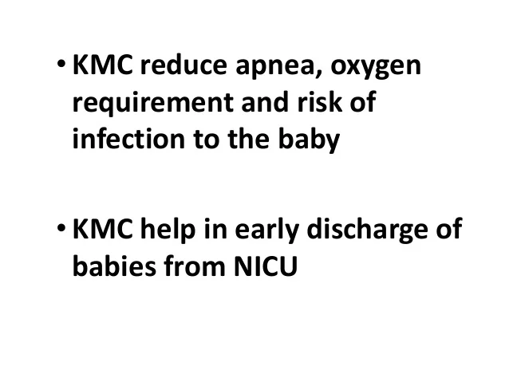

Slide 33
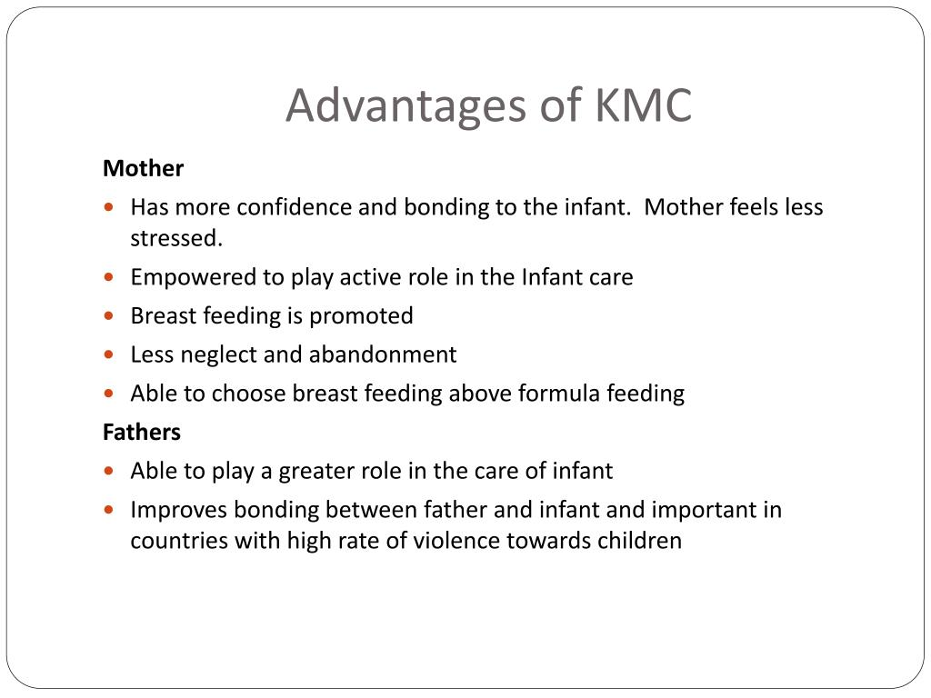

Slide 34
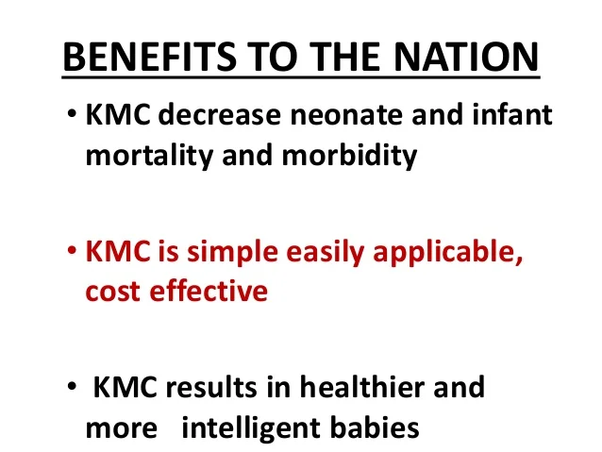

Slide 35
PARADIGM SHIFT
IMMEDIATE KANGAROO MOTHER CARE POST-BIRTH(ZERO SEPARATION) IS CRITICAL FOR SAVING LIVES, NEW RESEARCH SHOWS.
Approximately 45% of neonatal deaths occur within 24 hours after birth and 80% during the first week of life thus, the majority of deaths among infants with a low birth weight typically occur before kangaroo mother care can be initiated. The effect of initiating kangaroo mother care immediately after birth on physiological stabilization has been evaluated in randomized, controlled trials
STUDY SITES
Vardhman Mahavir Medical College & Safdarjung Hospital, New Delhi, India
Muhimbili University of Health and Allied Science, Dar es Salaam, Tanzania
University of Malawi, College of Medicine, Blantyre, Malawi
Obafemi Awolowo University, Ile-Ife, Nigeria
Kwame Nkrumah University of Science and Technology and Komfo Anokye Teaching Hospital, Kumasi, Ghana

Slide 36
KMC is already known to reduce mortality by 40% when introduced to clinically stable hospitalized infants with a birth weight of less than 2.0k. However, this important new study provides evidence to show a further 25% reduction in mortality when KMC is initiated immediately after birth, either by the mother or a surrogate. This suggests that early initiation of KMC could save up to 150,000 more lives each year.

Slide 37
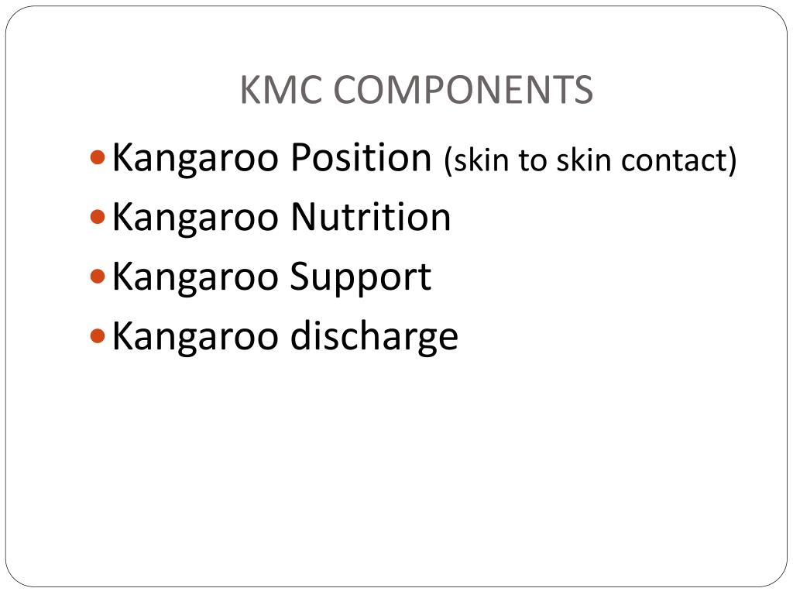
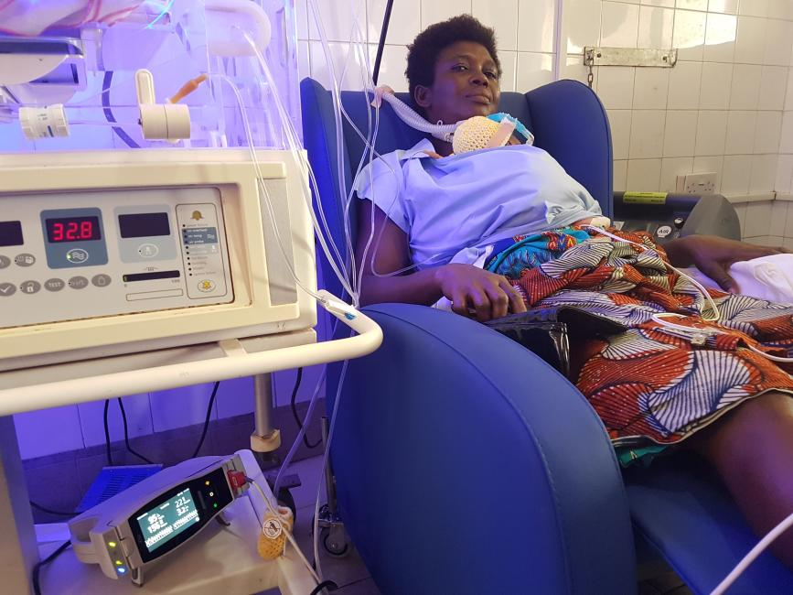
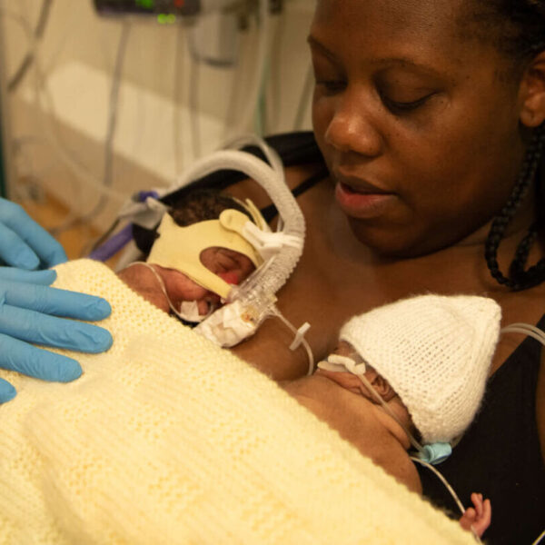

Slide 38
The results of a new clinical trial published on May 27 2021 in the New England Journal of Medicine, shows:
Kangaroo mother care, which involves skin-to-skin contact and exclusive breastfeeding, significantly improves a premature or low birthweight baby’s chances of survival
Starting kangaroo mother care immediately after birth has the potential to save up to 150,000 more lives each year (a further increase in survival of 25%), compared with the current recommendation of starting it only once a baby is stable
Mother-Newborn Intensive Care Units will be critical to support the mother, or a surrogate, in providing this immediate, ongoing skin-to-skin contact from birth.
The lifesaving benefits of kangaroo mother care for babies born early

Slide 39
CARE OF THE PRETERM (FAMILY)
For the family:
  Offer psychosocial support, holistic care during follow up visits post discharge. Parents should be counseled on red flags and warning signs as early intervention can help prevent minor problems from becoming major ones.

Slide 40
CARE OF THE PRETERM (SOCIETY)
For the society:
  Key interventions to help women enjoy good health and well-being before and throughout pregnancy, such as counseling on healthy diet and optimal nutrition, as well as on preventing tobacco and substance use. In addition, Antenatal care that includes a minimum of 8 contacts with health professionals throughout pregnancy to identify and manage other risk factors, such as infections.
  Better access to contraceptives and empowering women with accurate health information and access to quality services could also help reduce preterm births.

Slide 41
WAYS TO ENCOURAGE KMC
Policy:
  Development of plans, policies, guidelines, protocols, manuals.
  Establishing links with ministries, medical schools, agencies and organizations
Implementation:
  Adequate information on effectiveness, safety, feasibility and cost.
  Appropriate training and information strategies, community participation

Slide 42
WAYS TO ENCOURAGE KMC
Communication:
  Adequate information in the antenatal period and at the referral facility
  Improving communication and support skills of health workers
Feeding :
  Reducing separation as much as possible
  Accurate scales, appropriate growth charts, clear instructions
  Good skills for assessing breastfeeding and alternative of breastfeeding guidelines feeding methods

Slide 43
TAKEAWAYS
POLICY IMPLEMENTATION ON MOTHER-NICU STRATEGY TO ACHIEVE SDG 3.2.2
PREMATURITY IS A MAJOR CONTRIBUTOR TO CHILD MORTALITY
THERES NEED TO ADOPT LOW-COST STRATEGIES IN THE CARE OF THE PRETERM

Slide 44
Resources
Blencowe H, Cousens S, Oestergaard MZ, et al; National, regional, and worldwide estimates of preterm birth rates in the year 2010 with time trends since 1990 for selected countries: a systematic analysis and implications. Lancet. 2012 Jun 9379(9832):2162-72. doi: 10.1016/S0140-6736(12)60820-4
https://www.who.int/en/news-room/fact-sheets/detail/preterm-birth
Kangaroo Care Guidelines for Preterm Infant - Motherhood Care

Slide 45
Resources
Blackman JA. NICU micropreemies: How do they fare?. Contemporary Pediatrics. 2007;24:64-73.
Holditch-Davis D. Outcomes of prematurity and neonatal intensive care unit care. J Obstet Gynecol Neonatal Nurs. 2007;36(4):364-365. doi:10.1111/j.1552-6909.2007.00155.x
Neu M, Robinson J. Maternal holding of preterm infants during the early weeks after birth and dyad interaction at six months. J Obstet Gynecol Neonatal Nurs. 2010;39(4):401-14. doi:10.1111/j.1552-6909.2010.01152.x
Adams-Chapman I, Heyne RJ, DeMauro SB, et al. Neurodevelopmental impairment among extremely preterm infants in the Neonatal Research Network. Pediatrics. 2018;141(5). doi:10.1542/peds.2017-3091

Slide 46
Nigeria: main causes of infant mortality | Statista accessed on 25th of June ,2023 at 18.00hrs
Supplement to: WHO Immediate KMC Study Group. Immediate “kangaroo mother care” and survival of infants
with low birth weight. N Engl J Med 2021;384:2028-38. DOI: 10.1056/NEJMoa2026486
Immediate “Kangaroo Mother Care” and Survival of Infants with Low Birth Weight
List of authors.WHO Immediate KMC Study Group
Janet M.R., Giles S.K. Manual of Neonatal Intensive Care (Fifth Edition)

Slide 47
Thank you

